Slide 1
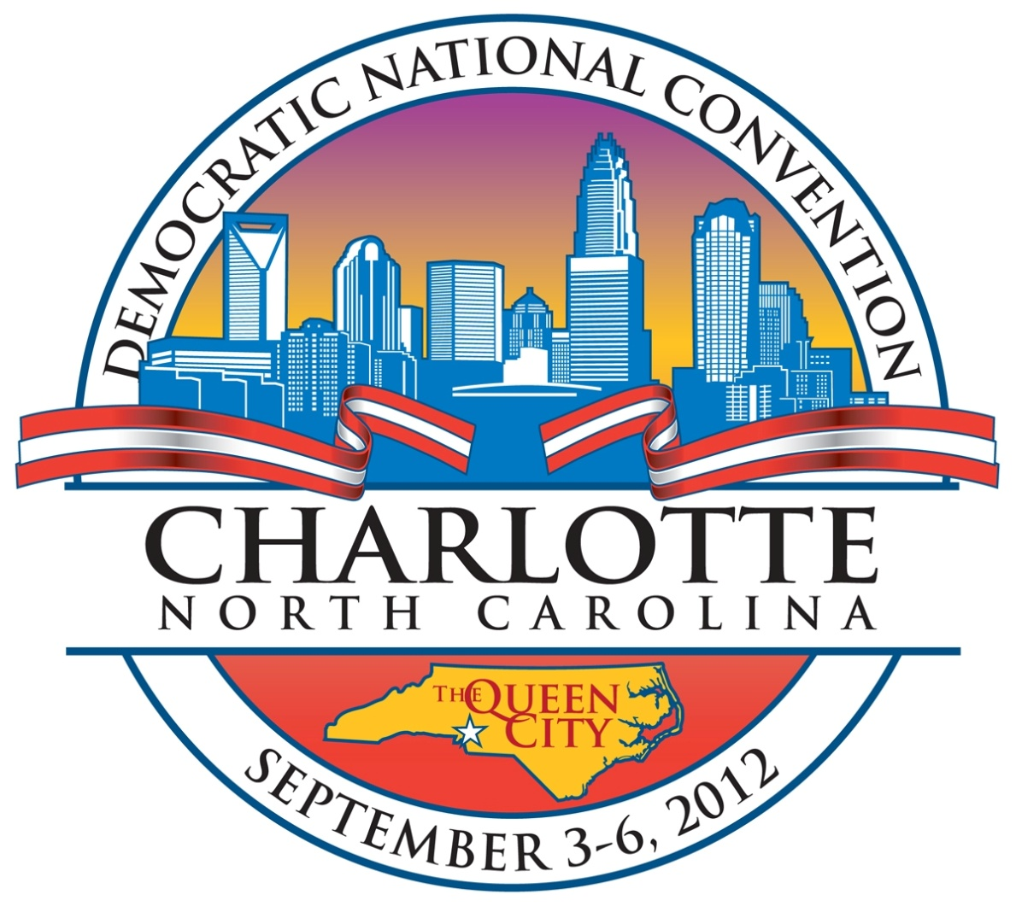
2012 DNC September 1-7, 2012

Slide 2
2012 Democratic National Convention
5,000 primary and alternate delegates / 30 governors in attendance
Total attendance with staff and associates 35,000
Media 15,000
Additional attendees to events and support 75,000
Venues range from arenas to convention centers to stadiums.
Venue attendance from 22,000 to 90,000
U.S. Secret Service protective details for protectees
U.S. Capitol Police to provide protection for members of the U.S. House of Representatives and Senators
U.S. Department of State provided protection for ambassadors within the Diplomatic Corps

Slide 3
NSSE Coordination
Event Coordinator
Oversees preparation for entire event – Planning &
Implementation, Crisis Response, Consequence Management
Promotes partnerships between local, federal and military
agencies
Coordinates requests for and utilization of federal support
Executive Steering Committee
Command level representatives of USSS, FBI, FEMA, DOD,
state & local counterparts
Oversees development and implementation of comprehensive,
integrated security plan

Slide 4
2012 DNC Executive Steering Committee
DNC Event Coordinator USSS SA
Charlotte - Mecklenburg Police Department
Charlotte Fire Department
North Carolina Crime Control and Public Safety
U.S. Secret Service
U.S. Attorney’s Office
Federal Bureau of Investigation
Federal Emergency Management Agency
U.S. Department of Defense

Slide 5
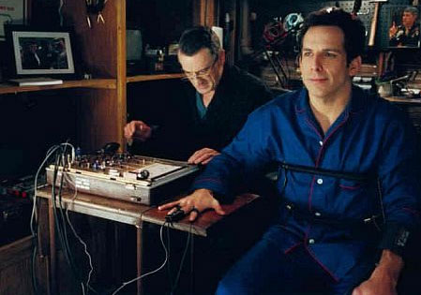
Circle of Trust

Slide 6
Fire and LEO Precautions
Secret Level Clearances
Direct Order by the Police & Fire Chiefs
HSIN Accounts
PCII Credentials
Cyber Security Assessments
Secured Communications
Social Media General Order

Slide 7
Why all this planning?
Protest
IED Attacks
Fires
Mumbai Style Attacks
Natural Events Ie. Gas Leaks, Power Outages
Hurricanes, Tornados

Slide 8
Current Issues
Spring of the Arab Uprising
Occupy Movement
Iran Nuclear Debate
Financial Crisis
Cyber Security Threats

Slide 9
Coordination Challenges
22 Command Centers across the two States
Information Sharing & Coordination of Information in Real Time Was #1 Challenge !

Slide 10
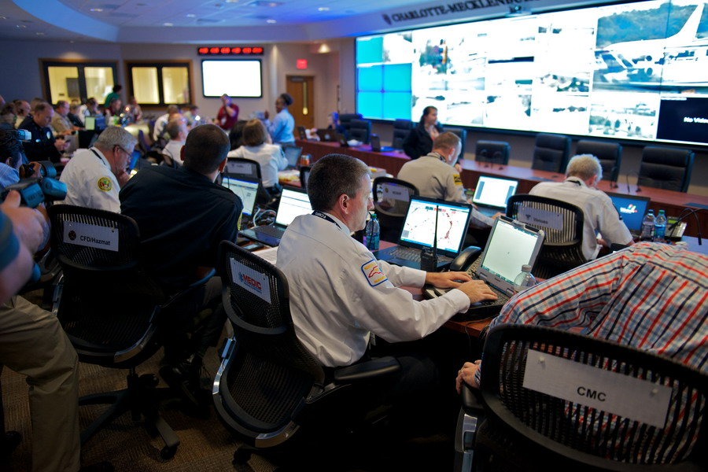
City Command Center

Slide 11
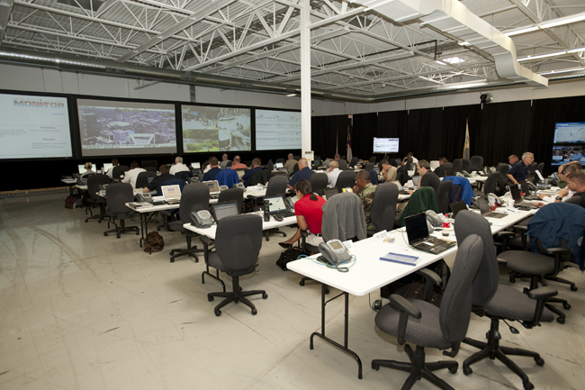
MACC

Slide 12
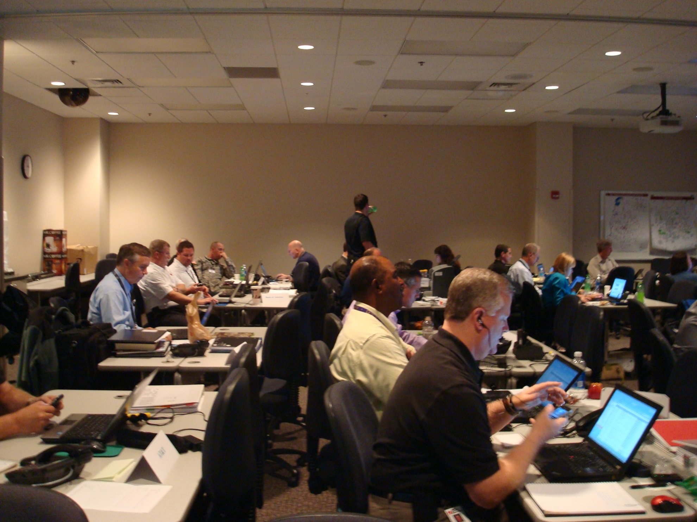
CIRC

Slide 13
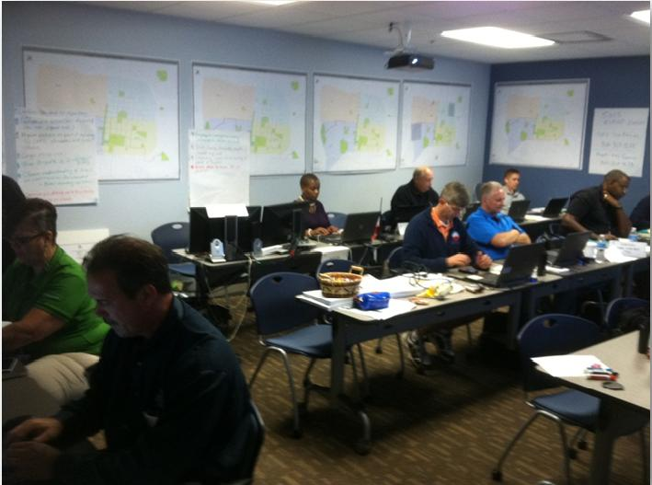
Public Works Operations Center

Slide 14
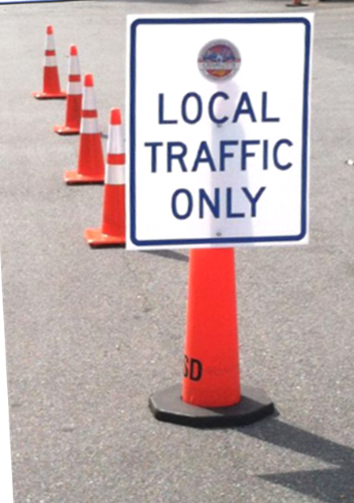
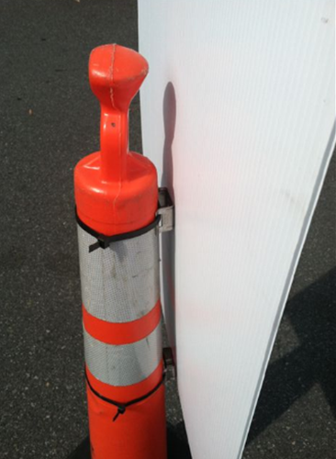
Traffic Management Plan Implementation
Sign design and fabrication
over 350 signs
Special mounting on 42”
plastic post
bollards
1,750 cones
Changed Daily
Notes:
CDOT’s Traffic Operations Division designed, fabricated and installed over 350 special signs for the event
Had to use special material for the signs and figure out a way to mount the signs differently than we normally would because SS and Police asked that we not use our traditional metal signs mounted on temp sign posts and barricades because they could be used by protestors wanting to do damage
Developed what you see here which are signs on foam board mounted on bollards

Slide 15
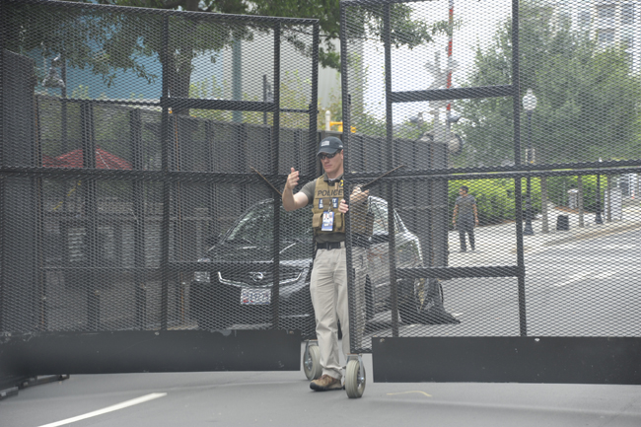
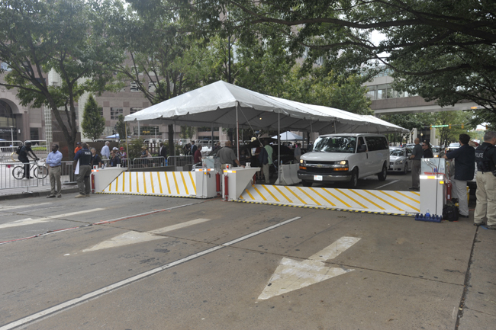
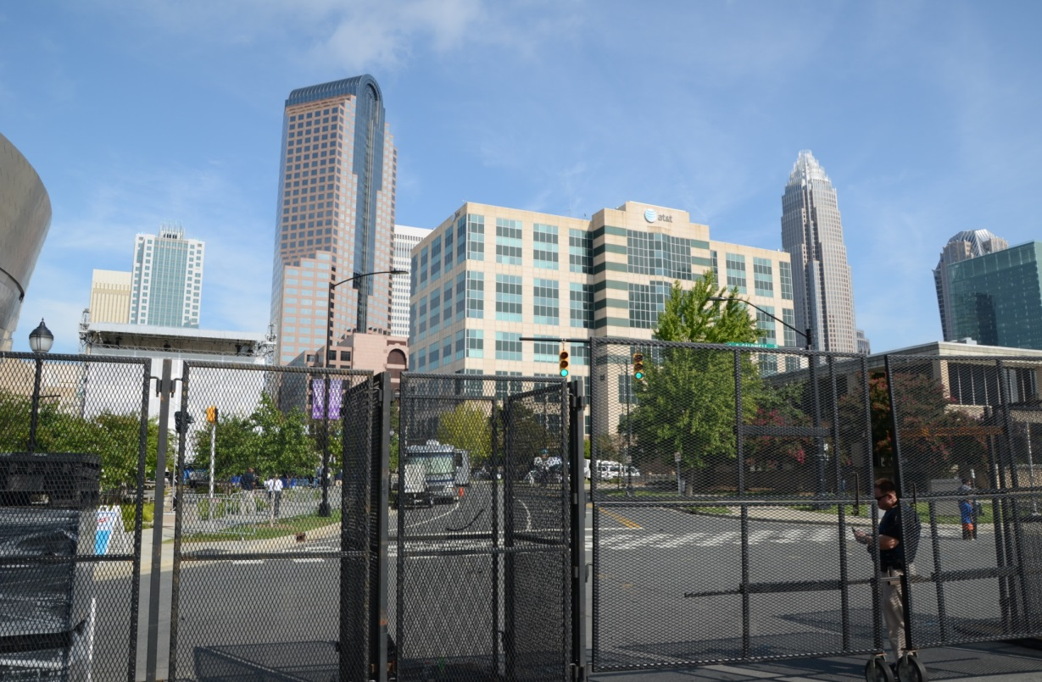

Slide 16
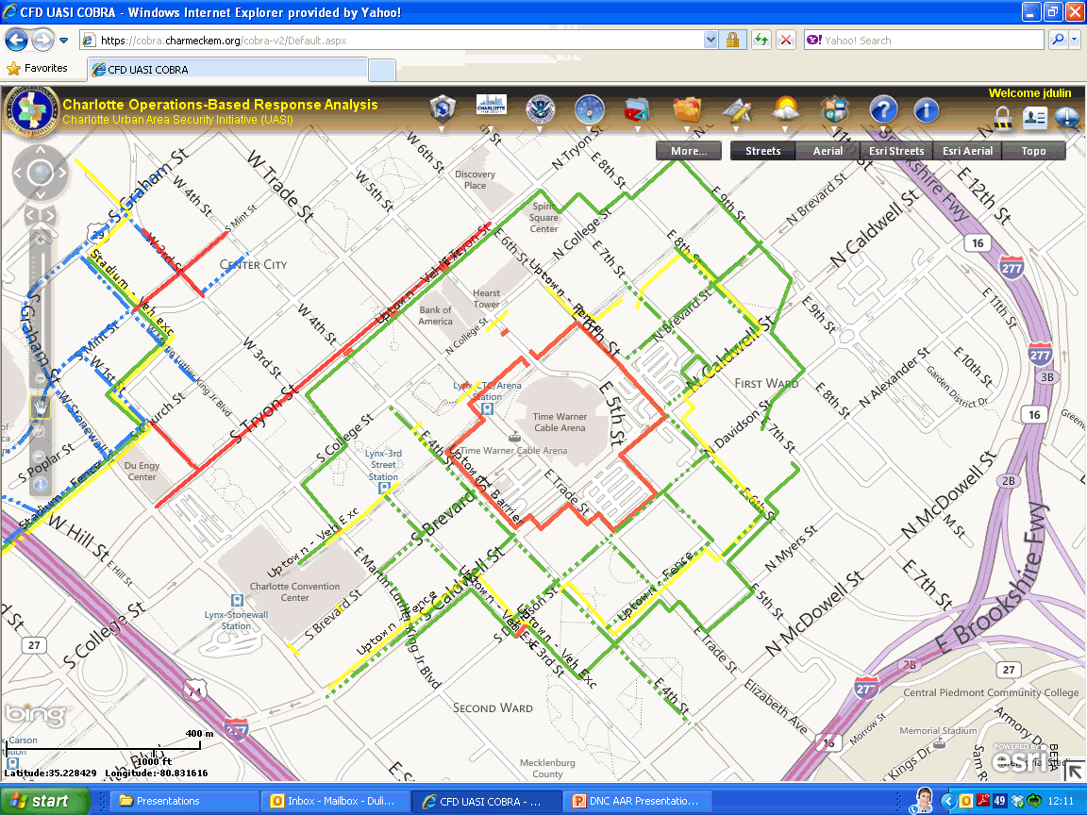

Slide 17
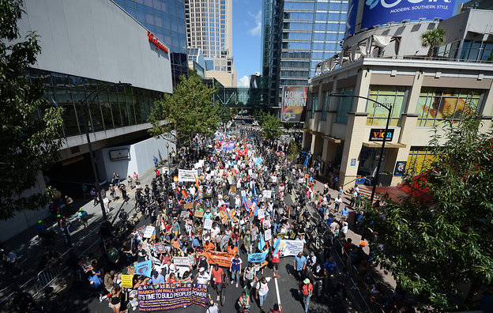
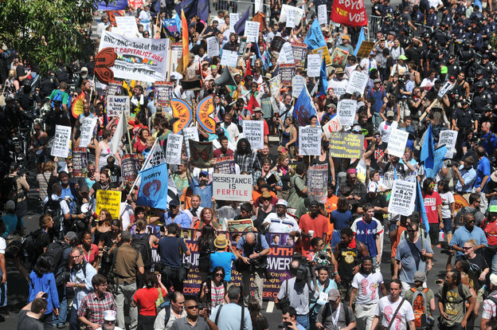

Slide 18
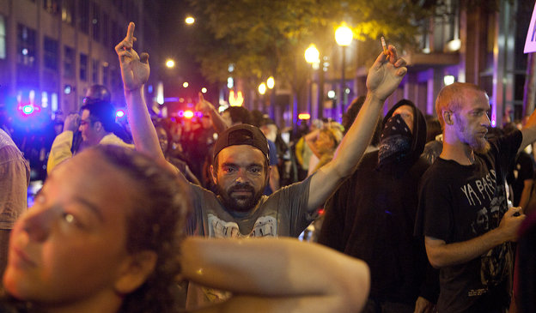
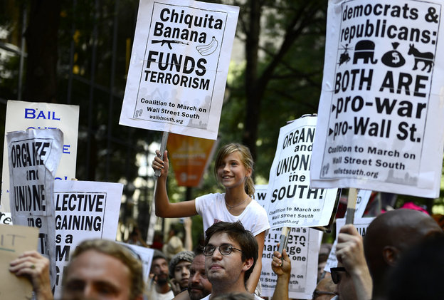
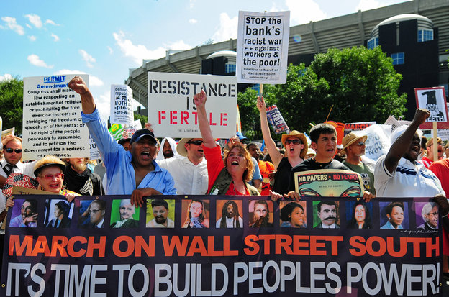

Slide 19
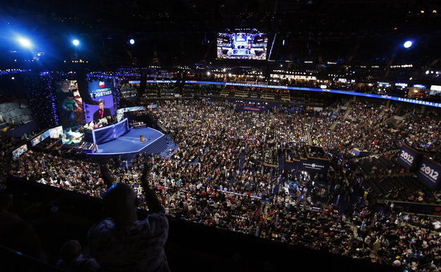
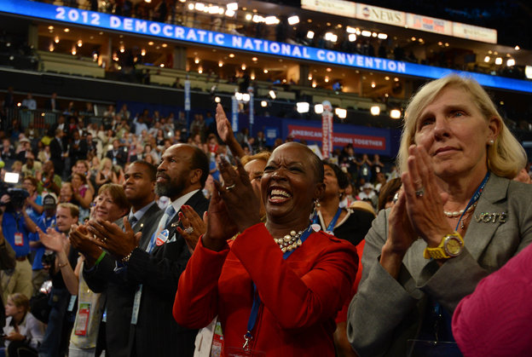

Slide 20
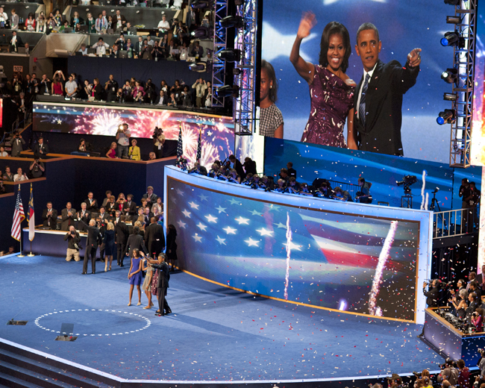

Slide 21
Event Monitoring

Slide 22
2012 DNC September 1-7, 2012

