Slide 1
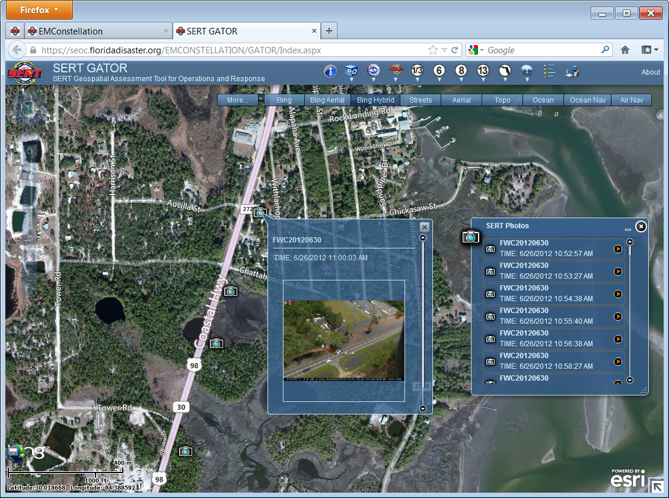
Post-Disaster Remote Sensing
for Situational Awareness
Richard Butgereit, GISP
Richard.Butgereit@em.myflorida.com
GIS Administrator
Florida Division of Emergency Management
850-413-9907

Slide 2
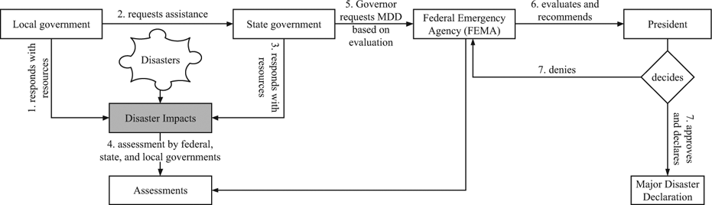
Post-Disaster Remote Sensing
State of Florida – SERT and Civil Air Patrol (CAP) geotagged photos, FDOT aerial photos, commercial
NOAA – NOAA aerial photos, contracted aerials
National Geospatial-Intelligence Agency (NGA) – satellite imagery (commercial/military), must be coordinated through FEMA, NGA and/or FEMA may activate Interagency Remote Sensing Coordination Cell
FEMA – contracted aerials, CAP photos, request data from NGA
USGS – Remote Sensing Work Group coordinates products like US satellite data (Landsat, SPOT, EagleVision) , some licensed data, may activate International Charter (for international space agency satellite data)
Notes:
2

Slide 3
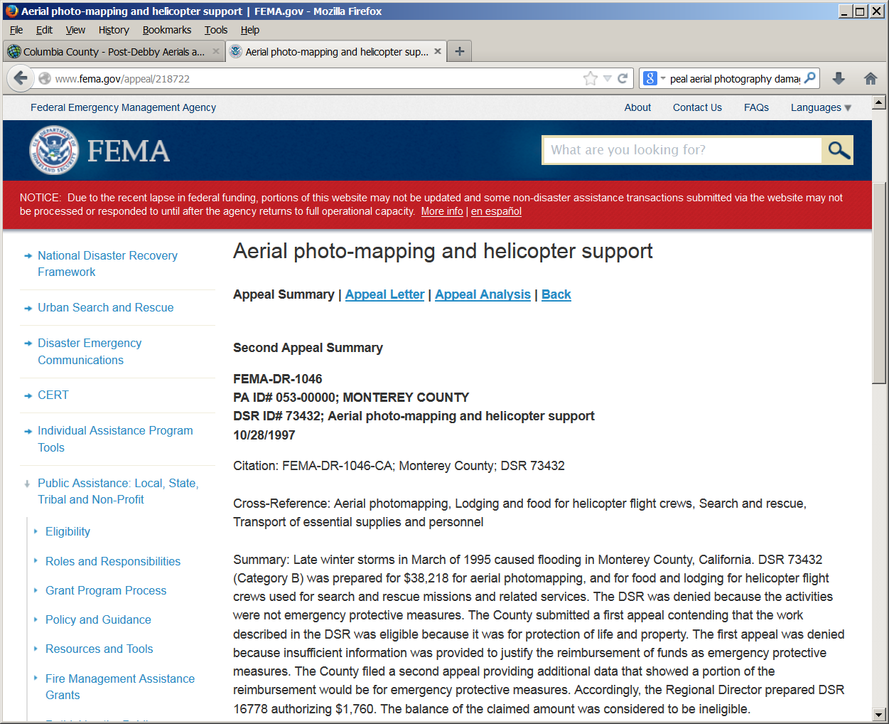
FEMA will not reimburse locals or states for aerial photos!!!
http://www.fema.gov/appeal/218722
http://bit.ly/shrug12_rs
Notes:
3

Slide 4
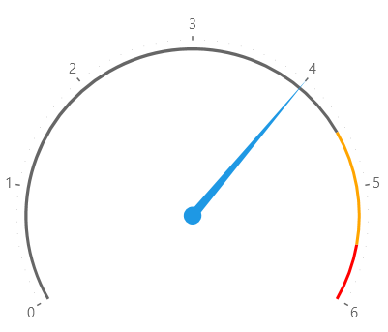
1 – Local incident
2 – Local disaster
3 – Regional disaster
4 – ???
5 – Presidential declaration
6 – The end of the world
You are on your own!
You can’t
keep the
feds out!
Disaster Gauge

Slide 5
1 – Local incident
2 – Local disaster
3 – Regional disaster
4 – ???
5 – Presidential declaration
6 – The end of the world
FEMA/NGA
USGS
NOAA
You are on your own!
You can’t
keep the
feds out!
Disaster Gauge

Slide 6
Geotagged Photos
Usually oblique – generally not nadir…
May be from aerial vehicle – or ground, boat, person…
Usually from a handheld camera – but may be fixed to vehicle
May be captured with GPS-enabled camera – may also be post-processed using GPS track log from handheld GPS time-synced with camera and photographs or smartphone
Notes:
6

Slide 7
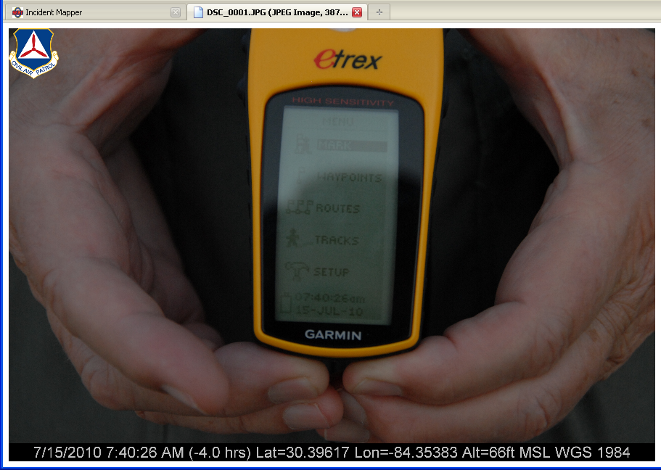

Slide 8
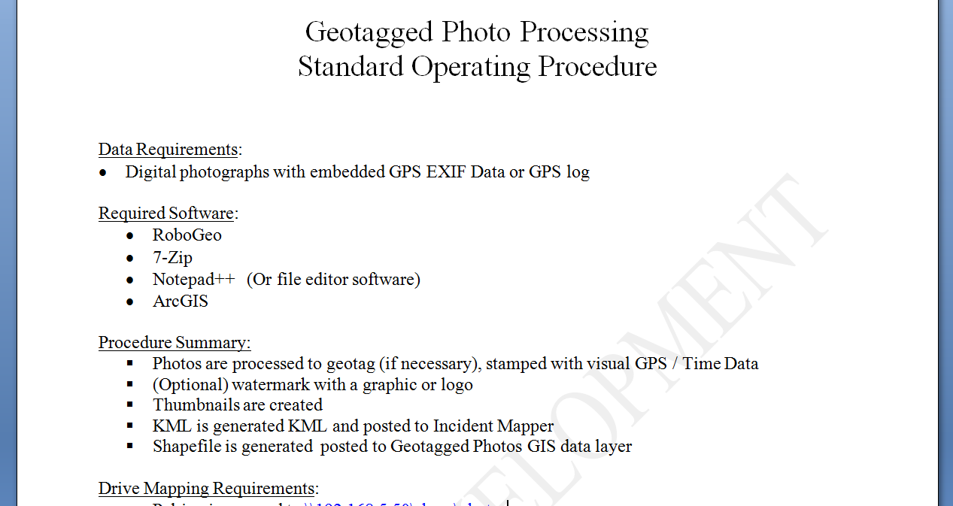

Slide 9
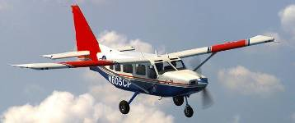
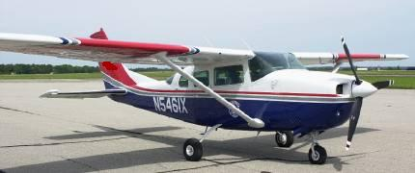
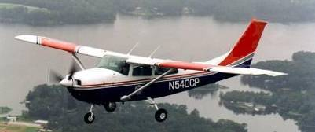
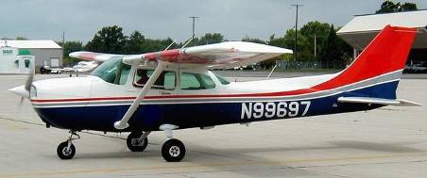

Florida Air Assets
Cruise speed 110-135 kts
Range 520-730 NM
Gippsland GA-8 (1)
Cessna 206 (1)
Cessna 182 (7)
Can operate with 2500’ runway
VHF AM and FM radio
100 aircraft have satellite phones
Cessna 172 (17)

Slide 10
About CAP
CAP is a Congressionally chartered, federally supported, non-profit corporation that serves as the official auxiliary of the United States Air Force. (USAF)
Title 10 Asset.
63,000 members nationwide.
Performs 95% of inland Search and Rescue for the US Air Force.
Homeland Security support for various federal agencies

Slide 11
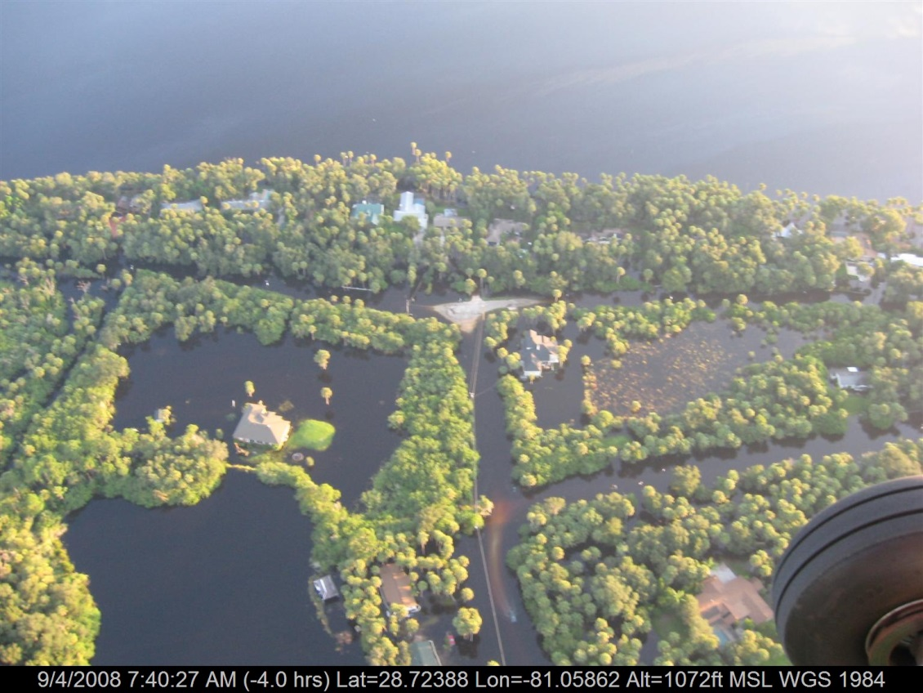
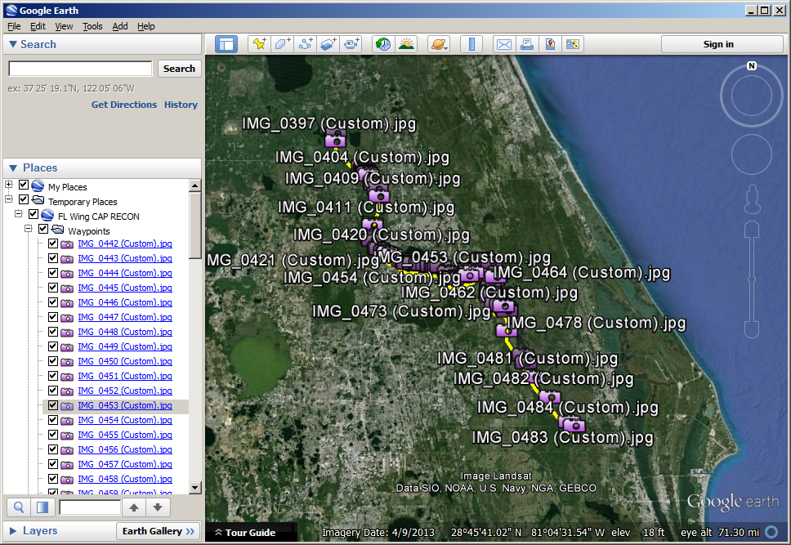
Tropical Storm Fay August 2008
~80 geotagged photos captured 9/4/2008 between 0700 – 0750
On screens in State EOC by 1000
Set new expectation….

Slide 12
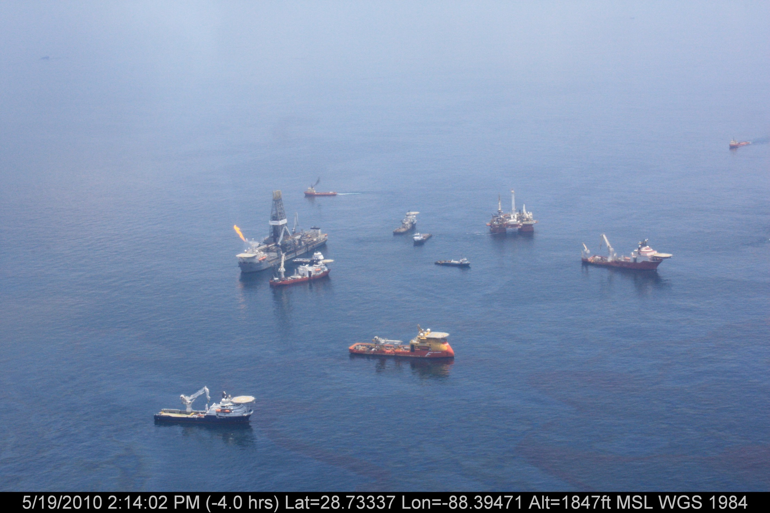
Deepwater Horizon Response 2010

Slide 13
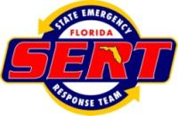




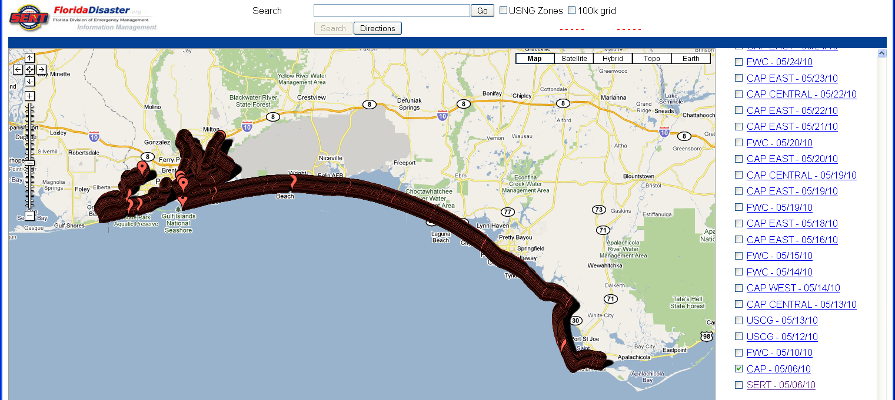

Slide 14
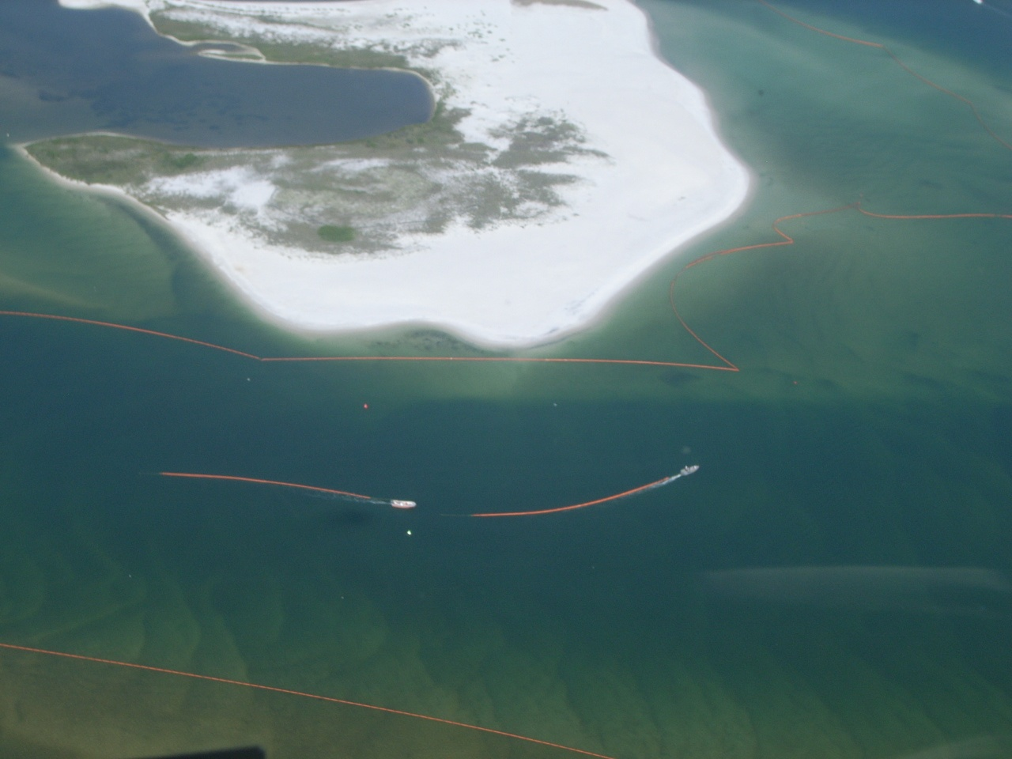
Boom verification
05/06/10

Slide 15
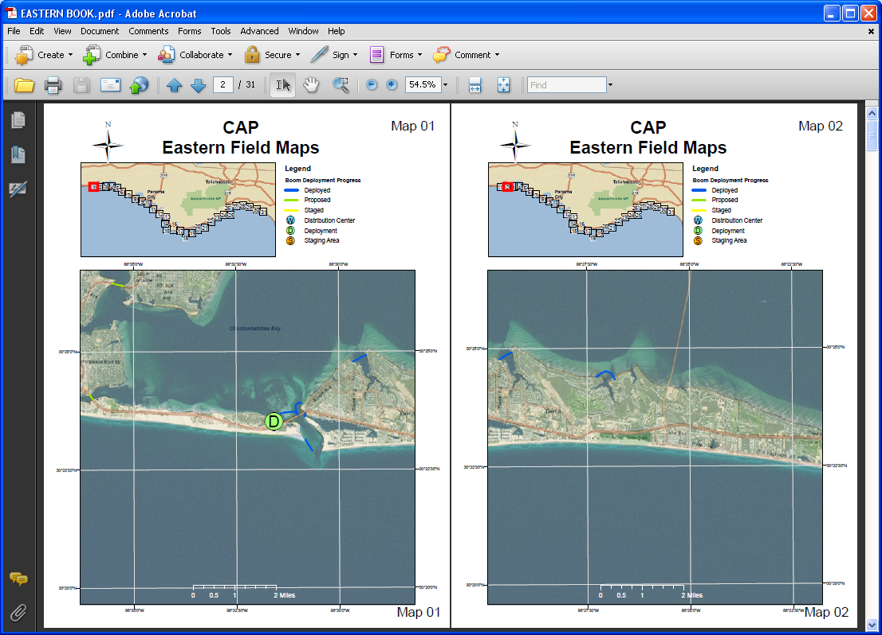

Slide 16
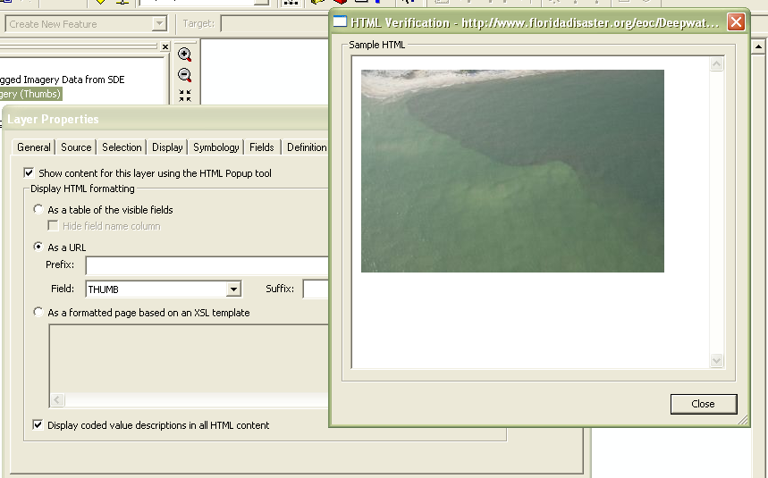

Slide 17
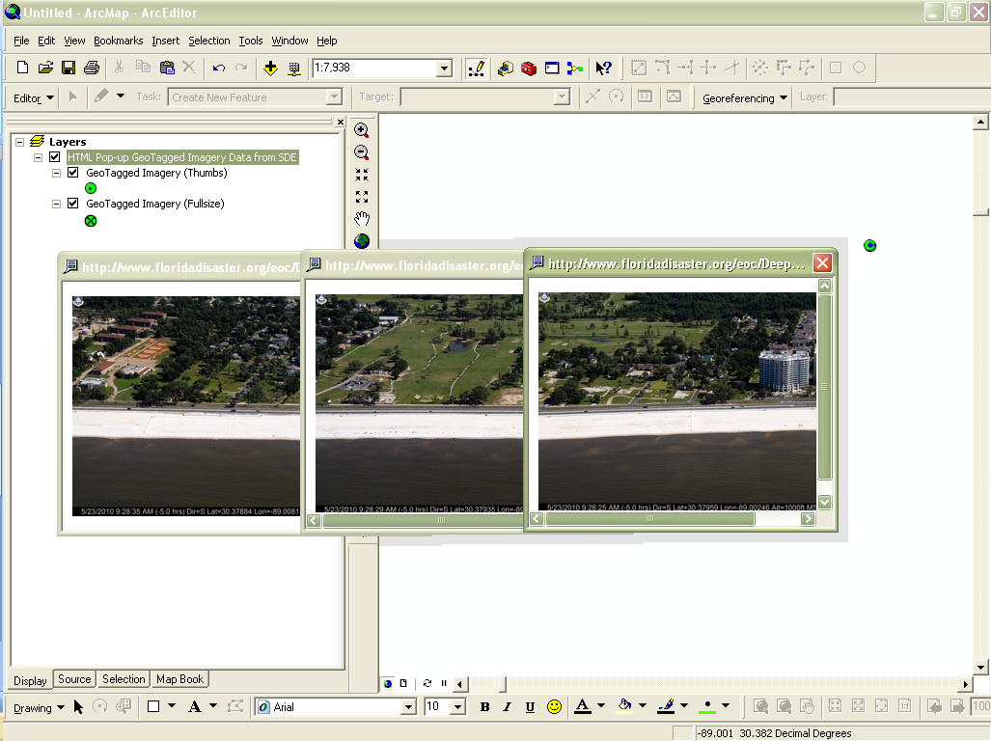

Slide 18
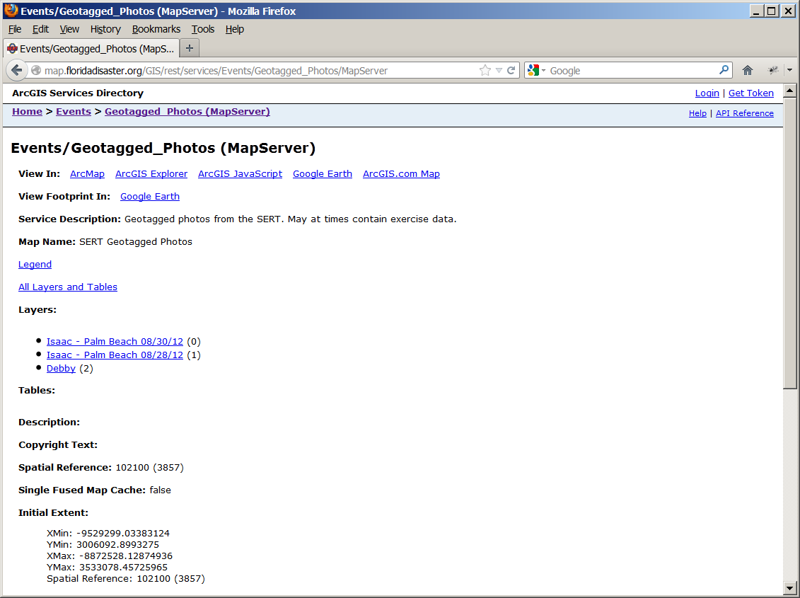

Slide 19
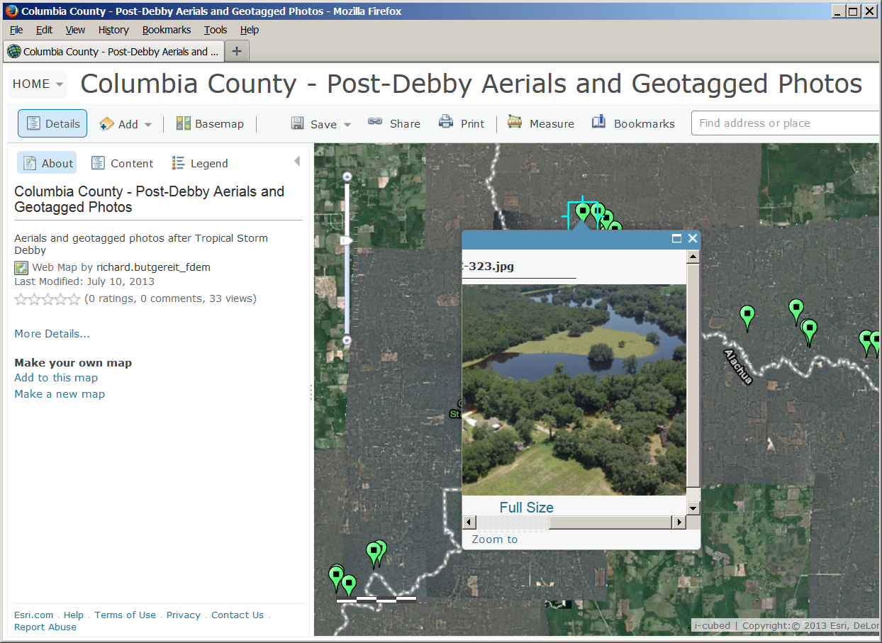

Slide 20
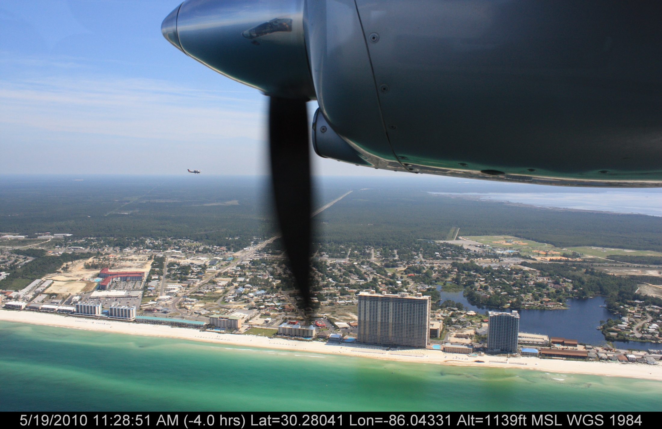
http://www.floridadisaster.org/photos/FWC05192010/IMG_0104.JPG

Slide 21
GATOR
http://map.floridadisaster.org/GATOR
Geospatial Assessment Tool for Operations and Response
web mapping application
real-time data like weather radar, watches, storm reports
base map, event, and post-event data
Notes:
21

Slide 23
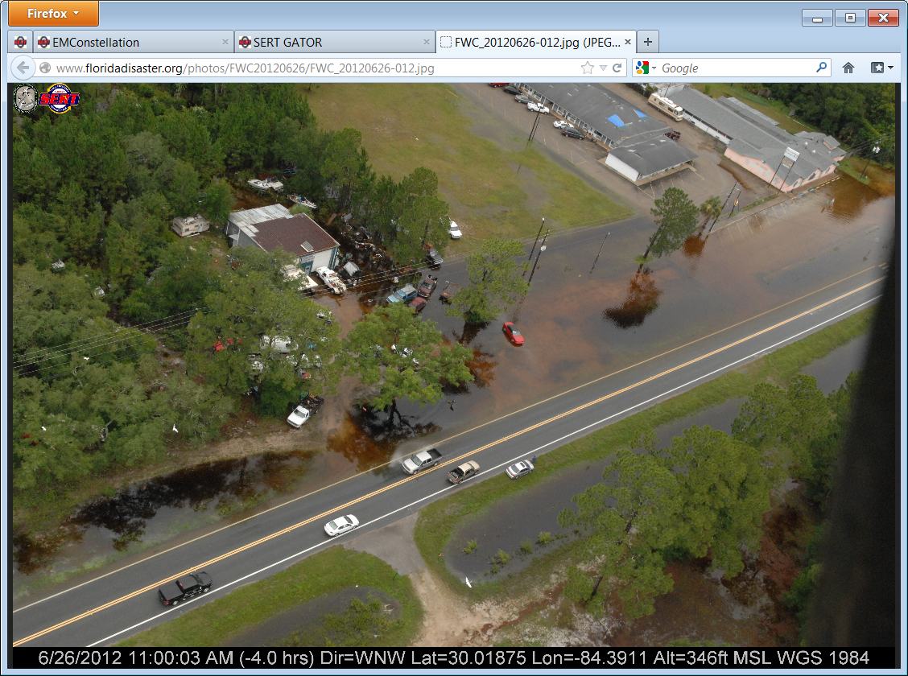

Slide 24
Geotagged Photos
Point missions –
  coordinates (Lat/Long – decimal degrees or USNG)
  shapefile – we’ll use DNR Garmin to export to *.gpx
  GPX file for direct use in Garmin MapSource
Linear missions –
  shapefile – we’ll use DNR Garmin to export to *.gpx
  GPX file for direct use in Garmin MapSource
Notes:
24

Slide 25
Aerial Photos
Florida Department of Transportation –
  Aerial Surveying & Mapping group is responsible for both Flight Operations and Photogrammetry. They develop statewide policies, procedures, and standards for aerial surveying products for the department and also acquire and process aerial photography. They support the District Offices in the production of planimetric and topographic mapping and create ortho-rectified and georeferenced imagery and digital terrain models (DTMs). The Aerial Surveying and Mapping group also provide critical support to the State Emergency Response Team by collecting aerial photography for disaster analysis and mapping. Professional Surveyors, Mappers, Photogrammetrists, and Pilots employed by the State.
  Requirements and capabilities coordinated through statewide GIS coordination call and tasked as missions within EM Constellation.
Private Sector –
  FDEM has no standing contracts with any commercial aerial acquisition company.
  However, several counties and Water Management Districts do…
Notes:
25

Slide 26
Aerial Photos
Regardless of how acquired, for quick turnaround…
Photos delivered via hard drive to State EOC, as soon as possible after acquisition and with minimal processing…
  Not true ortho-rectified images
  Very little color balancing
  Very little seaming, removal of overlap
  TIF or SID
SERT GIS uses ArcGIS Image Extension for Server to dynamically mosaic and on-the-fly process large numbers of images for display
Following initial delivery, FDOT may follow up with additional deliveries of increasing image quality

Slide 27
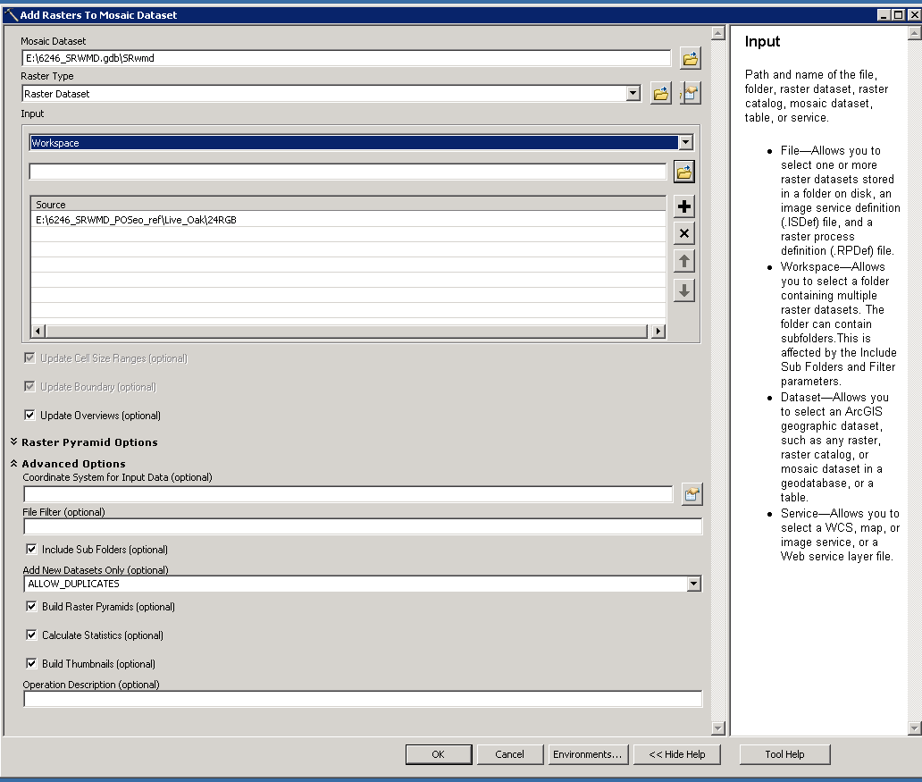
Photos are stored on network drive and on web server
On web server, start ArcMap…
  create new file geodatabase
  create new Mosiac Dataset
  add rasters – by file or workspace (directory)
  publish to ArcGIS Server

Slide 28
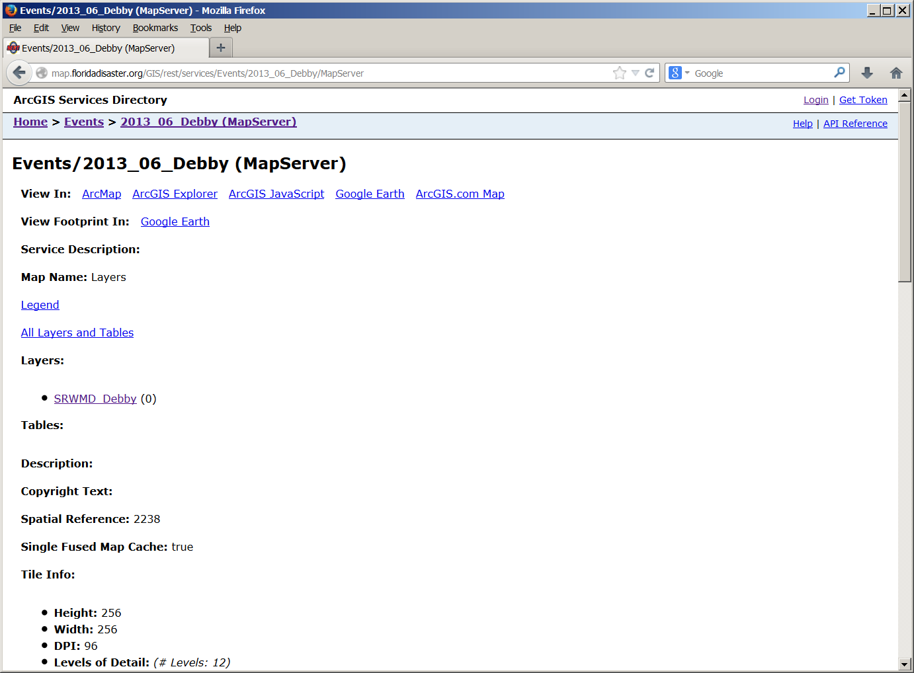

Slide 29
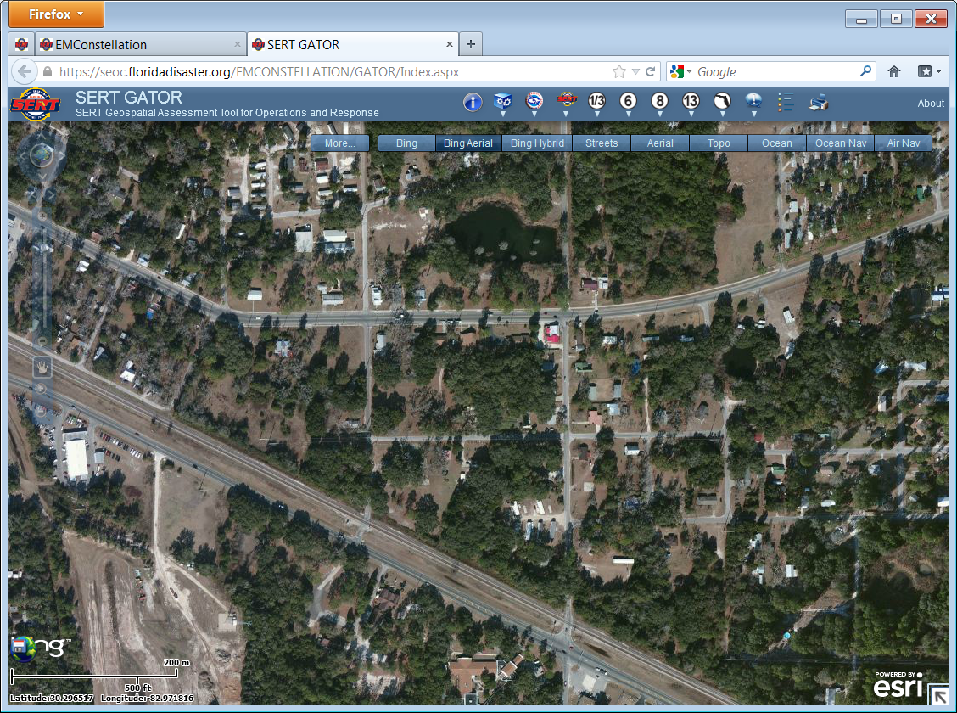

Slide 30
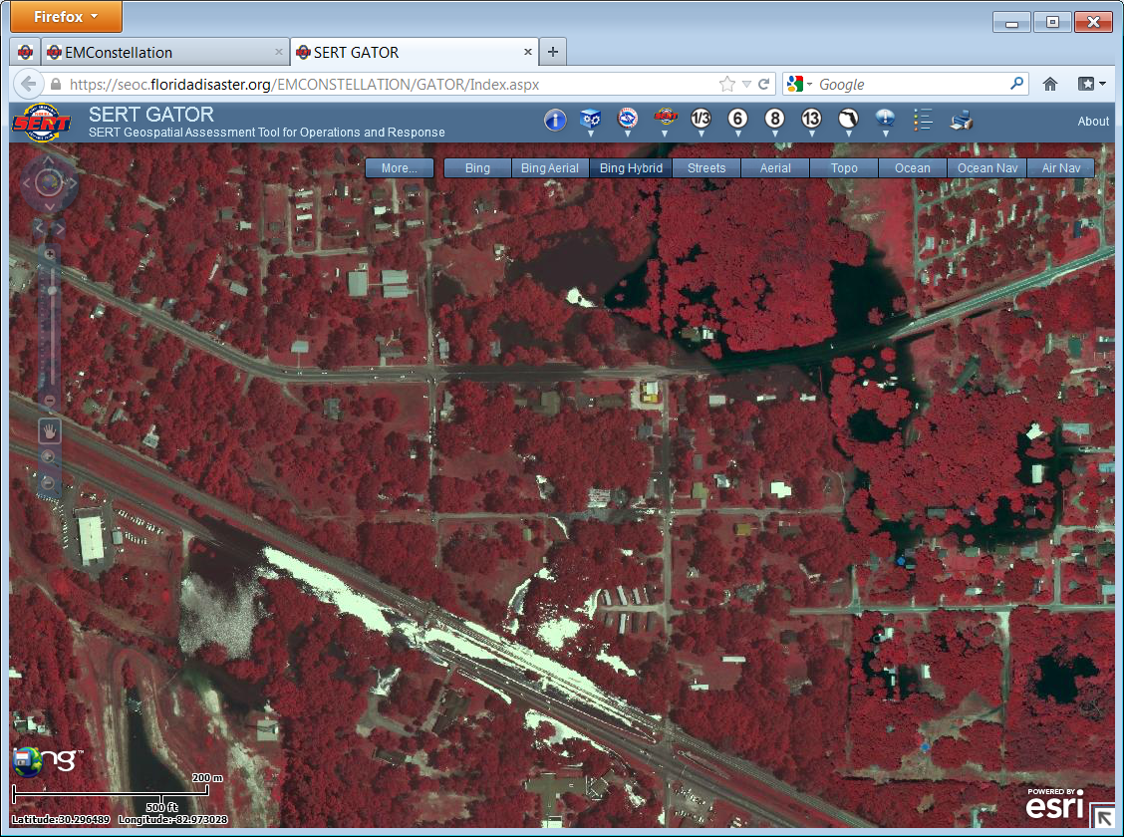

Slide 31
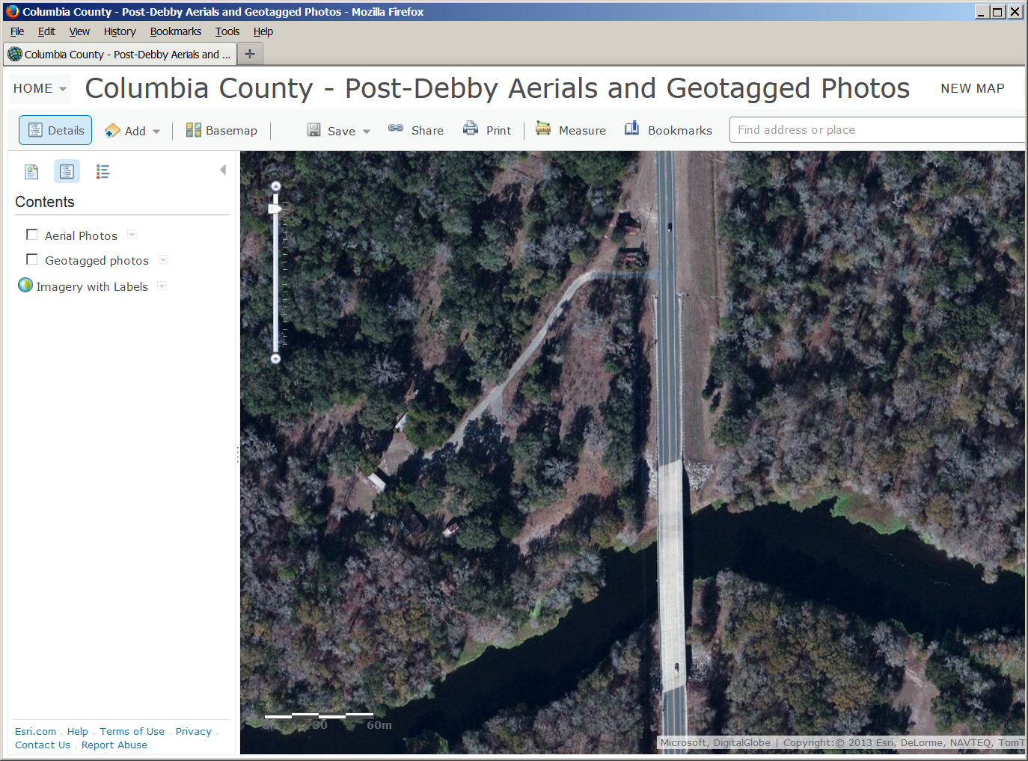

Slide 32
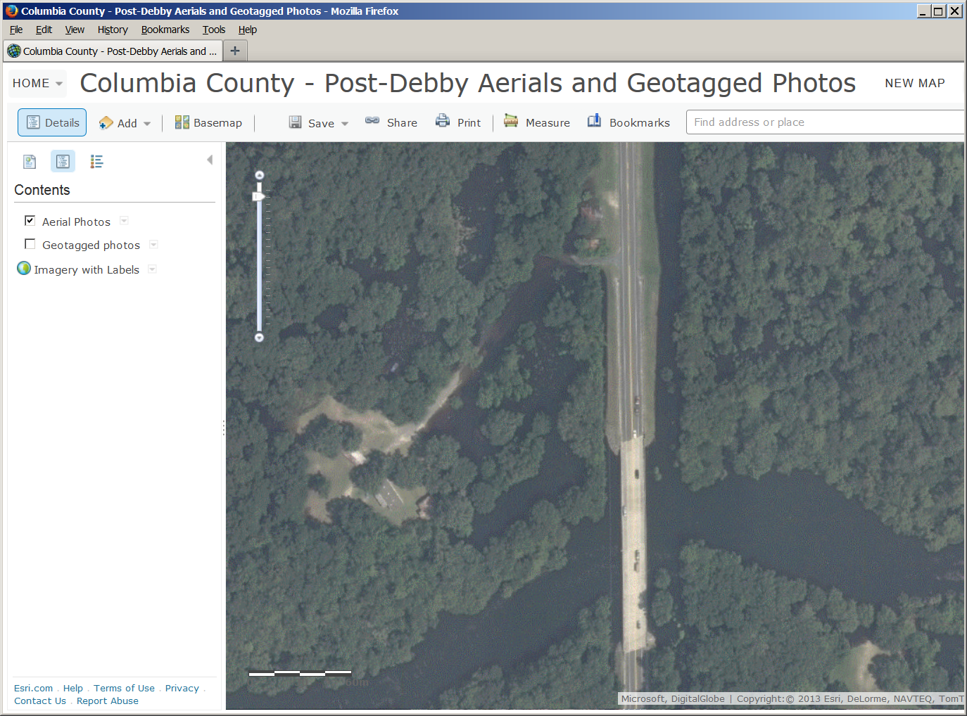

Slide 33
Aerial Photos
State of Florida –
  State of Florida 5,000ft x 5,000ft orthophoto-LiDAR data acquisition grid
  agreed upon by FDOT, FDEP, FDEM, FWC, and the WMDs
FEMA –
  USNG grid (10,000m x 10,000m, or 1,000m x 1,000m better)
NOAA –
  USGS quad grids
Notes:
33

Slide 34
Daily Coordination Calls
State of Florida –
  Exact time will depend upon disaster type
  1145 Eastern for most, so that it follows the statewide emergency management coordination call, which may include briefings from National Hurricane Center and Southeastern River Forecast Center
  Situation reporting, collection requirements gathering and prioritization, other data coordination
FEMA –
  1000 Eastern national call (if disaster spans multiple FEMA regions)
  Situation reporting, mainly federal-to-federal communication (but states are invited)
  may also host a region specific call
USGS – Remote Sensing Work Group
  Afternoon exclusively remote sensing (NOAA aerials and satellite based platforms)
IRSCC – Interagency Remote Sensing Coordination Cell
  time set during disaster, very heavy on Department of Defense
Notes:
34

Slide 35
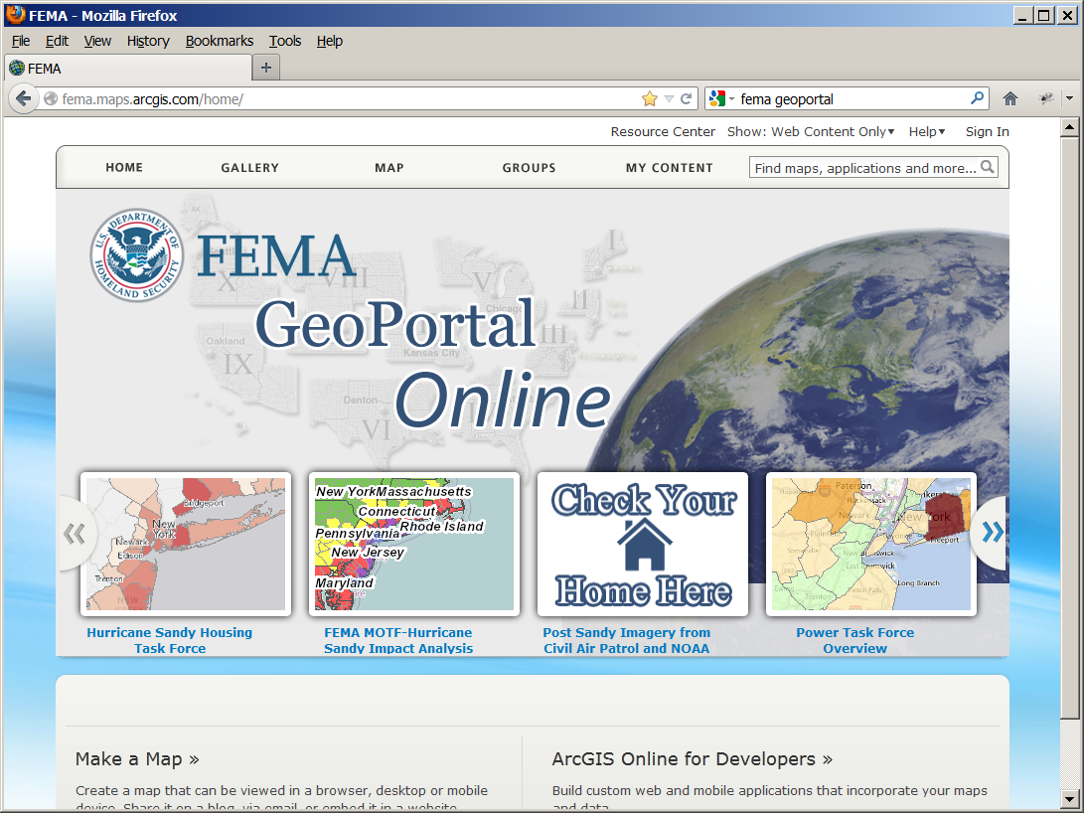

Slide 36
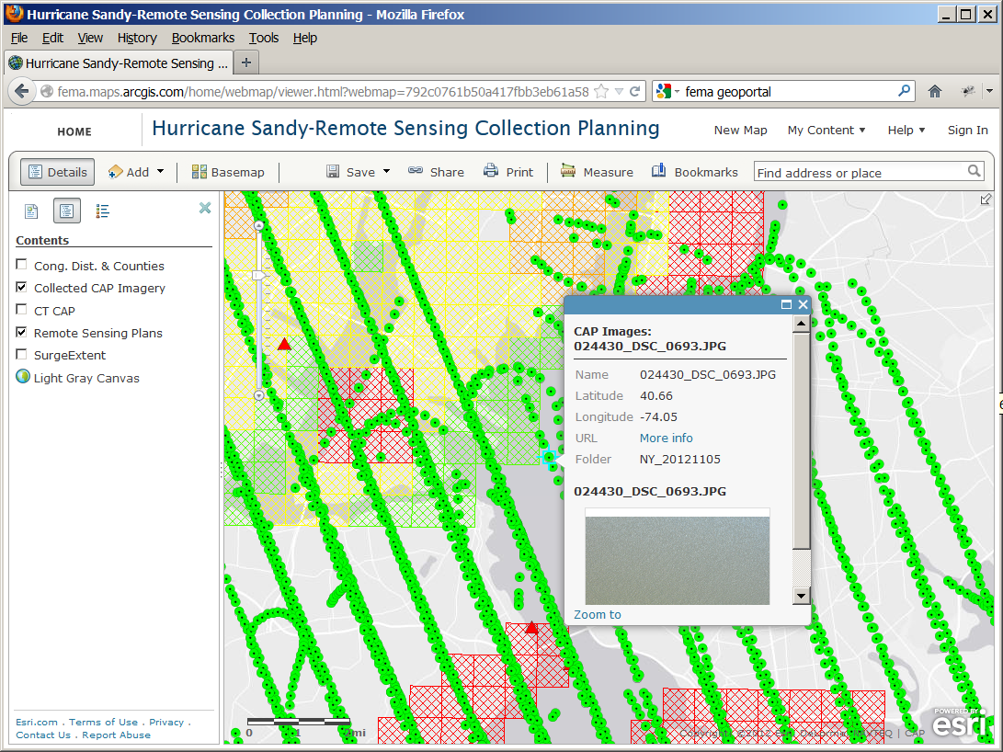

Slide 37
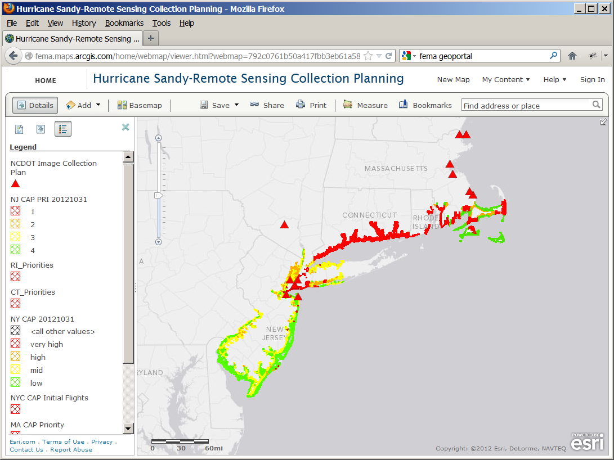

Slide 38
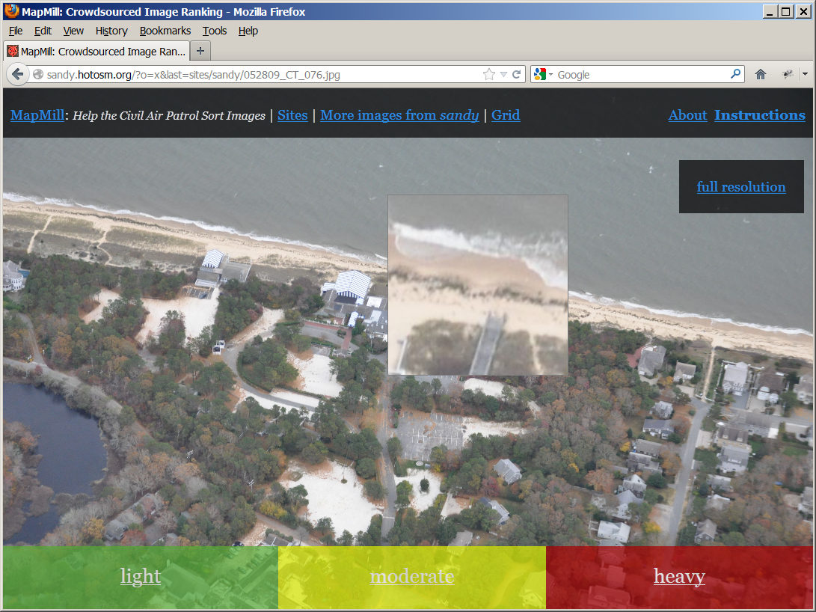

Slide 39
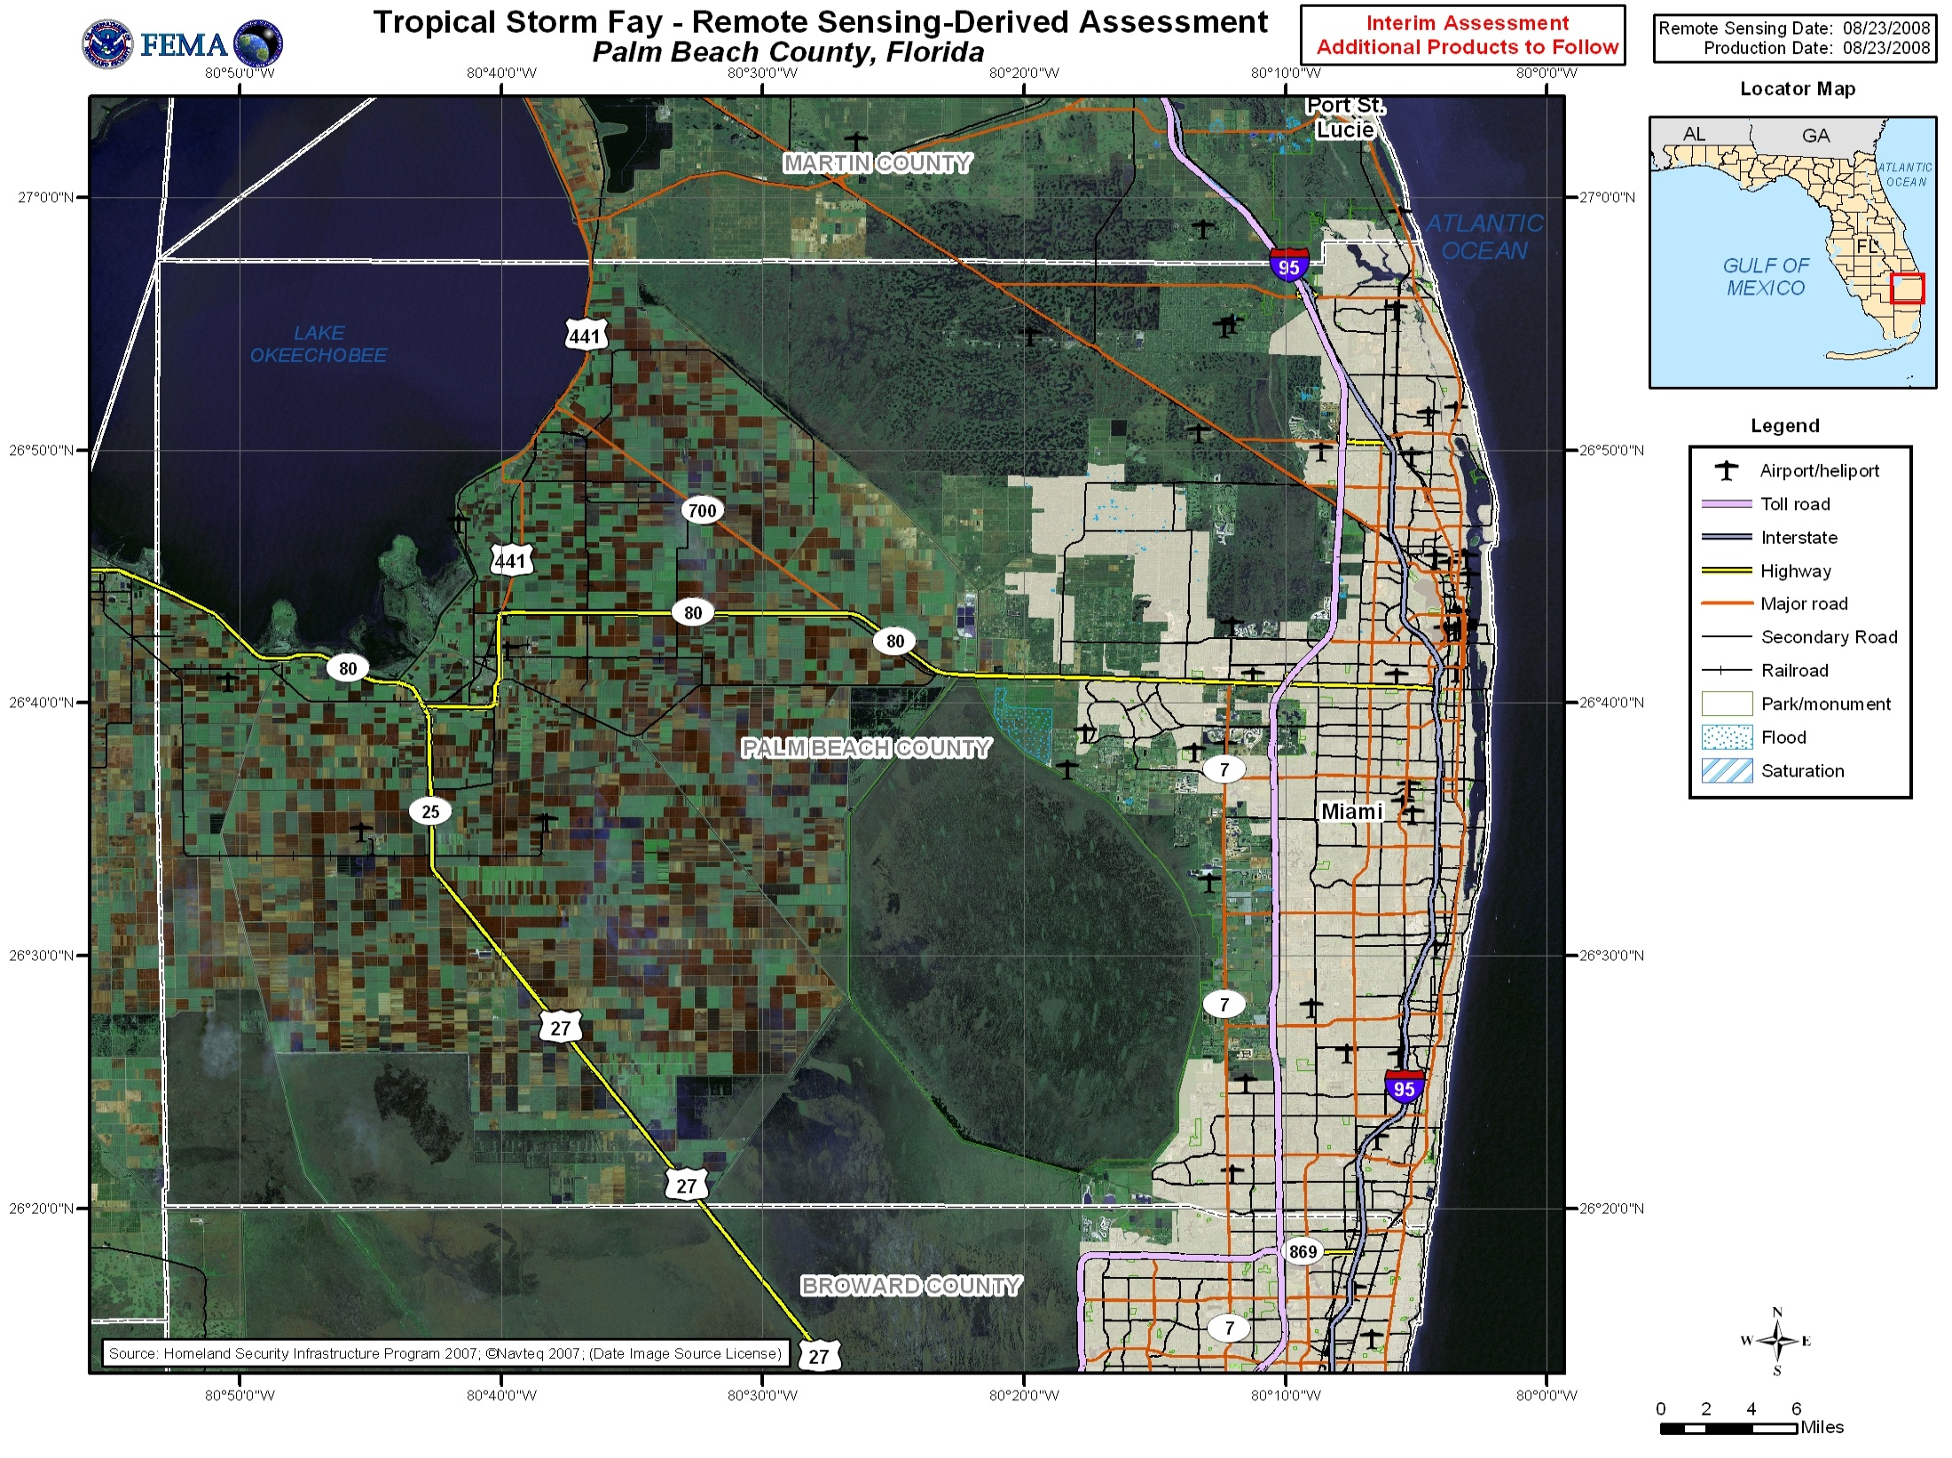

Slide 40
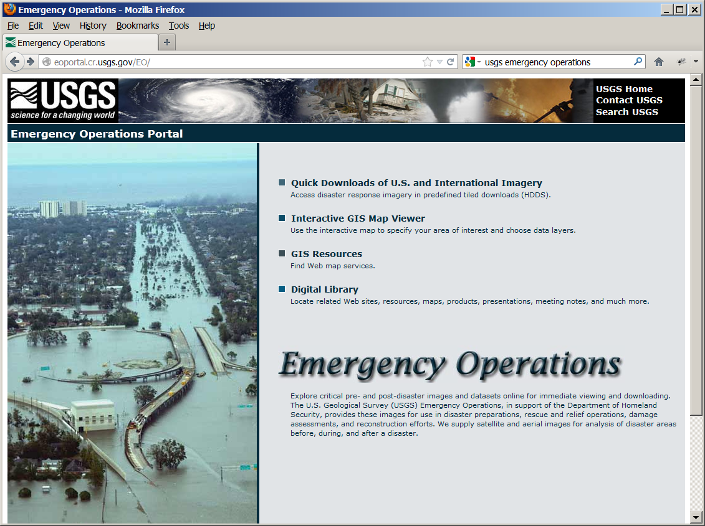

Slide 41
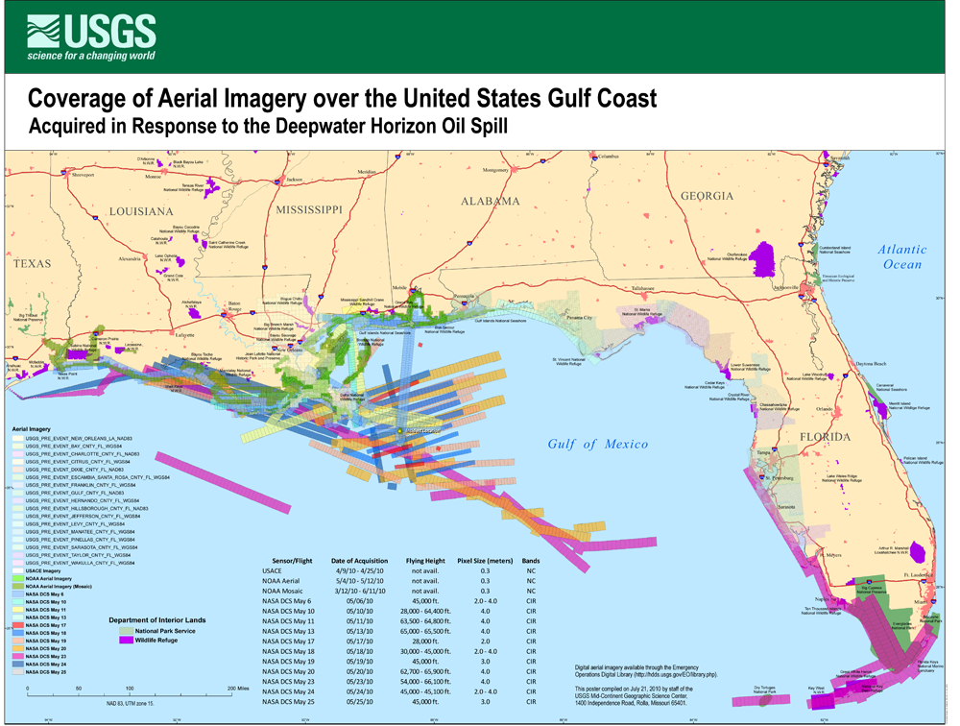

Slide 42
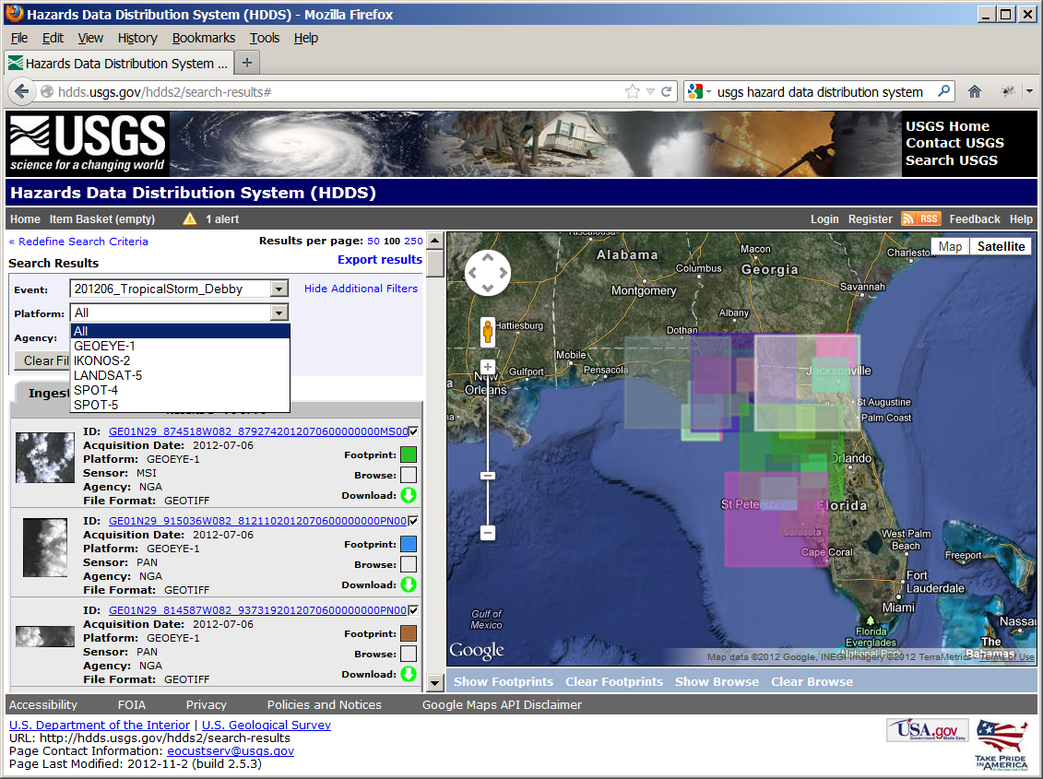

Slide 43
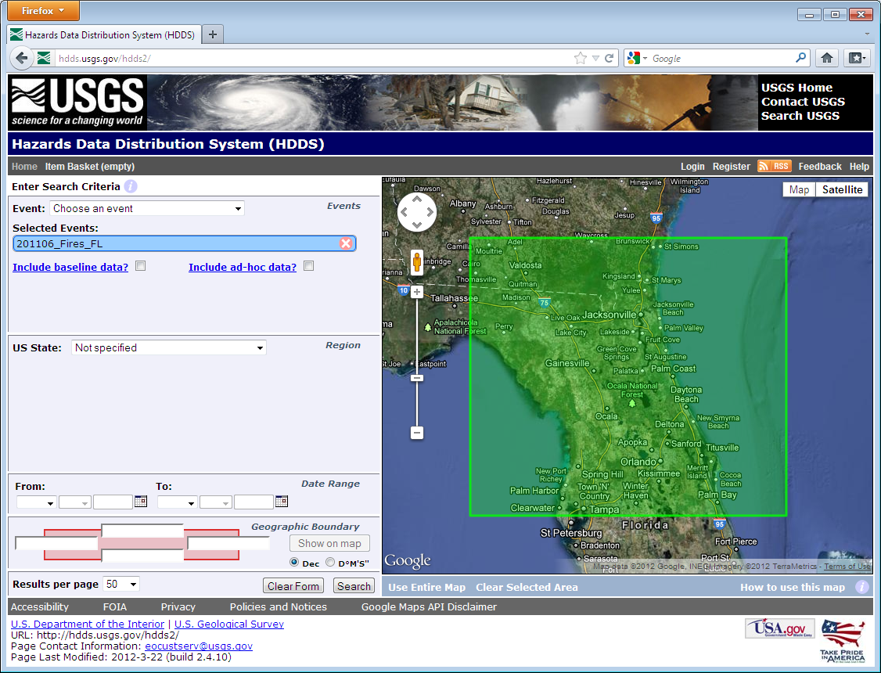

Slide 44
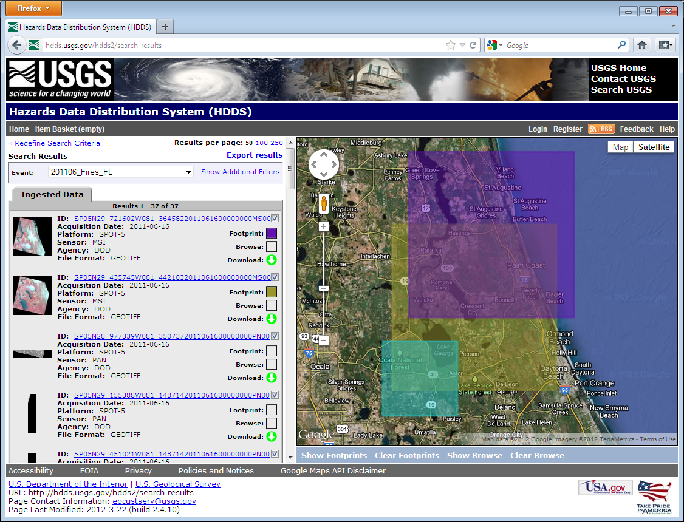

Slide 45
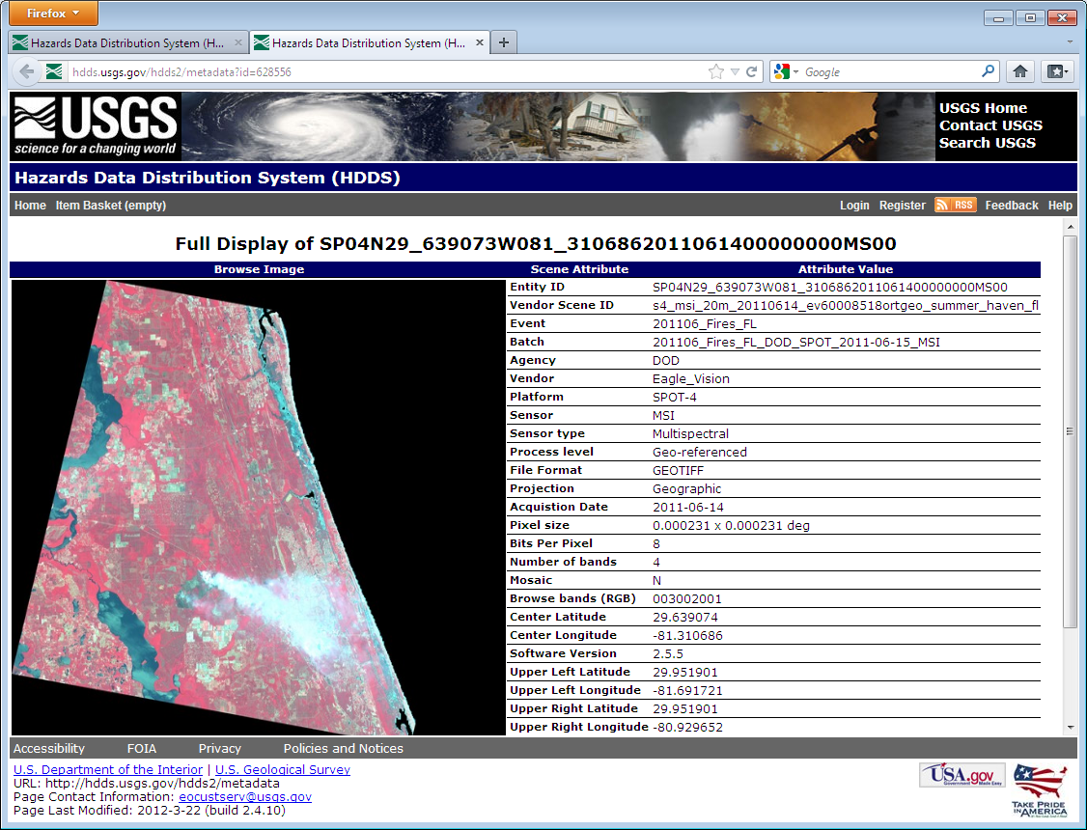

Slide 46
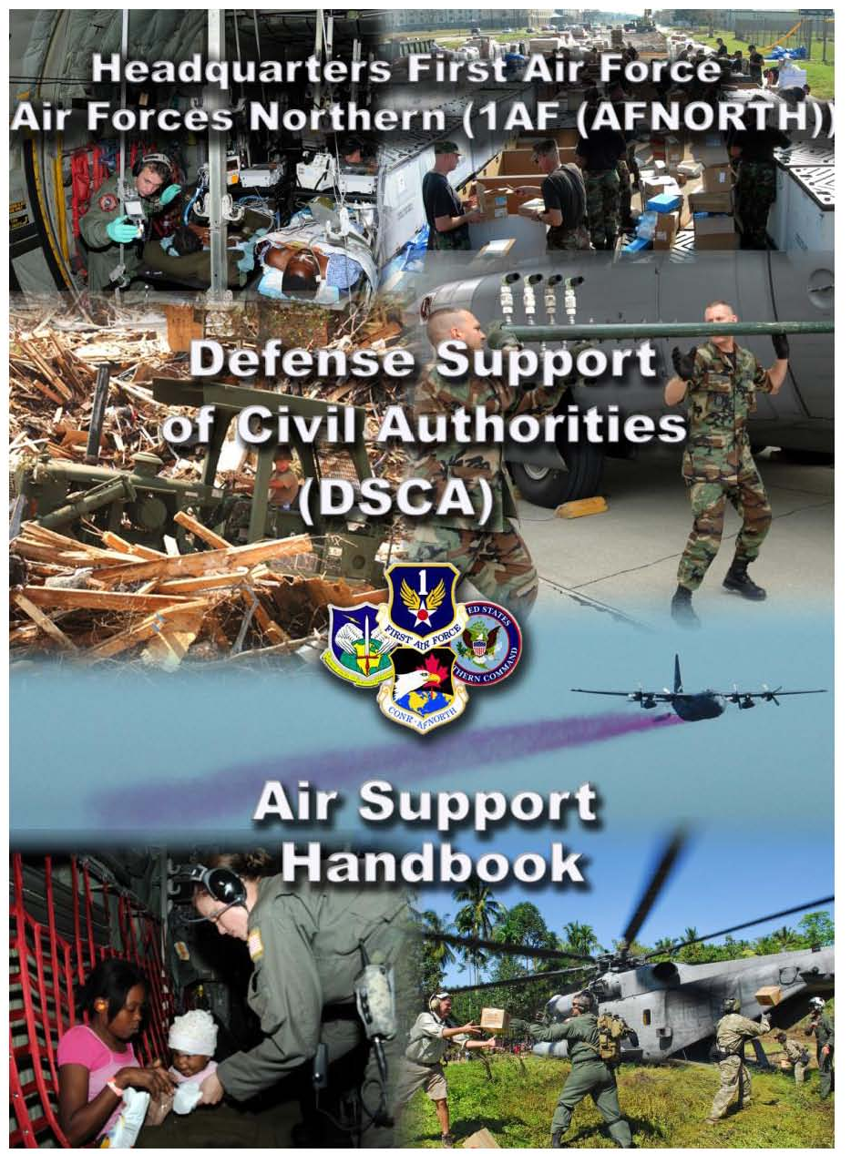
Military & National Guard
Each National Guard –
  May have different capabilities, resources
Air Force –
  1 AF AFNORTH has Incident Assurance Awareness
  Numerous resources
  All complicated by who pays, who’s in charge, and posse comitatus

Slide 47
Commercial/Civil Satellite Imagery
U-2 (DOD) – Black and White Imagery
Ikhana UAV (NASA) - Direct video (infrared and visible)
DOD P3 Orion – Direct video (infrared and visible)
Global Hawk (DOD) – Visible and Infrared Imagery
Civil Air Patrol – Digital Imagery
Notes:
Information Assurance Awareness

Slide 48
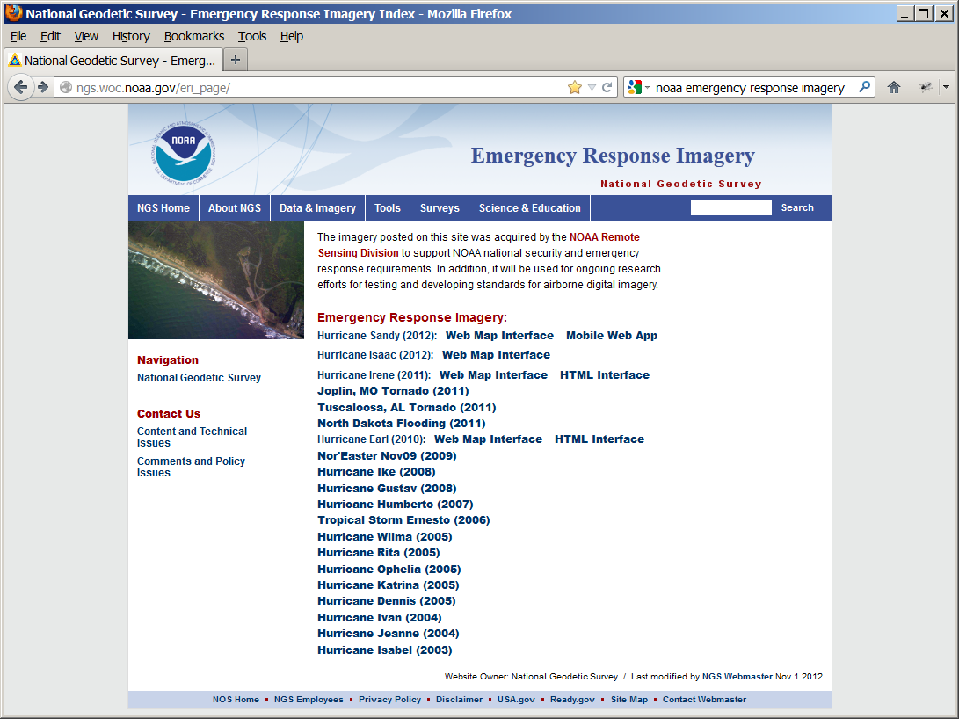
Notes:
NOAA Emergency Response Imagery

Slide 49
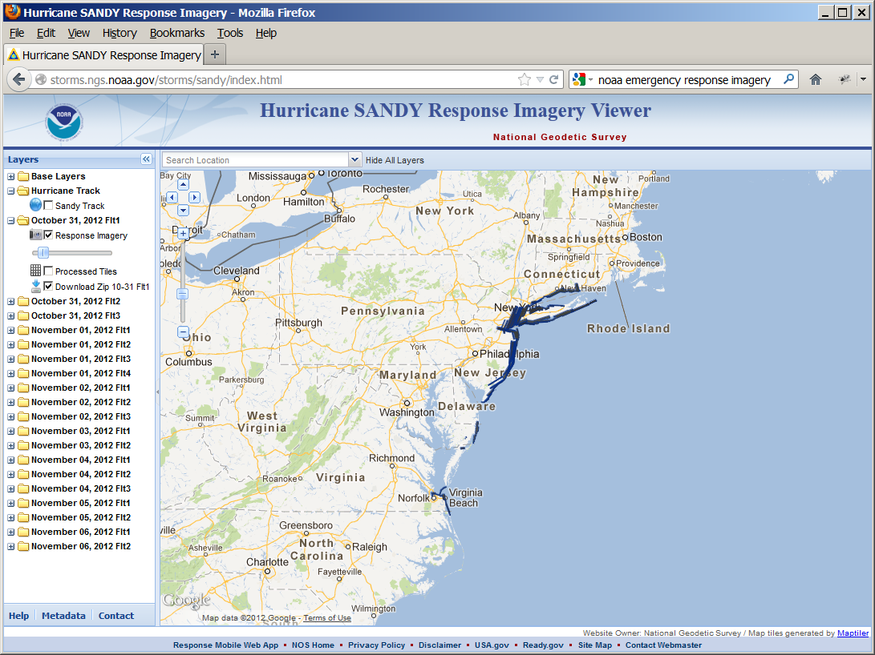

Slide 50
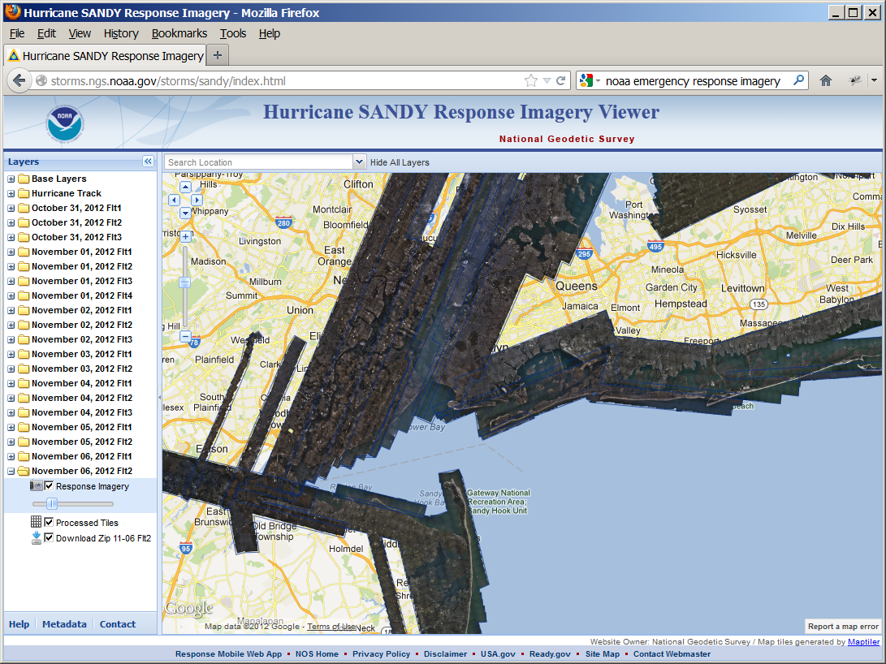

Slide 51
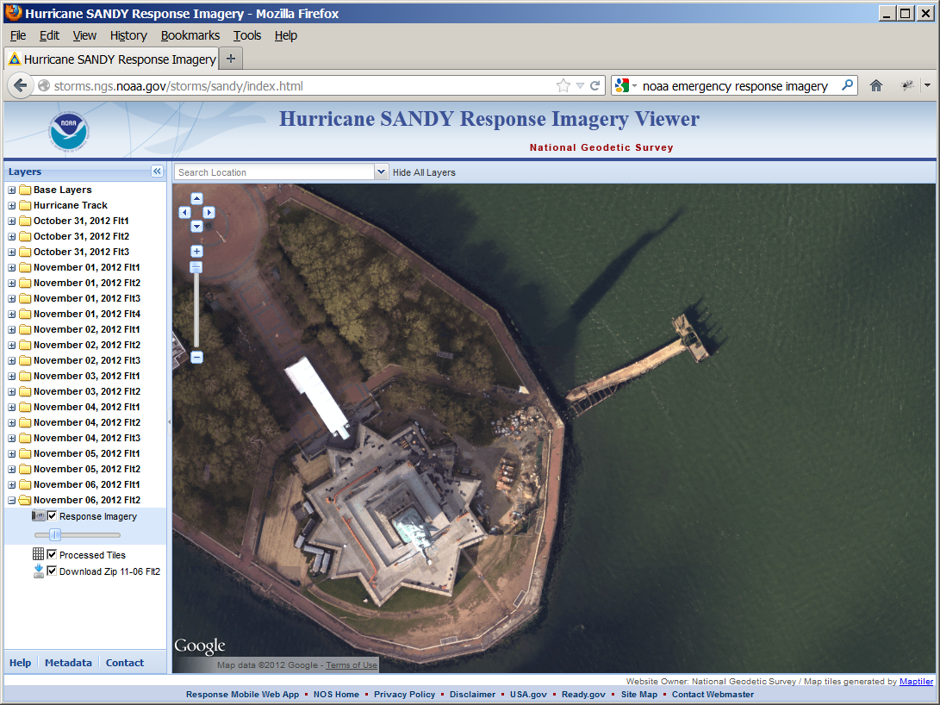

Slide 52
Interagency Remote Sensing Coordination Cell

Slide 53
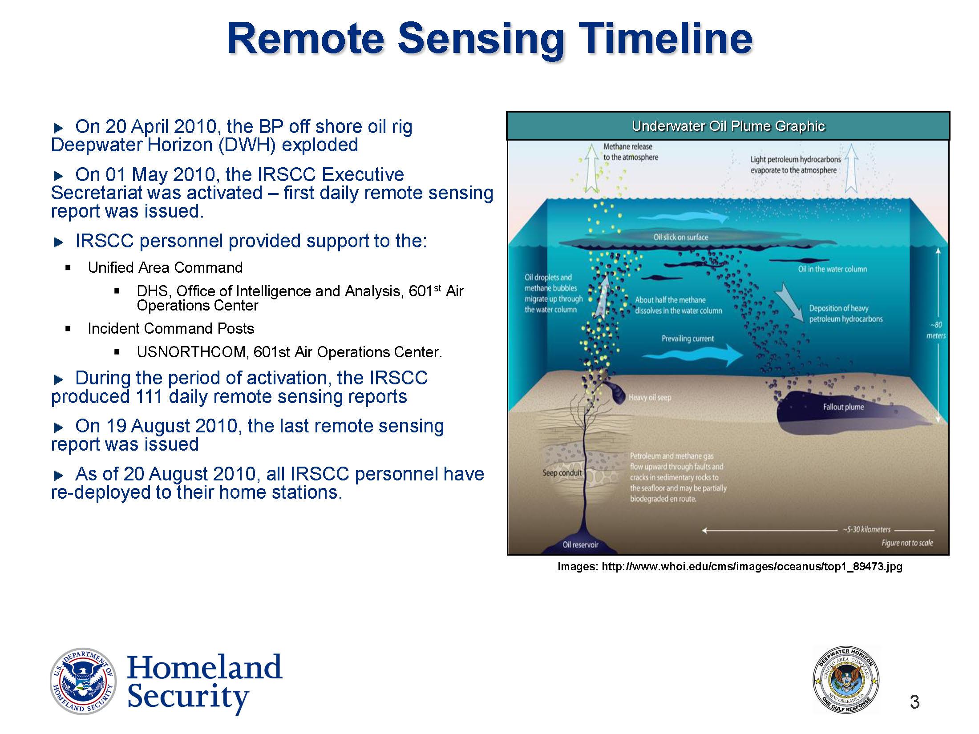

Slide 54
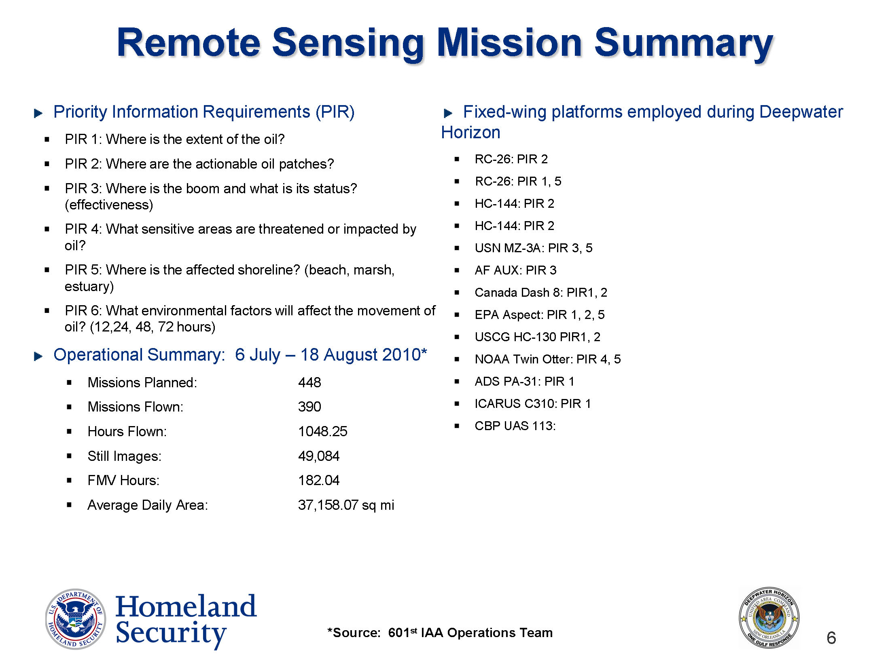

Slide 55
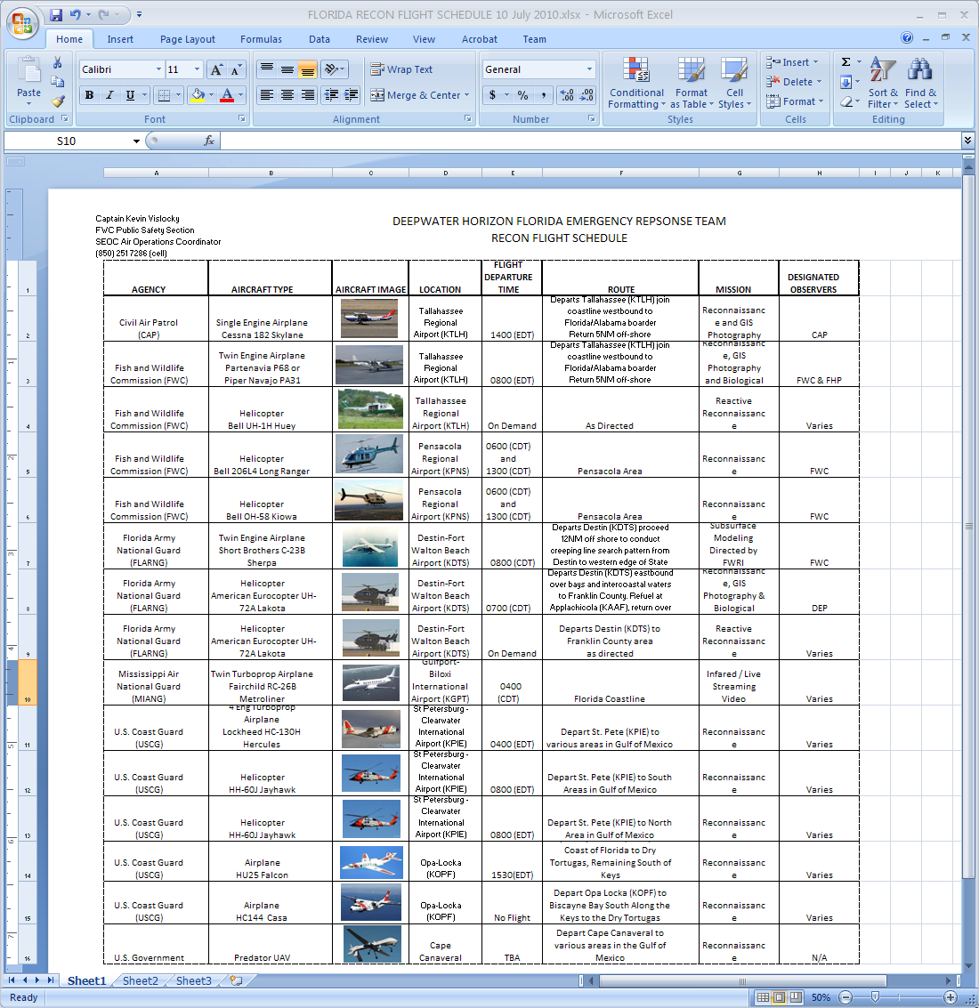

Slide 57
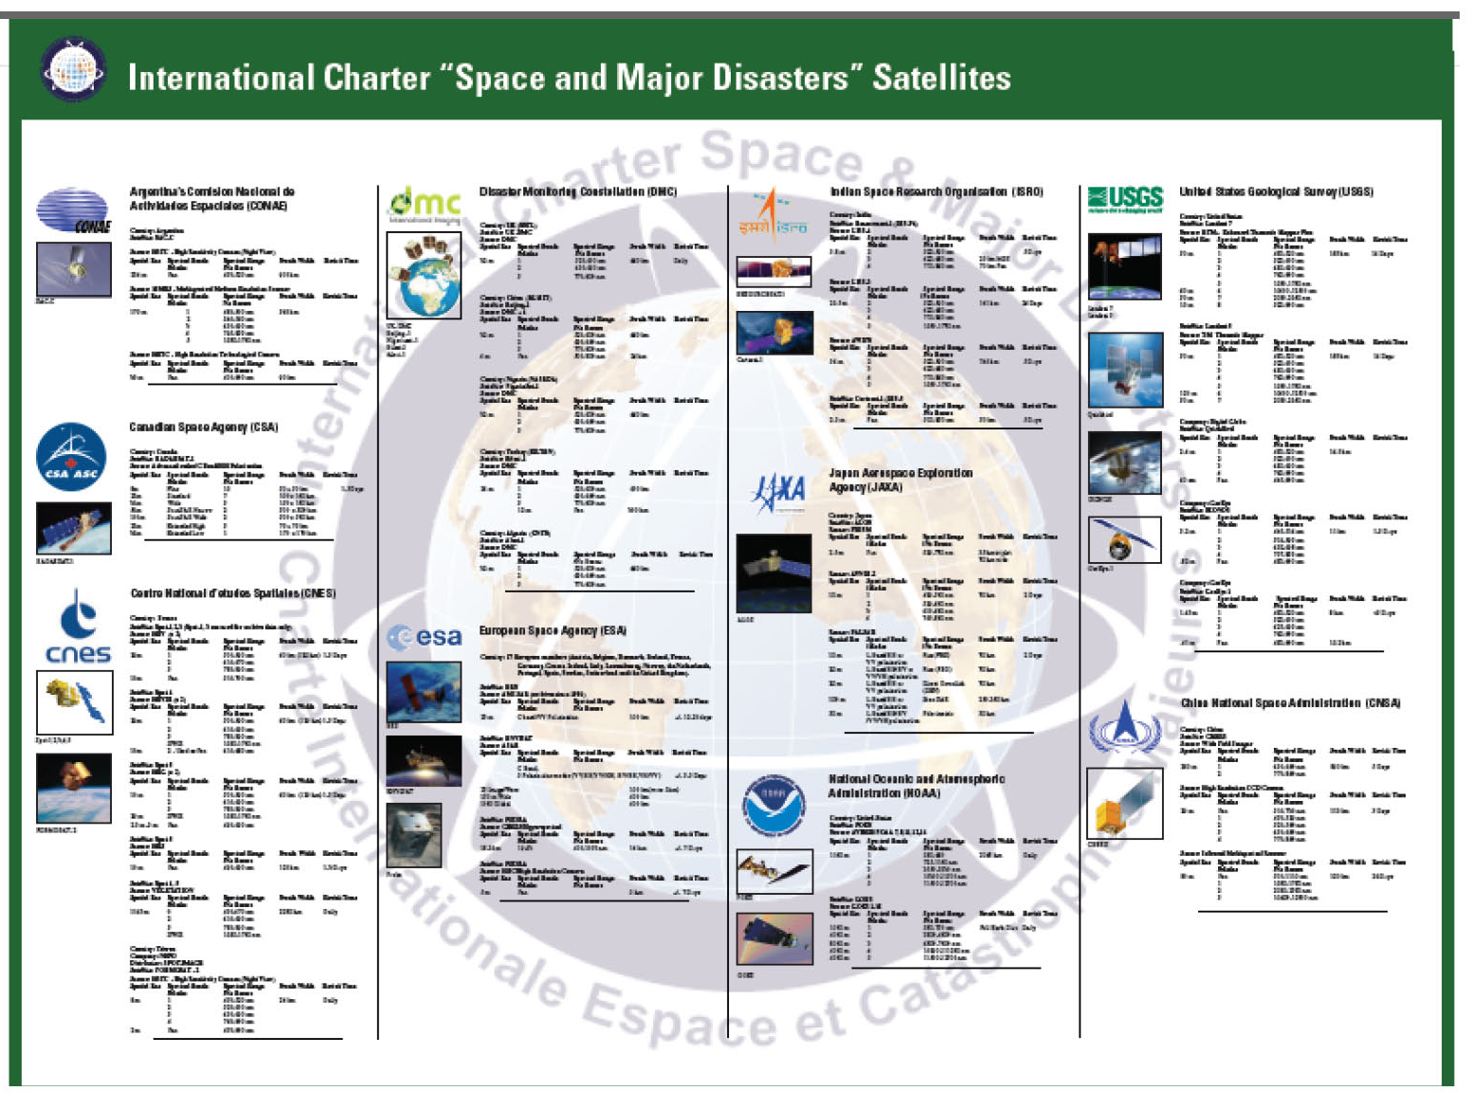

Slide 58
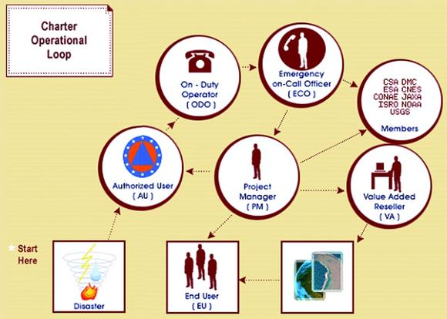
Roles for Call 419 – Hurricane Sandy
Richard Butgereit
USGS
FEMA
America View
GIS Corps
http://bit.ly/flseem13

Slide 59

Dossier
http://bit.ly/flseem13

Slide 60


Radar –
  DLR (German Aerospace Center) – TerrraSAR-X
  ASI (Italian Space Agency) COSMO-SkyMed

Slide 61


Optical –
  DLR (German Aerospace Center) – RapidEye
  DMC (DMC International Imaging) – L1R
http://bit.ly/flseem13

