Slide 1
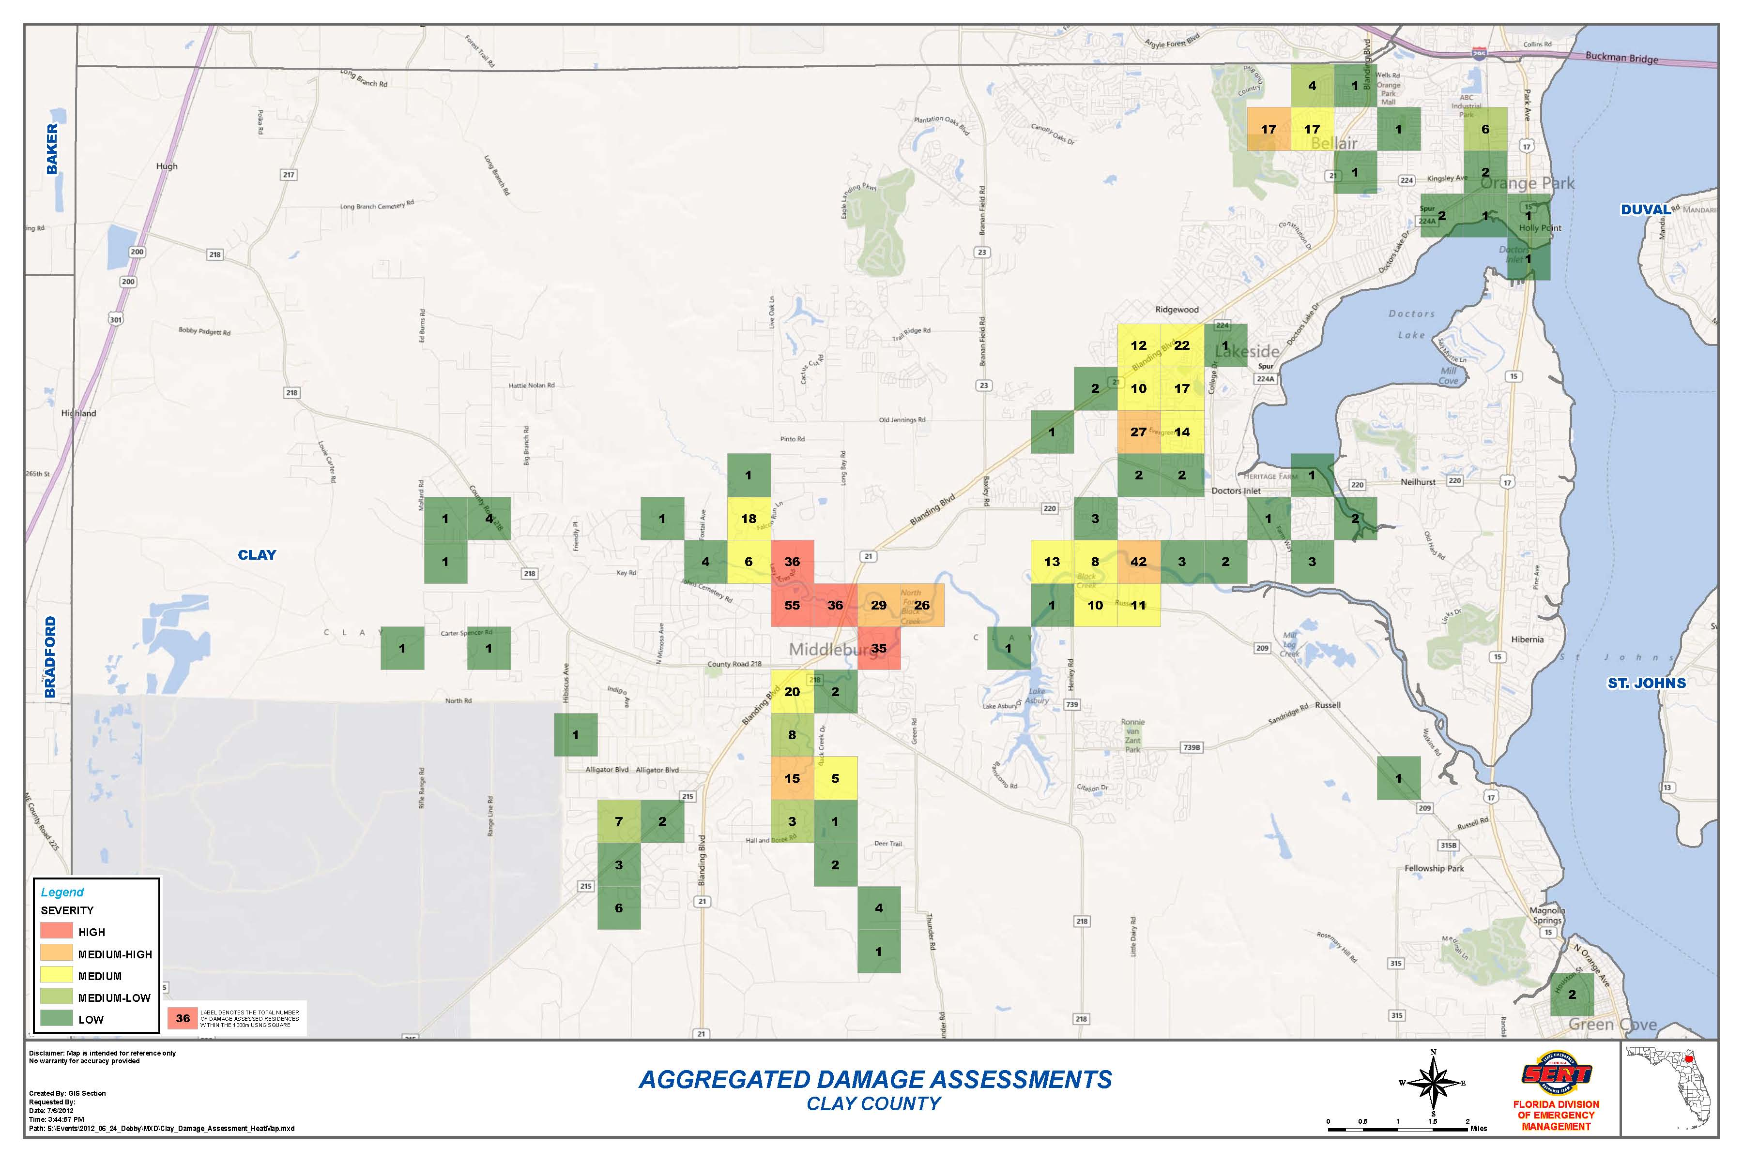
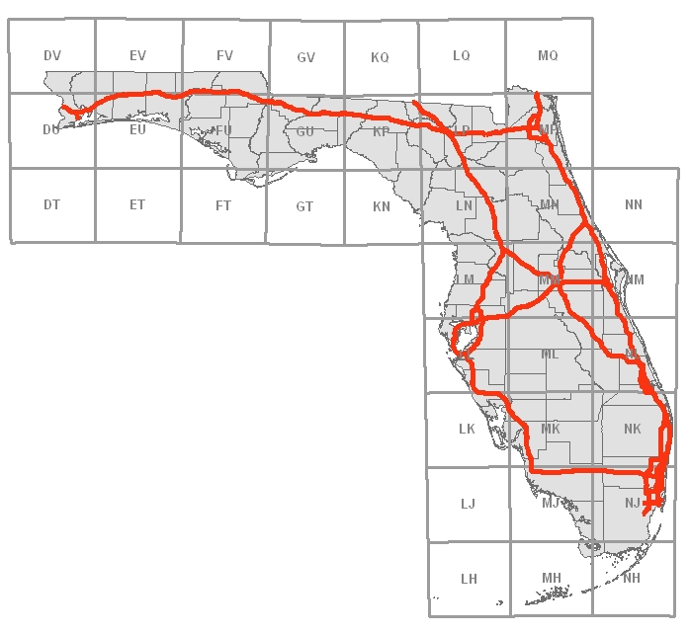
US National Grid – Implementing USNG within your Emergency Management Agency
Richard Butgereit
richard.butgereit@em.myflorida.com
Information Management Section Head
Florida Division of Emergency Management
850-413-9907
Notes:
Introduction

Slide 2
NAPSG Implementation Guide to the USNG
USNG Basics
Governance
Standard Operating Procedures
Training and Education
Maps
Technology

Slide 3
What’s wrong with current systems?
We already have…
Latitude/Longitude
Township/Range/Section
Street Address and Zip
UTM

Slide 4
Latitude/Longitude
Multiple formats are confusing
DD -85.990151, 30.272240
DM -85 59.409089, 30.16.334386
DMS 85 59’24.545”W, 30 16’20.063”N
All the same location!!!

Slide 5
How far is a second anyway?
What is the distance from….
85 59’24.545”W, 30 16’20.063”N
To here….
85 59’26.292”W, 30 16’14.546”N

Slide 6
Worse yet…
What is the distance from
-85.990443, 30.275358
To here….
85 59.364547, 30 16.504539

Slide 7
Township/Range/Section
Township/Range/Section grid from the Public Lands Survey System is an important and good system…
basis of land ownership records
been in use for over 180 years

Slide 8
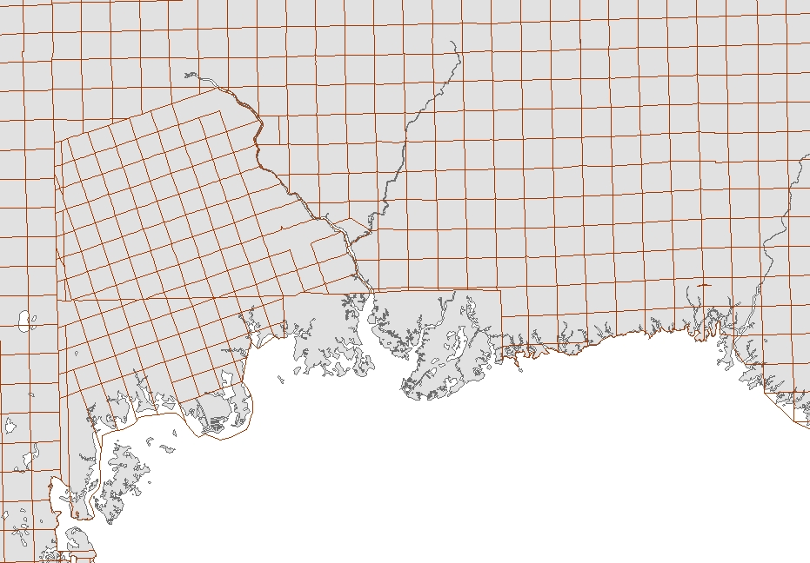
Township/Range/Section
But a perfect section really doesn’t exist
irregular in coastal areas
too large to meet needs of ground crews
Notes:
Florida’s unique geography of miles of coastlines, multiple river corridors, and large watersheds make the use of the common Township/Range/Section grid (PLSS) all but impossible except for a handful of inland counties. As the grid approaches wetlands, river corridors and the coast line, sections become irregular in shape and can be significantly larger than the typical square mile, which is too large to accommodate the needs of ground crews.

Slide 12
Street Address and Zip
Problematic due to…
rural routes
post office boxes

Slide 13
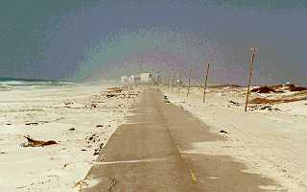
What do you do when the SIGNS are gone?

Slide 14
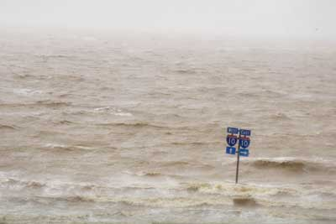
What do you do when the ROADS are gone?

Slide 15
When you ain’t got much else left, you still got the grid!

Slide 16
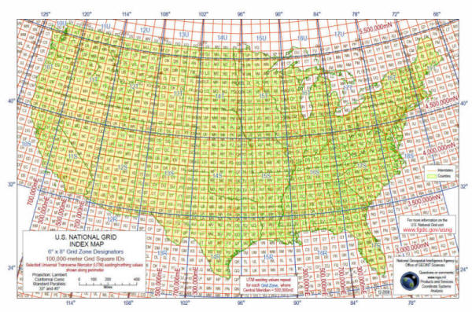
US National Grid
The USNG is a point reference system of grid references that provides a nationally consistent language of location in a user friendly format.
Notes:
The United States National Grid is a point reference system of grid references that provides a nationally consistent language of location in a user friendly format.

Slide 17
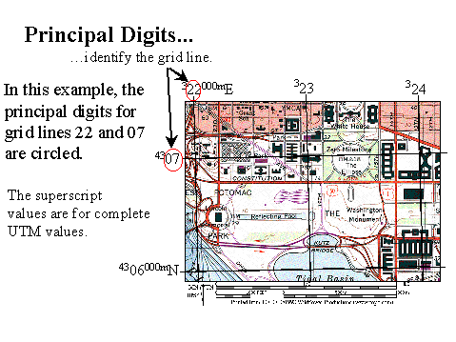
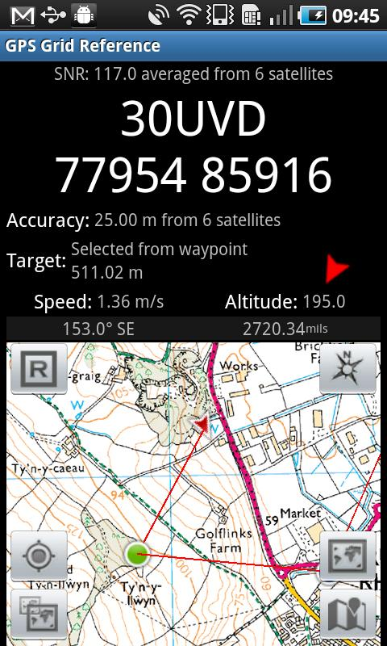
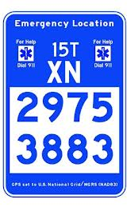
US National Grid
Built to create “a more interoperable environment for developing location-based services within the United State and to increase the interoperability of location services appliances with printed map products”…
Notes:
Built to create “a more interoperable environment for developing location-based services within the United State and to increase the interoperability of location services appliances with printed map products”…

Slide 18
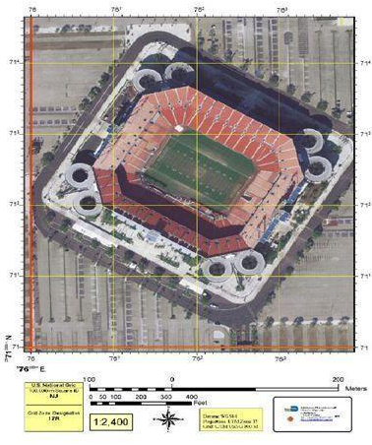
… use of the National Grid has been widely adopted within emergency management for use in preparedness, response, and recovery efforts.
Notes:
… use of the National Grid has been widely adopted within emergency management for use in preparedness, response, and recovery efforts.

Slide 19
National Standards
National Search and Rescue Committee – specifies US National Grid as primary system for ground operations
Federal Geographic Data Committee – US National Grid Standard since 2001
FEMA - Established a standard for operational maps using the National Grid

Slide 20
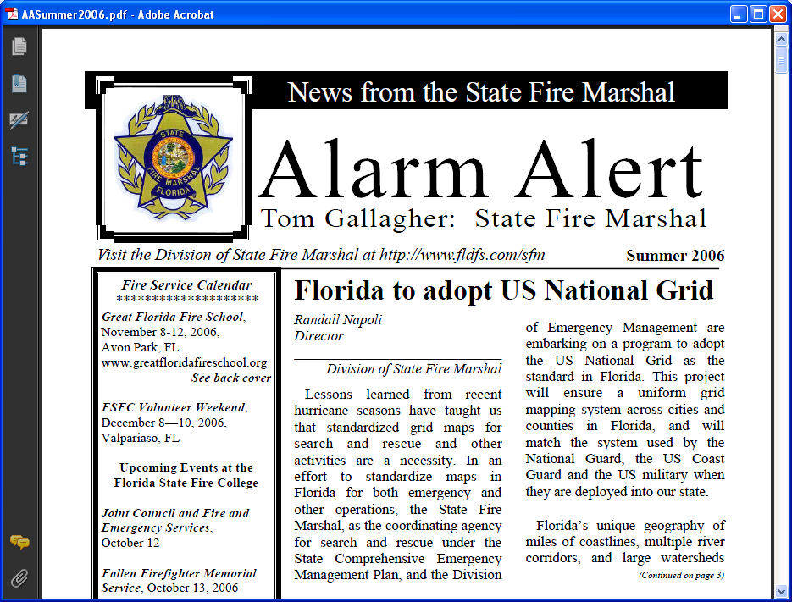
Notes:
Florida to adopt the US National Grid first announced in Summer 2006 by the State Fire Marshall

Slide 21
Florida Adopts the USNG
Florida Fire Chiefs Association adopts through 2010 Statewide Emergency Response Plan
FDEM adopts through 2010 Comprehensive Emergency Management Plan (CEMP)
Notes:
Recent plans, including the Statewide Emergency Response Plan of the Florida Fire Chiefs Association and the State of Florida’s Comprehensive Management Plan, have formally adopted the USNG.

Slide 22
Florida CEMP
“The State of Florida has adopted the use of the U.S. National Grid (USNG) during response and recovery efforts which allows for both point and area referencing.”
Notes:
Language from the Comprehensive Emergency Management Plan adopting the USNG

Slide 23
EM Constellation
EM Constellation is the web-based information management software platform adopted by the State of Florida for emergency management.
The platform allows the State Emergency Response Team composed of county, state, federal, volunteer, and mutual aid entities to use the same operating environment when responding to and recovering from an emergency.
Notes:
Summary of what EM Constellation is

Slide 24
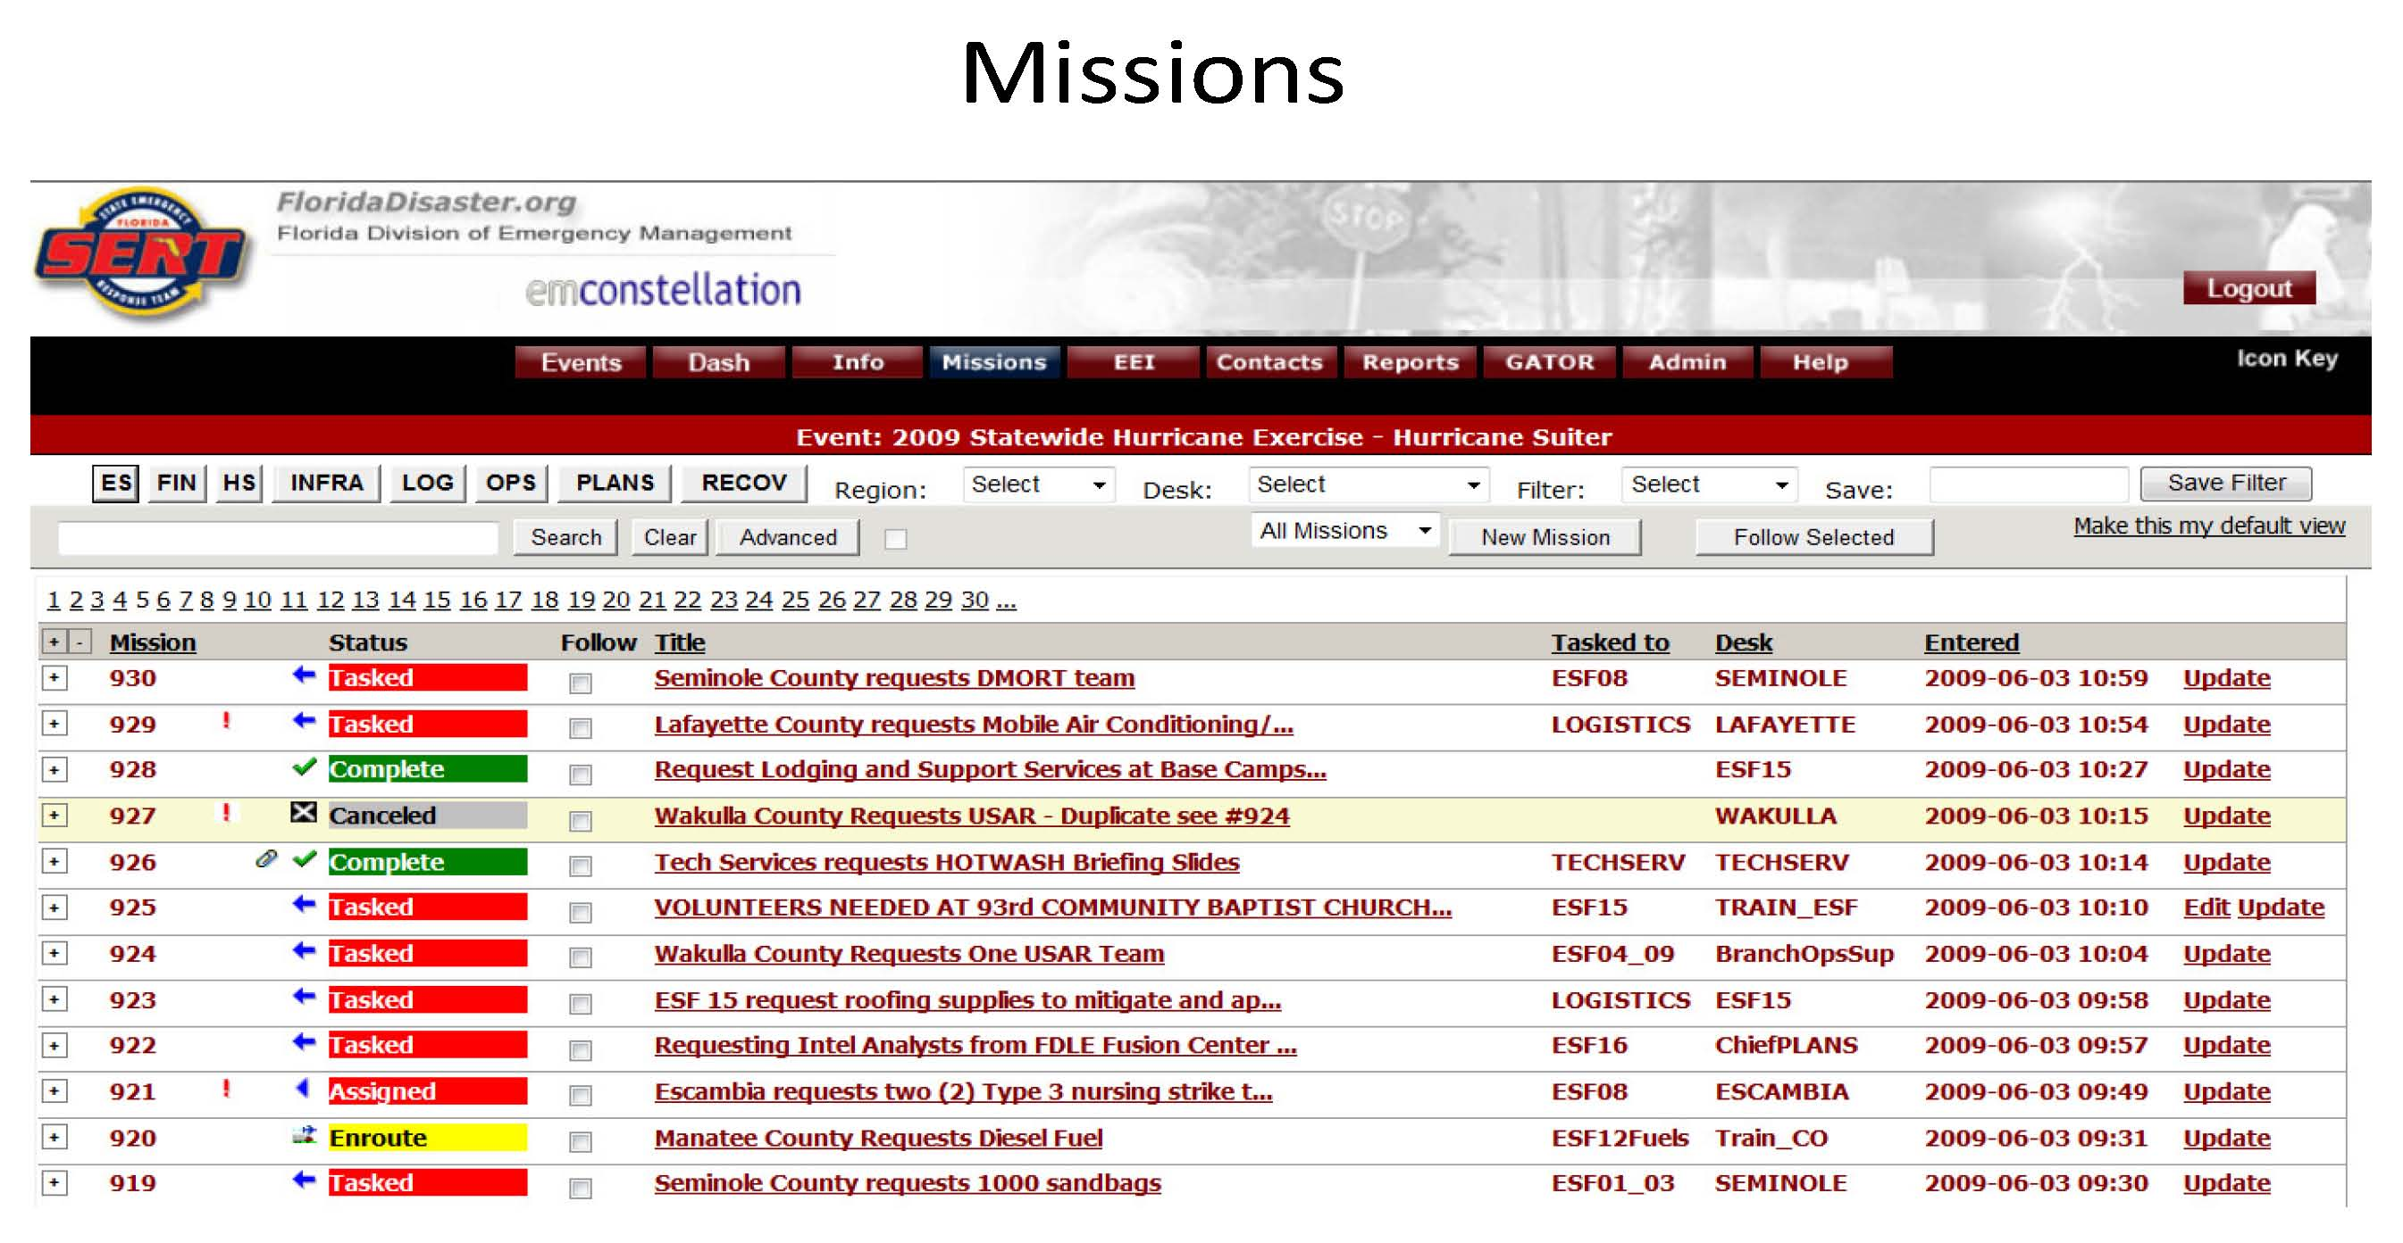

Slide 25
Getting Missions on the Map
Notes:
25

Slide 26
SWO Incident Tracker
FIRE / SEARCH & RESCUE
LAW ENFORCEMENT
INCIDENTS / SUSPICIOUS ACTIVITY
NATURAL HAZARDS
POPULATION PROTECTIVE ACTIONS
TECHNICAL HAZARDS
ENVIRONMENTAL CONCENRS
TRANSPORTATION
INCIDENTS
UTILITIES / INFRASTRUCTURE
MILITARY EVENTS
Notes:
26
Additionally, this summer, the State Watch Office’s Incident Tracker was modernized, including the integration of GIS into the system.

Slide 27
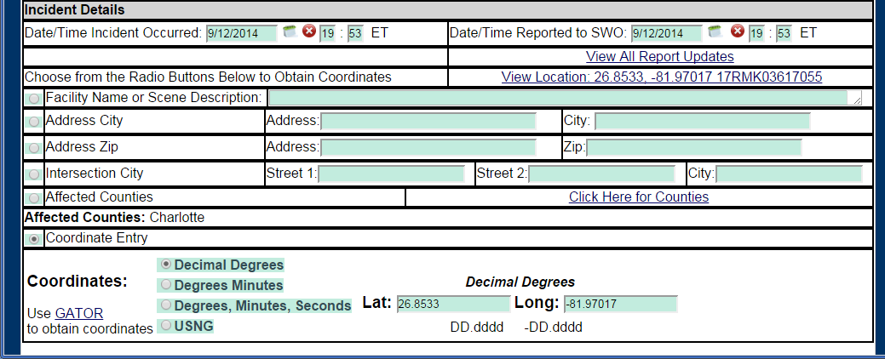
Notes:
In this map, SWO GATOR displays a road closure on AIA in Flagler county. Incidents reported to the State Watch Office like wastewater and petroluem spills, wildfires and large structural fires, aircraft incidents, and road closures are all tracked and mapped through this system. For access to the SWO Incident Tracker, contact the State Watch Office.

Slide 28
Support for USNG
Integration into other applications
FDEM’s GATOR
FDEM’s Incident Mapper
FDEM’s State Watch Office Incident Tracker
EM Constellation
RECON Reports
Support for GIS Staff - http://www.floridadisaster.org/gis/usng
tools and instructions for GIS staff
map book templates
downloadable shapefiles from Florida Geographic Data Library
Editor Tracker extension to ArcGIS 9.x
Editor Tracker add in to ArcGIS 10.x
USNG Training Course
http://trac.floridadisaster.org/TRAC/CourseDetailPublic?ID=192
Notes:
Support for the USNG has been integrated into several flagships applications of the Division and the State Emergency Response Team – applications like, GATOR, EM Constellation, RECON Reports, and the State Watch Office Incident Tracker. Additionally, instructions, data, and tools for GIS teams that support local agencies have been developed and released via the Division’s website. Recently, an introductory USNG training course has been created and is being delivered across the state for first responders.

Slide 29
KML for Google Earth
http://map.floridadisaster.org/GIS/KML
Critical Facilities – including USNG coordinates for facilities
USNG layers – statewide 100,000m, 10,000m, and 1,000m

Slide 30
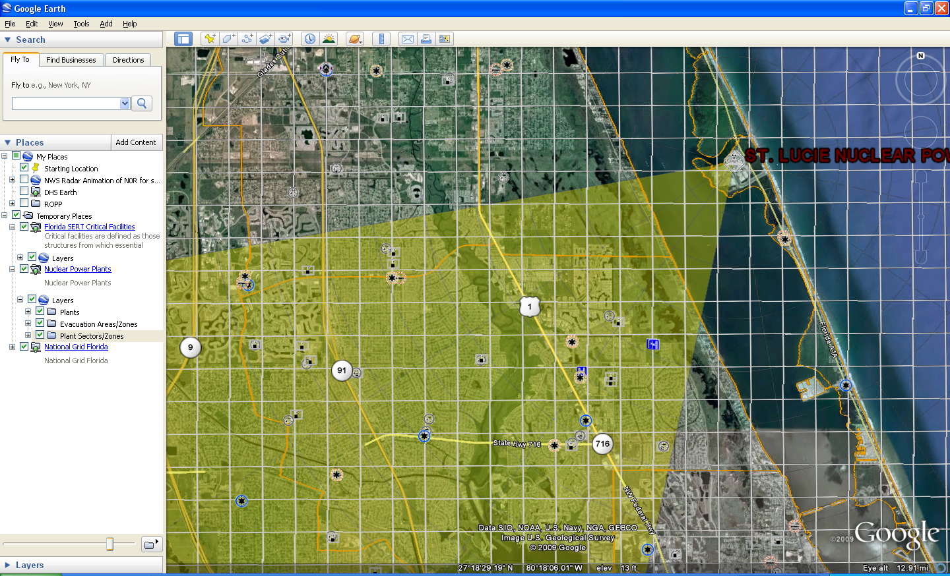
KML for Google Earth

Slide 31
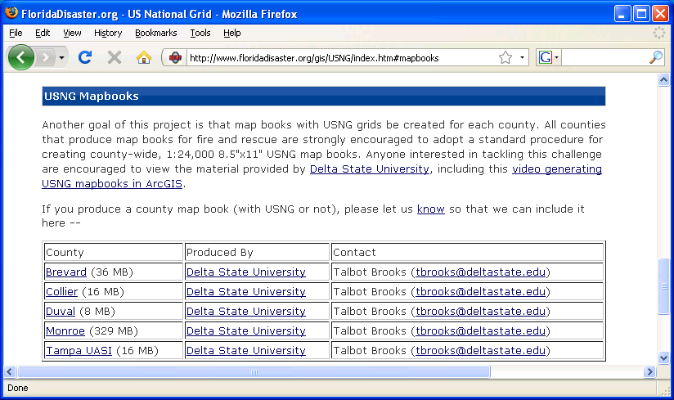
County Map Books

Slide 32
Map Book Templates
Produce 4,000 m x 5,000 8.5” x 11” 1:24,000 scale maps
Style guide, templates and video from Delta State University linked from http://www.floridadisaster.org/gis/USNG/index.htm#mapbooks

Slide 33
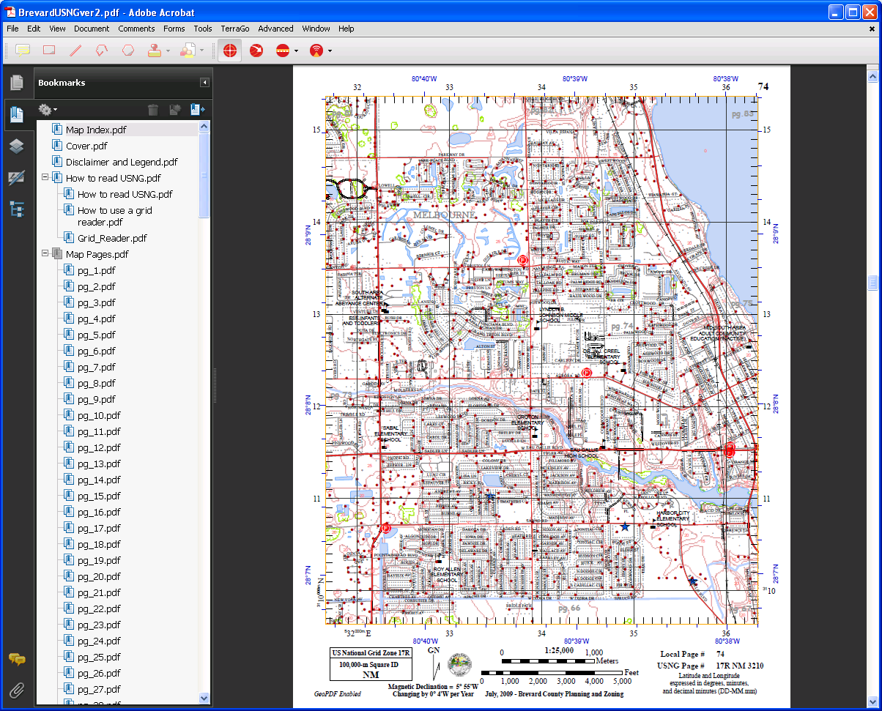

Slide 34
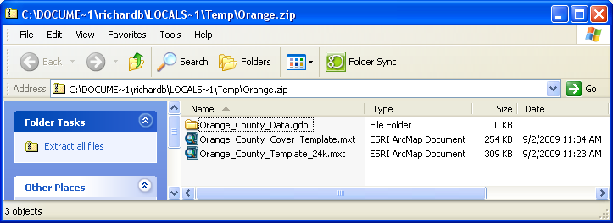
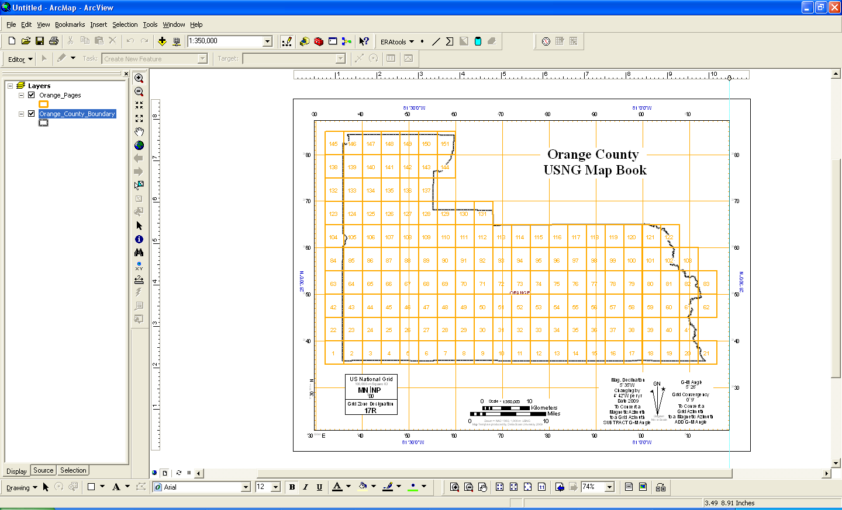
Map Book Templates

Slide 35
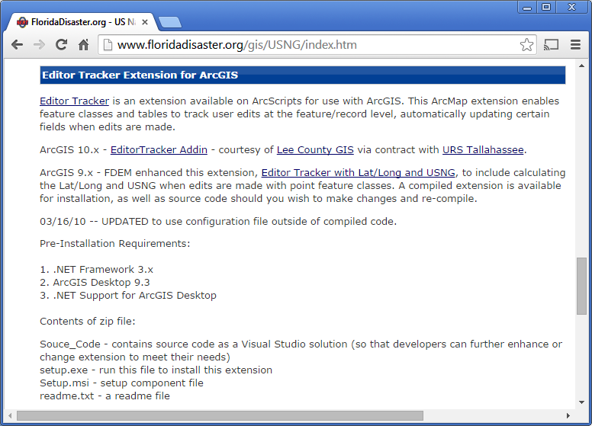

Slide 36
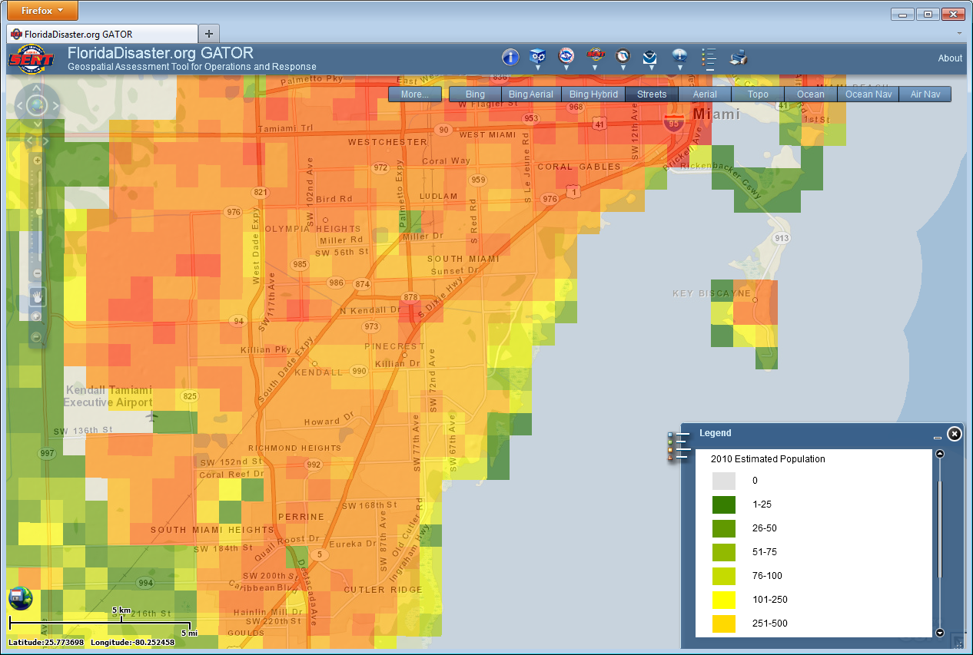
USNG – Data aggregation
Notes:
So what we have found is that with the USNG, which is already a scalable, interoperable system tailored for use in the field, is a good system for re-sampling and aggregating disparate datasets to assess risk and prioritize deployment of resources. Here we’ve re-sampled estimated population to the 1000 meter grid within Miami-Dade county to better visualize population density.

Slide 37
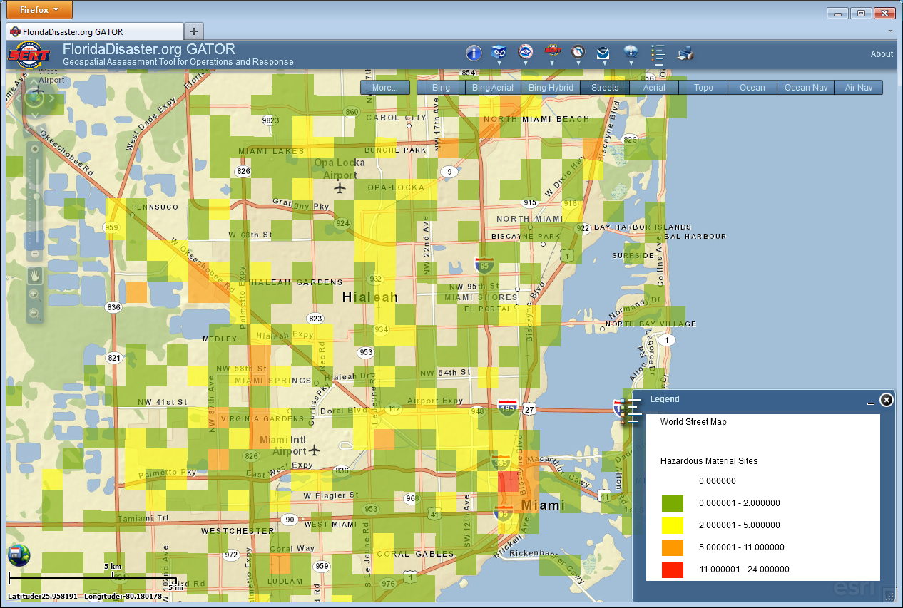
USNG – Data aggregation
Notes:
Here density of hazardous material sites

Slide 38
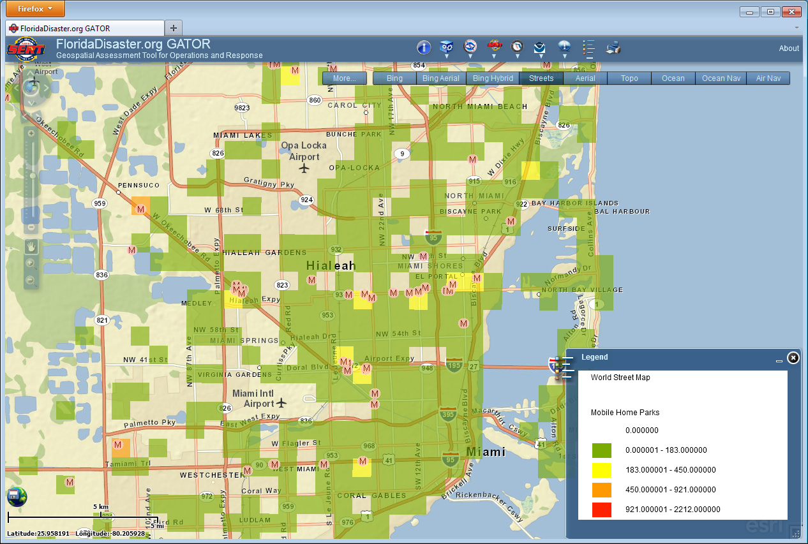
USNG – Data aggregation
Notes:
And here density of mobile home parks from the parcel database as well as an overlying point layer of mobile home parks from a licensing database.

Slide 39
USNG – Data aggregation
Notes:
And here density of mobile home parks from the parcel database as well as an overlying point layer of mobile home parks from a licensing database.

Slide 40
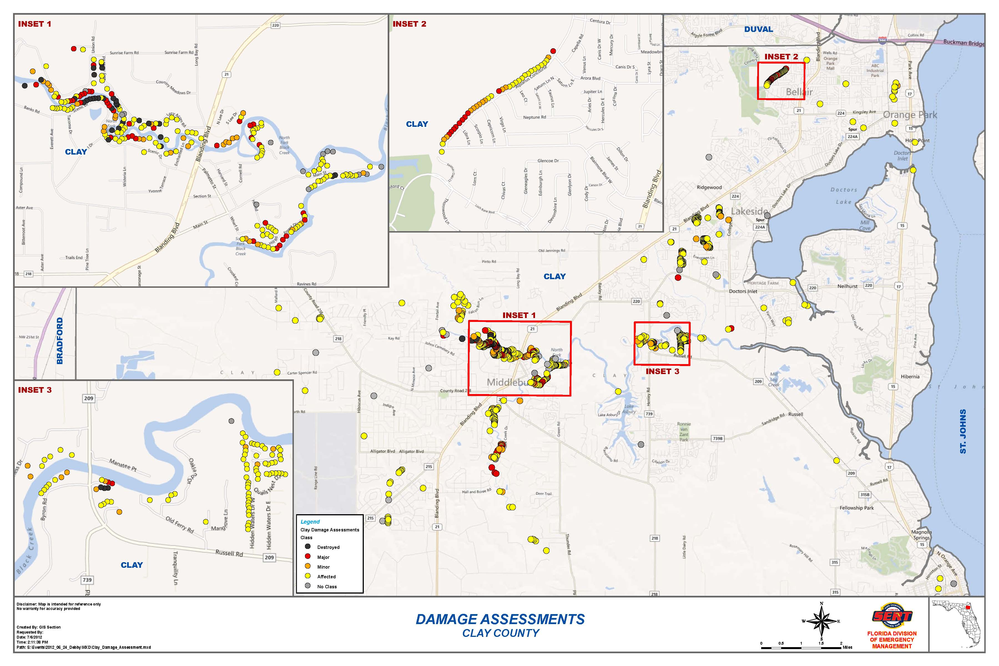
USNG – Data aggregation
Notes:
And lastly a map of damage assessments for Clay County, Florida following flooding from Tropical Storm Debbie, where the county dispatched initial damage assessments teams and collected data at their public service answering point from calls made to 911. The data was shared with the state in a tabular format, with street addresses geocoded to Latitude/Longitude and USNG coordinates. We aggregated the points to the grid intending to aid in visualization of damage and assist in prioritizing resources. What we found, however, was also an opportunity to share data with FEMA and visualize something that had previously been doable.

Slide 41
USNG – Data aggregation
Notes:
And lastly a map of damage assessments for Clay County, Florida following flooding from Tropical Storm Debbie, where the county dispatched initial damage assessments teams and collected data at their public service answering point from calls made to 911. The data was shared with the state in a tabular format, with street addresses geocoded to Latitude/Longitude and USNG coordinates. We aggregated the points to the grid intending to aid in visualization of damage and assist in prioritizing resources. What we found, however, was also an opportunity to share data with FEMA and visualize something that had previously been doable.

Slide 42
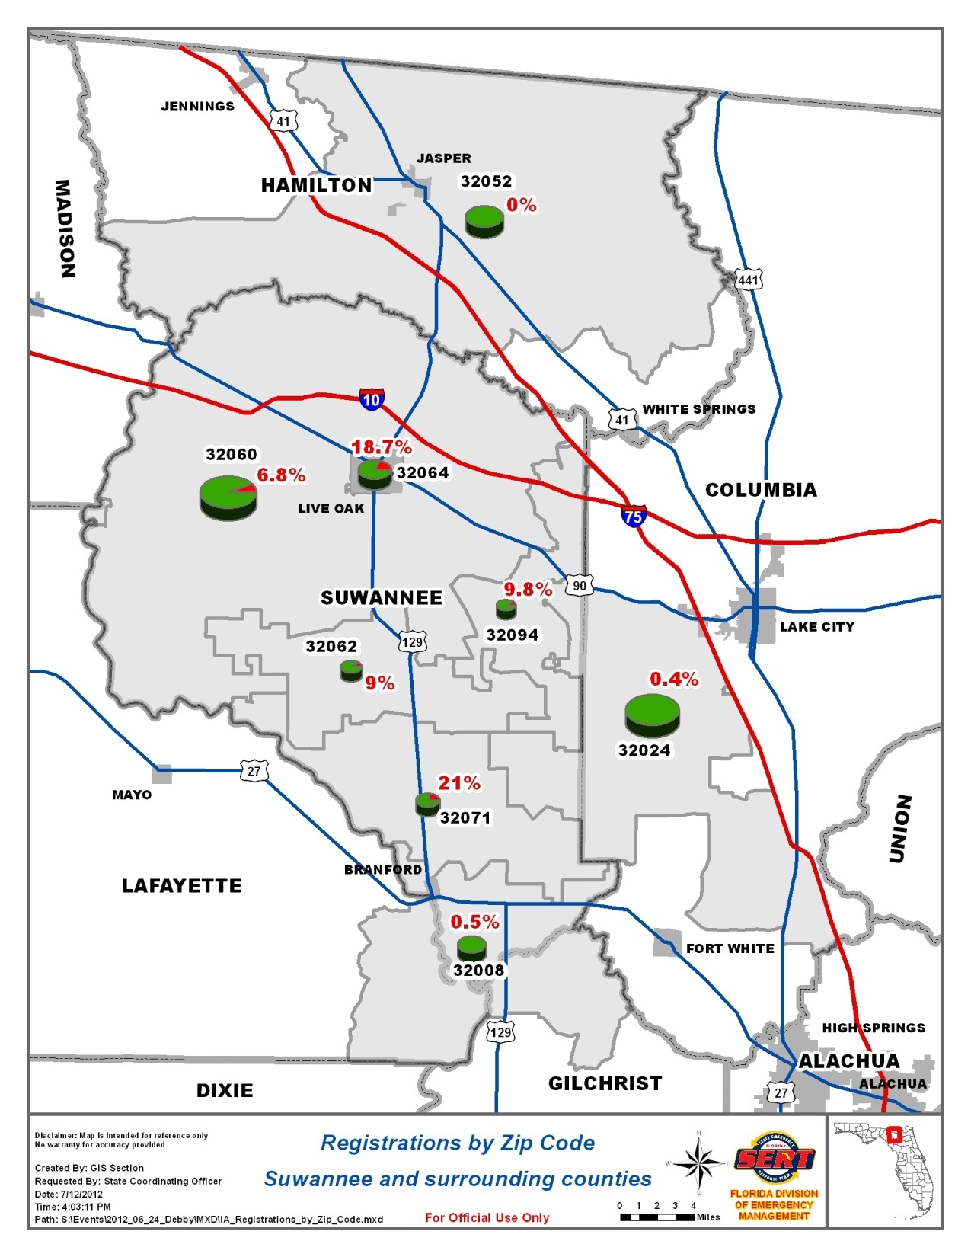
Zip Code
Not effective…
Zip codes cross jurisdictional boundaries (counties)
No contiguous
Notes:
And lastly a map of damage assessments for Clay County, Florida following flooding from Tropical Storm Debbie, where the county dispatched initial damage assessments teams and collected data at their public service answering point from calls made to 911. The data was shared with the state in a tabular format, with street addresses geocoded to Latitude/Longitude and USNG coordinates. We aggregated the points to the grid intending to aid in visualization of damage and assist in prioritizing resources. What we found, however, was also an opportunity to share data with FEMA and visualize something that had previously been doable.

Slide 43
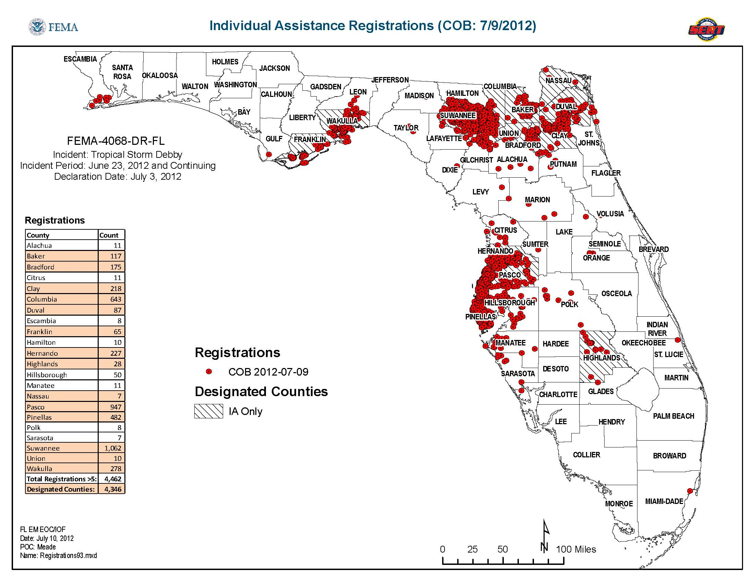
USNG – Data aggregation
Map of statewide IA applicants
Notes:
Following a disaster, a type of federal assistance is Individual Assistance – which is financial or direct assistance to individuals and families whose property has been damaged or destroyed as a result of a federally declared disaster. This data is of interest to emergency managers as it both helps establishes the extent and scale of damage as well as is very important to recovery, as it exactly pinpoints those who will need assistance the most in recovering. What’s the problem with that – FEMA can’t actually share the pinpoint data – they will give me a statewide, “dumb” PDF displaying the locations of those who have applied for this assistance via their website, 1-800 number, and in person at Disaster Recovery Centers set up after the disaster at the local level. The data is “personally identifiable information” and cannot be shared directly.

Slide 44
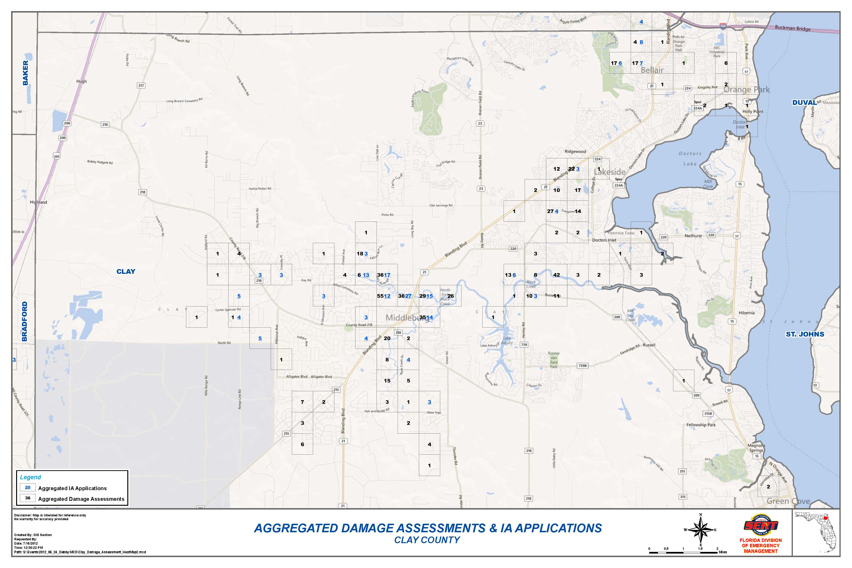
USNG – Data aggregation
Map of Clay county damage assessments and IA applications
Notes:
However, through the Geospatial Unit at a Joint Field Office, FEMA will share the total count of IA applicants per 1000 meter grid, filtered where there is 2 or more applicants per grid. The result is that emergency managers can now effectively visualize where are the areas hardest hit by this disaster, and within those areas, how many of those affected have applied to receive assistance. When those numbers are appear close to each other, are we done with the short term response? And now we can shut down the Disaster Recovery Center? Or if those numbers do not appear close to each other, is there more targeted public outreach needed? Media campaigns? Send teams door-to-door? Or are there other factors – the affected populace may not apply for federal assistance as they have high social resiliency, are well off and insured, etc…

Slide 45
USNG – Data aggregation
Map of Clay county damage assessments and IA applications
Notes:
However, through the Geospatial Unit at a Joint Field Office, FEMA will share the total count of IA applicants per 1000 meter grid, filtered where there is 2 or more applicants per grid. The result is that emergency managers can now effectively visualize where are the areas hardest hit by this disaster, and within those areas, how many of those affected have applied to receive assistance. When those numbers are appear close to each other, are we done with the short term response? And now we can shut down the Disaster Recovery Center? Or if those numbers do not appear close to each other, is there more targeted public outreach needed? Media campaigns? Send teams door-to-door? Or are there other factors – the affected populace may not apply for federal assistance as they have high social resiliency, are well off and insured, etc…

Slide 46
Conclusion
US National Grid has proven a useful tool for transforming raw data into meaningful and useful information for the Florida State Emergency Response Team
USNG is truly the language of location.

