Slide 1
E9-1-1 Consolidation & Next Generation 9-1-1
Charleston County Consolidated 9-1-1 Center
Notes:
Consolidation of E911 operations for multiple PSAPs & NextGen911
NAPSG Foundation Southeast Summit, September 13-14, 2014 Francis Marion Hotel, Charleston, South Carolina

Slide 2
Presenter – Jim Lake
Director, Charleston County Consolidated 9-1-1 Center
South Carolina 9-1-1 Advisory Committee Member
National Emergency Number Association Education Advisory Board Member
Instructor
International Academies of Emergency Dispatch
National Emergency Number Association

Slide 3
Today’s Objectives
Provide you with information about the Charleston County Consolidated 9-1-1 Center
Successes & Challenges
Integration with NG9-1-1
Geo and 9-1-1
(Lots of information in a short amount of time!)

Slide 4
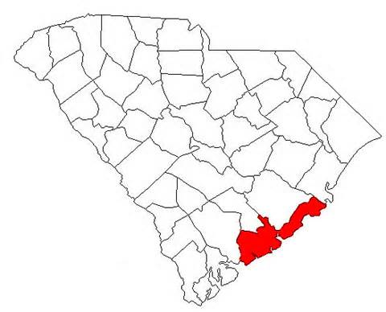
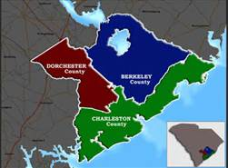
Charleston County
3 of top 5 largest cities in SC
350,000 Population
917.4 Total Square Miles
163.6 Urban
753.8 Rural
Geographic Challenges
Annexation
Bridges
Notes:
Charleston County is a diverse community because of it’s rich blend of:
Culture such as our Performing Arts Center with everything from country, rock, ballet and comedy performances
Economic activity such as Boeing,
Environmental beauty such as our beaches
History such as Downtown Charleston
Charleston is or has been a:
Top ten "most livable places" in the United States.
Top five travel cities in America
Top twenty travel cities worldwide
There is always something going on in Charleston from:
Cooper River Bridge Run
Arts Festivals
Charleston, North Charleston and Mount Pleasant are three of the top five largest cities by population in South Carolina.
Geographically our challenges are annexations which occur weekly and have no County boundaries. For example, the City of Charleston is in 2 counties and the City of North Charleston is in 3 counties.
We also have the challenge of bridges. Folly Beach has 1 way on & off, Kiawah Island has 1 way on & off, Isle of Palms has 2 ways on & off, Sullivan’s Island has 2 ways on and off, etc. All bridges are closed when sustained winds reach 40 mph.

Slide 5
CDC History
2007 Intergovernmental Agreement to consolidate all 5 Primary PSAPs, 1 Secondary PSAP and 5 ECCs in Charleston County
7 Law, 13 Fire, 1 EMS, 2 Rescue Agencies
County created a Consolidated Dispatch Board
October 2008 Hired Director (me)
January 2009 began consolidation
November 19, 2013 achieved “full consolidation”
Notes:
In 2007, after completing a Consolidation Feasibility Study conducted by Kimball Consulting, Charleston County chose to move forward with consolidation of all 9-1-1 public safety answering points (PSAPs) and emergency communications centers (ECCs).
This one consolidated PSAP would provide all call taking and dispatching for 24 agencies within Charleston County.
All personnel are County employees. The County manages the HR & Budget, a Consolidated Dispatch Board provides operational direction.
CDC Board made up of Sheriff, Police Chiefs, Fire Chiefs, EMS Director and Coast Guard.
Although the original plan was to plan the consolidation process over 3 years, the U.S. financial crisis drove government officials in Charleston County to start the process immediately so that there would be no turning back.
The consolidation project will be considered successfully completed in 2014 with the consolidation of last PSAP.

Slide 6
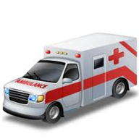
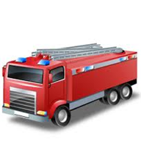
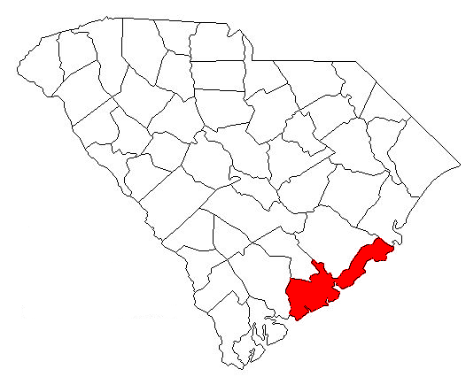
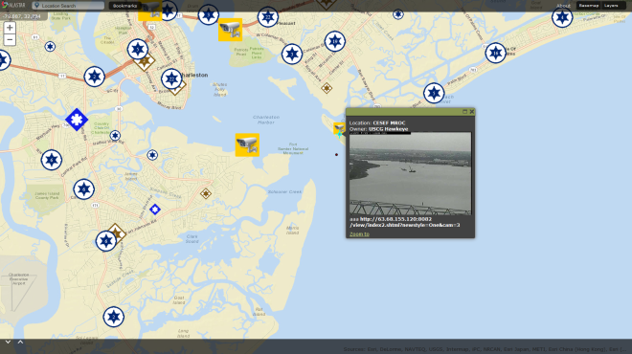
SCDNR
County
EMS
Sherriff's Office
North Charleston
Mount Pleasant
City of Charleston
Isle of Palms
Sullivan's Island
Fusion Center
EOCs
Web based
Base Mapping
Services
IP Surveillance
Camera
Public Safety Information Sharing Hub
Notes:
The Charleston County Consolidated 9-1-1 Center is an information sharing hub. We take in a large amount of data and although the Center may not use all the data we make it available to our partners.
We use the term “data” to describe:
Mobile Data Units – laptops equipped with automatic vehicle locators (AVL) in law, fire and medical vehicles so we all know where each other is
Last Know Location – for units without AVL
Fixed Cameras – over 135 cameras and increasing throughout Charleston County which overlook critical infrastructure and priority areas
School locations
Day Care locations
Medical facilities
Hydrant locations
Etc., etc., etc.
CAD is the heart of the hub
The PSAP takes in all information and then shares that information with those that need to know
Caution – beware of information overload!

Slide 7
Consolidation Partners
Law Agencies
Charleston County Sheriff's Office
City of Charleston Police Department
Isle of Palms Police Department
Mount Pleasant Police Department
North Charleston Police Department
Sullivan's Island Police Department
Fire Departments
Awendaw Fire District
Charleston County Rescue Squad
City of Charleston Fire Department
Isle of Palms Fire Department
James Island Fire District
Lincolnville Fire
Lincolnville Rescue
Mount Pleasant Fire Department
North Charleston Fire Department
St Andrews Fire District
St John's Fire District
St Paul's Fire Department
Sullivan's Island Fire Department
Medical Services
Charleston County EMS
Emergency Management
Charleston County Emergency Management
Notes:
These are the “Consolidation Partners”. Those that have chosen to have their 9-1-1 calls answered and dispatched through the Consolidated 9-1-1 Center. Although Folly Beach is not on this list, we do answer their 9-1-1 calls, transfer those to their dispatch center and assist when they need us.

Slide 8
Other Partners
College of Charleston Public Safety
Charleston County Parks & Recreation Commission
State Law Enforcement Division
Department of Natural Resources
United States Coast Guard
Department of Homeland Security Seahawk Interagency Operations Center
Joint Base Charleston
Notes:
We also have other partners that we work closely with and share information on a regular basis. Our current major project is with Joint Base Charleston. This primarily Air Force/Navy Base has their own 9-1-1 center. We are working with them to share our technology, information and provide additional services for them.

Slide 9
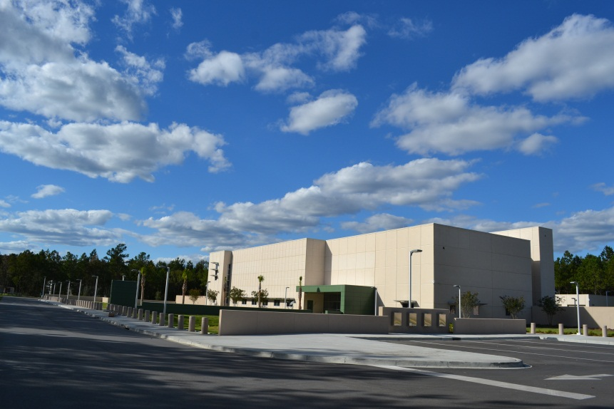
Outside the Center
Notes:
This image is a view of the Charleston County Consolidated 9-1-1 Center and Emergency Operations Center. As it’s name implies, the building houses the 9-1-1 Center and the EOC.
This 38,000 square foot building is 49 feet above sea level and designed to withstand winds of 191 mph. At a cost of $27 million, this facility is LEED Gold Certified for environmental efficiency and has diverse and redundant infrastructure to increase the likelihood of survivability during a natural or manmade disaster.
The building is also home to the County’s Backup Data Center storing vital County records and has a Sensitive Compartmented Information Facility (SCIF). Essentially a SCIF, when certified by DHS, FBI or some other Federal Agency, provides a location where sensitive information can be exchanged with the appropriate parties. The SCIF also serves as a backup communications center for the U.S. Coast Guard should they need to evacuate their Center.

Slide 10
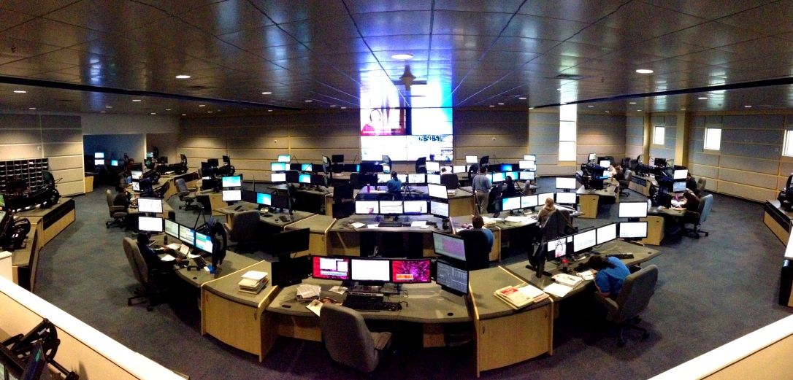
Inside the Center
Notes:
This image shows a panoramic view of the 9-1-1 Communications Center floor. The 36 console positions support law, fire and EMS dispatch as well as 9-1-1 call taking. Our department has 132 Call Taker, Dispatcher & Supervisor positions to handle the workload. We have 28 Support, IT, Administrative and Manager positions to maintain the support and technology for the Center.
We manage all of this with a $12 million Operating Budget comprised of general funds from taxes and 9-1-1 surcharge fees.

Slide 11
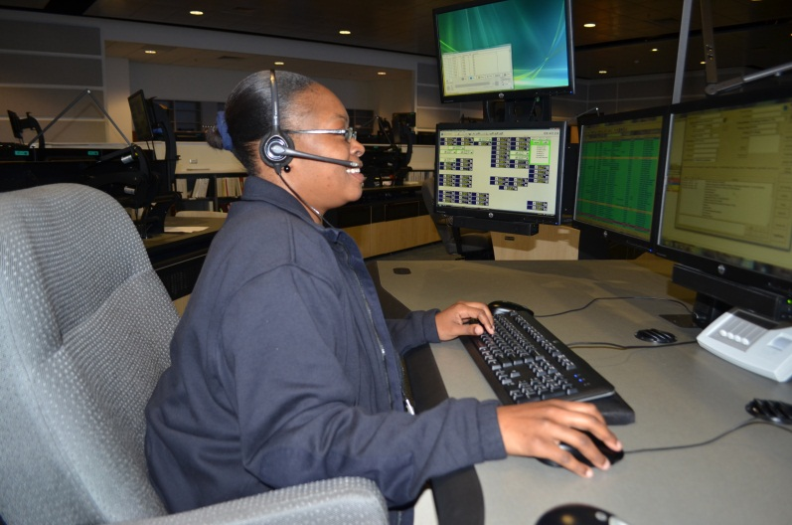
“We handle big city crime in a small city setting,” Charleston County Consolidated 9-1-1 Center Deputy Director Allyson Burrell.
1.2 million inbound & outbound phone calls
Notes:
Our workload consists of 1.2 million inbound and outbound calls annually or 3,500 phone calls per day.
Approximately 1,000 of those 3,500 calls will be on a 9-1-1 line while the others are on seven-digit inbound and outbound lines.
Of those 1.2 million calls comes 620,000 law, fire & medical incidents annually. As an example, we may receive 20 calls about the traffic accident on the highway but it is only one incident.

Slide 12
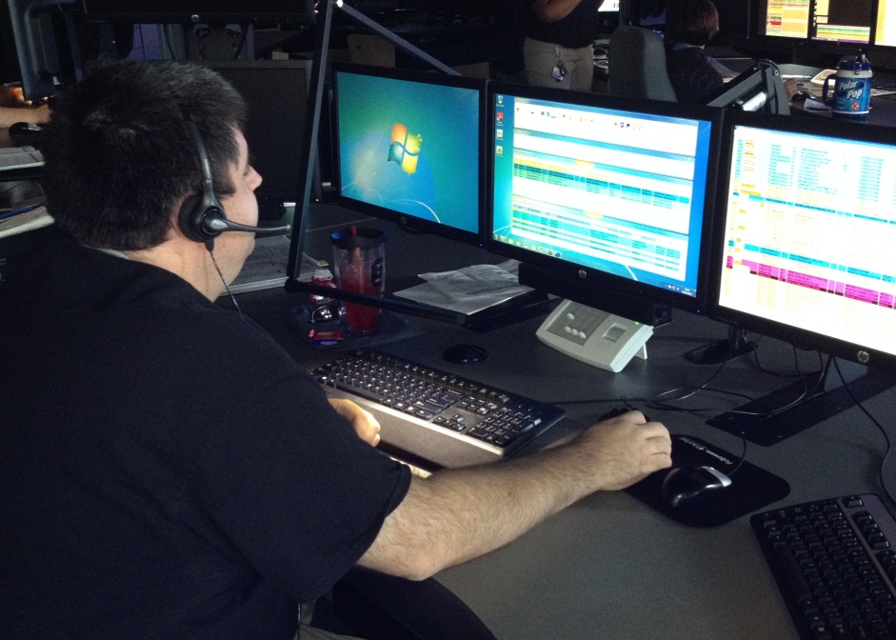
Human Resources
Finding the right person to do the job
Fast/Slow paced
Multi-tasking
Stress
Local Area Knowledge & Geography

Slide 13
Technology
Cell phones account for 81% of all our 9-1-1 calls
Cell phones do not provide an exact location
We rely on Wireless Phase II info that is not always accurate
Phase II = latitude & longitude
This is where our GIS journey begins!

Slide 14
Consolidation
Successes
Challenges
Reduced response times
Information sharing
Inter-agency cooperation
Automatic Aid
Technology advancements
Higher quality of service
Accountability
Local area knowledge
Human Resources
Not enough
Stress

Slide 15
National Emergency Number Association Next Generation 9-1-1 Definition
NG9-1-1 is an Internet Protocol (IP) based system comprised of:
Managed Emergency Services IP networks (ESInets),
Functional elements (applications),
Databases that replicate traditional E9-1-1 features and functions and provides additional capabilities
NG9-1-1 is designed to provide access to emergency services from all connected communications sources, and provide multimedia data capabilities for Public Safety Answering Points (PSAPs) and other emergency service organizations.

Slide 16
Jim’s Expanded Version of the NG9-1-1 Definition
Systems that use IP technology to:
- Enable information sharing
Enhance situational awareness
Provide information to public safety responders

Slide 17
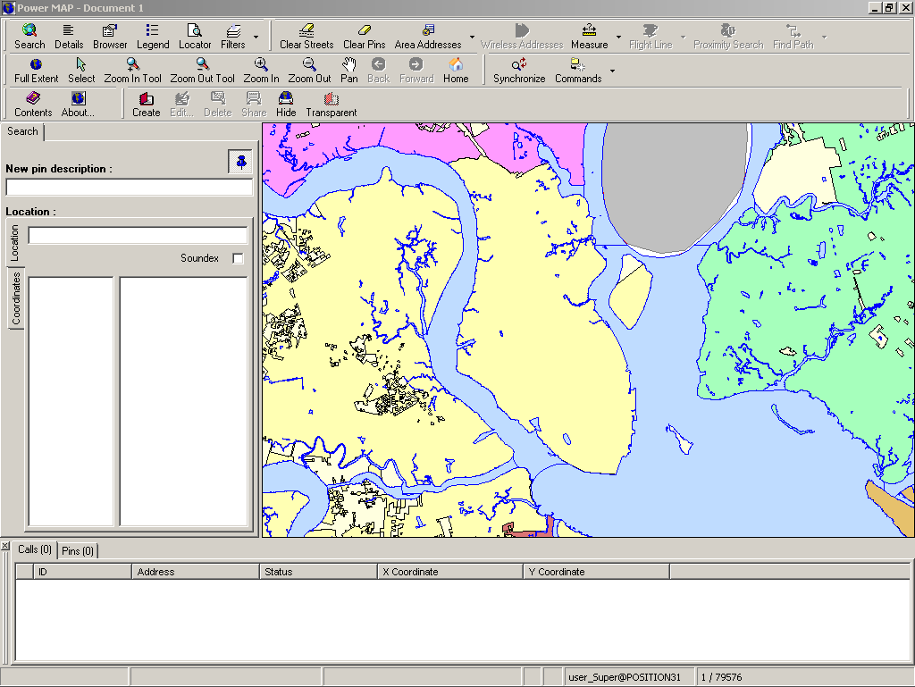
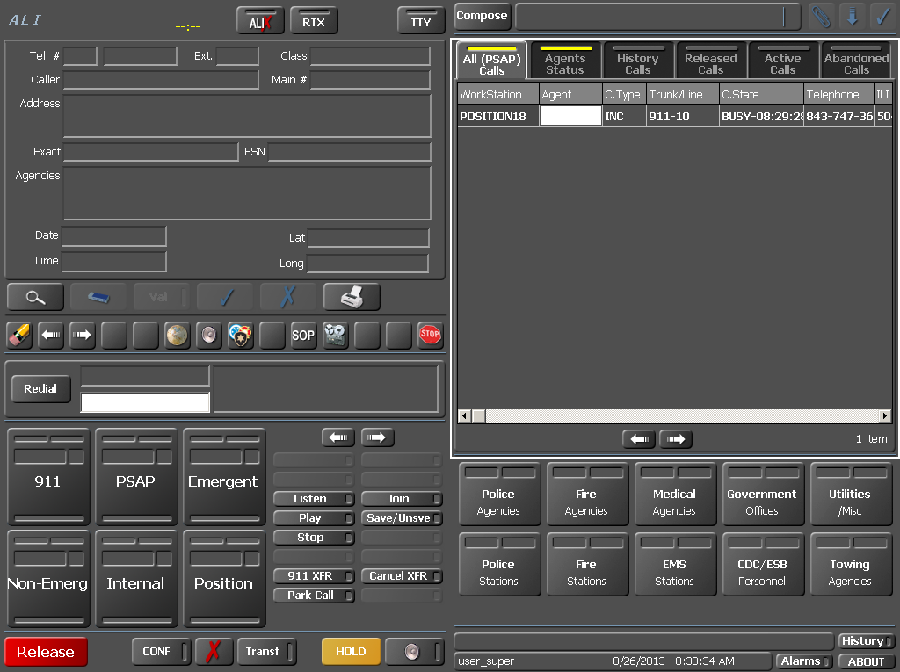
Intrado Viper 9-1-1 Telephony (IP)
The CDC has an NG 9-1-1 capable telephone system
Intrado Viper equipment capable of receiving voice, text and video from callers
Our incoming lines are IP and analog to ensure redundancy

Slide 18
Motorola Radio
Charleston County Radio Network
P25 compliant
Digital 800 mhz trunked radio system
Used by all public safety agencies in Charleston County as their primary
Palmetto 800 (aka Pal800) System
Statewide
Moving toward P25 compliancy

Slide 19
TriTech Computer Aided Dispatch (CAD)
Unit tracking
Incident tracking
Geographic position of units and incidents
Response recommendations based on incident type, location, capabilities and sharing
Caution Notes

Slide 20
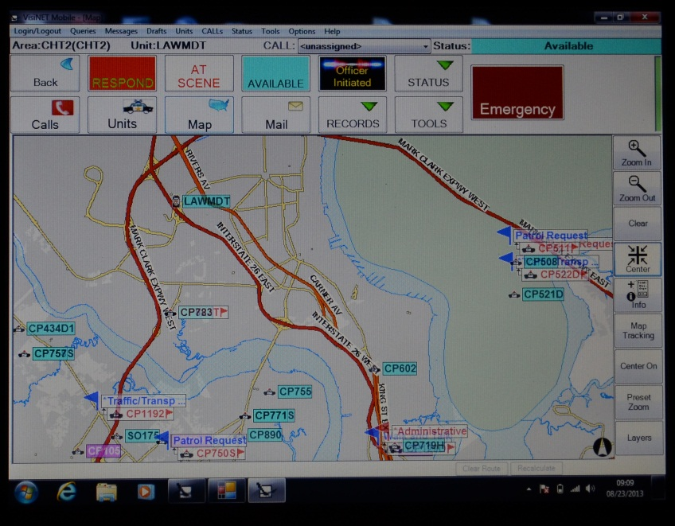
TriTech Mobile Data (MDT) & Automatic Vehicle Location (AVL)
Over 500 MDTs being used in Charleston County by Law, Fire, Rescue and EMS officials
MDTs provide the “quickest path” to the call based on geography, speed limits and other factors
AVL allows us to see the location of resources in order to send the closest
They can see each other

Slide 21
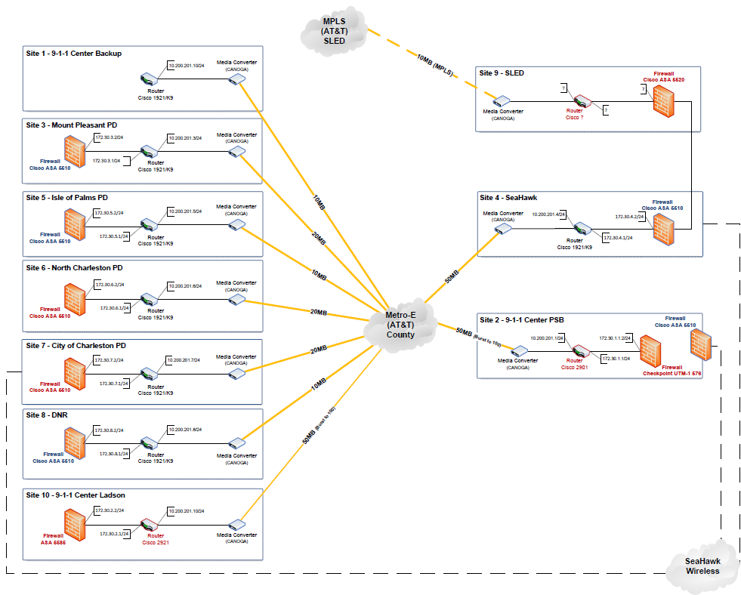
AT&T Metro E Network
Voice & Data Network Between Member Agencies
CAD data
RMS data
Station Alerting
Alastar
Etc.

Slide 22
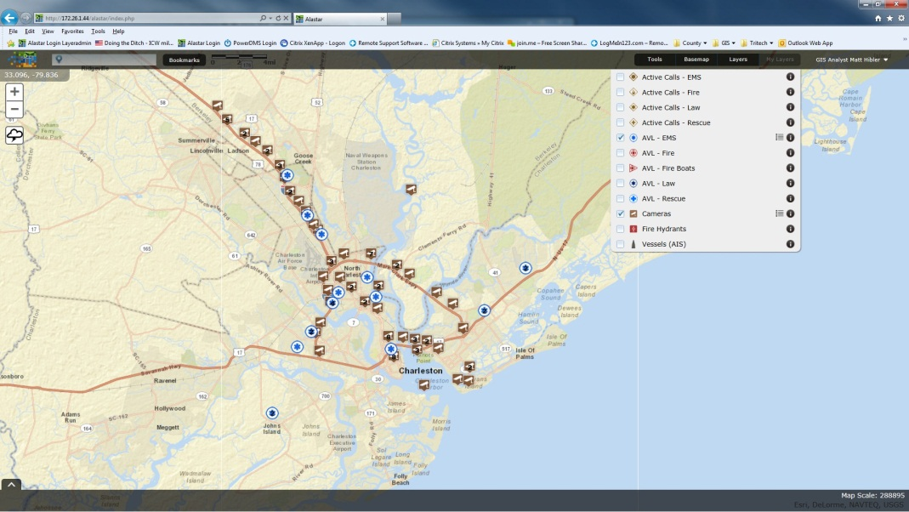
SCRA Alastar
Multiple database sources to provide situational awareness and information sharing view in GIS layers
Notes:
Floor Plans
Fire Control Panels
Ingress, Egress, Stairwells
Fire Code Inspections
Past historical data (law and fire)
Building Inspections
Hazardous Materials
Sensor Locations and Data
Historical Data
Surveillance Camera Locations
Campus / Facilities Layouts

Slide 23
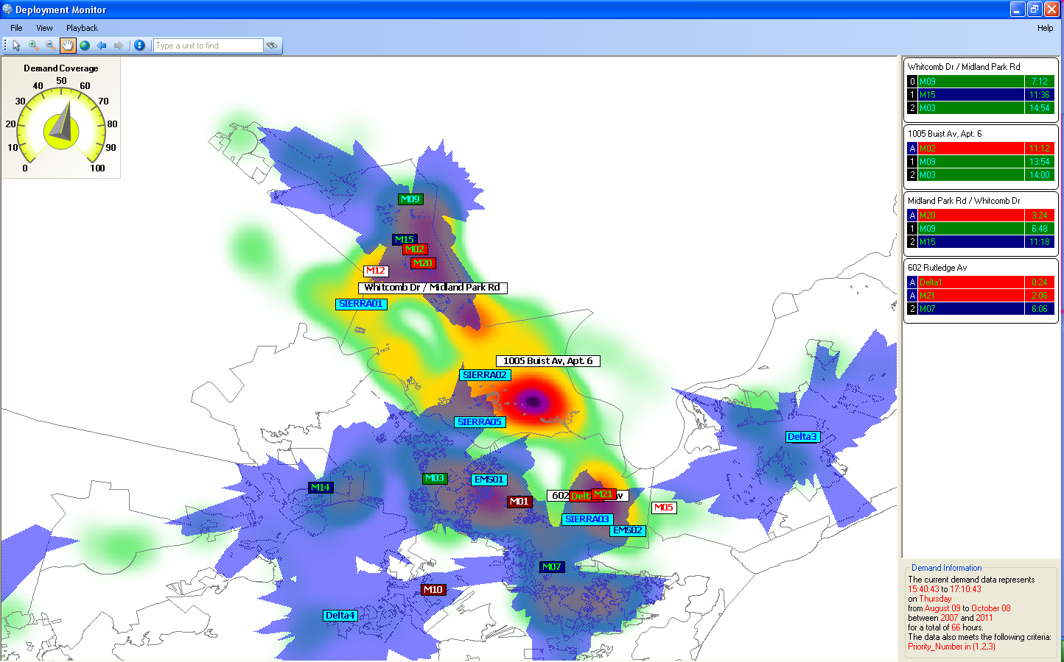
Marvlis by BCS
GIS based tool
Predicts where the next call will occur based on historical data
Provides recommendations for deployment of resources for optimum coverage

Slide 24
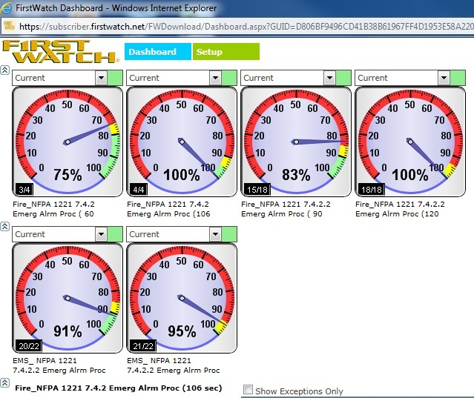
FirstWatch
Data analysis tool used for:
Performance Monitoring and Operational Reporting
Situational Awareness and Data Visualization Intelligence
Early Event Detection and Syndromic Surveillance
Geo-Fences set up for Marine Units and Crime Intelligence Analysts

Slide 25
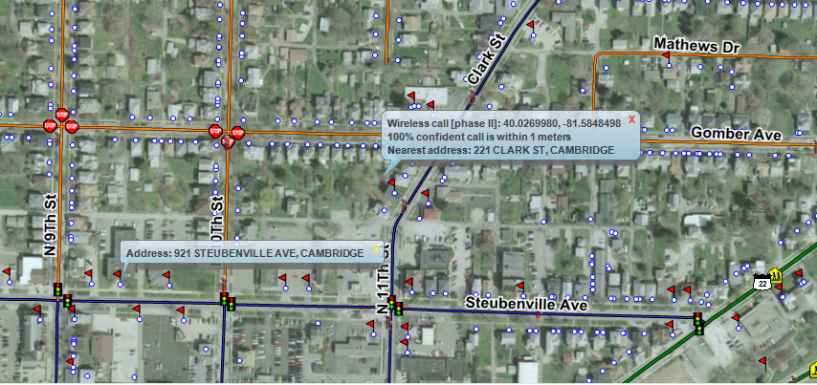
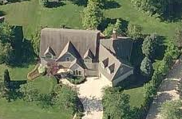
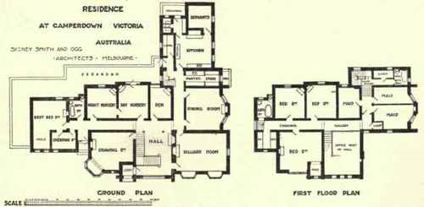
NG9-1-1 and GIS
GIS becomes one of the central data stores in NG9-1-1
GIS is fully integrated into NG9-1-1
GIS will be fully integrated into Call Taking, CAD, Emergency Services, Dispatch and Response
Locations Validated with Local GIS Data
Responders (any number of them) have service boundaries as polygons with associated contact data

Slide 26
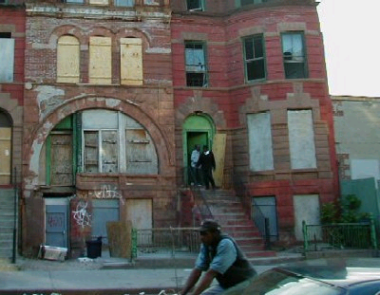
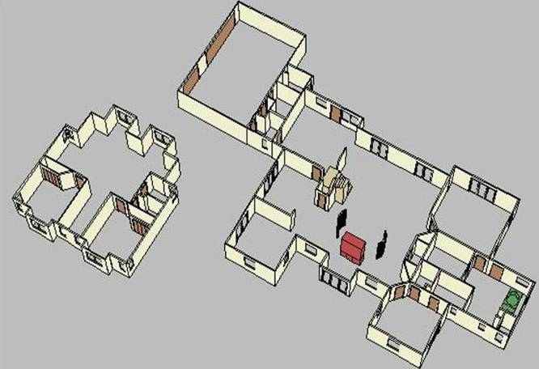
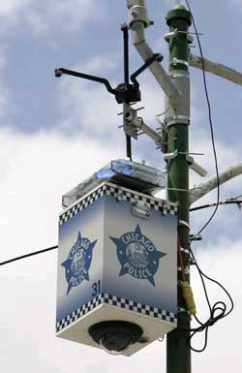
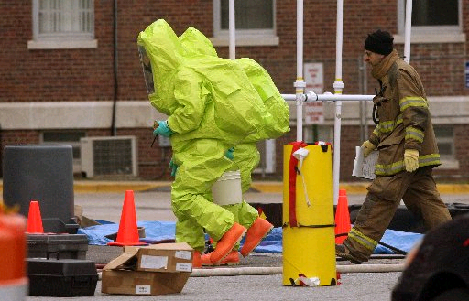
NG9-1-1 and GIS
Support data associated with the caller location
Floor Plans
Fire Control Panels
Ingress, Egress, Stairwells
Fire Code Inspections
Past historical data (law and fire)
Building Inspections
Hazardous Materials
Sensor Locations and Data
Historical Data
Surveillance Camera Locations
Campus / Facilities Layouts

Slide 27
ESInet Emergency Services IP network
An ESInet can service many PSAPs and allow for sharing of cost and resources
ESInets connect together, allowing sharing of data and information across a state or nation (network of networks)
ESInet
ESInet
ESInet

Slide 28
What are we working on right now?
ESInet
Geographically Diverse 9-1-1 Backup Center
Coop Backup
CAD to CAD
Automatic Video Identification (AVI)
Notes:
ESInet
Using an AT&T IP enabled infrastructure we will be moving forward next year with an Emergency Services IP network (ESInet) and transitioning off of our old legacy telephone network.
AT&T is shutting down the old telephone network and hopes to be transitioned away from that equipment by 2019
Geographically Diversity for our 9-1-1 Center Backup
We are working with Spartanburg, SC to answer our calls and dispatcher our responders in the event that we cannot do so
Four hours away in the “upstate”, Spartanburg should not feel our hurricane and we would not be affected by their tornado
Continuity Of Operations Plan (COOP)
Again, thinking geographically diverse, we are working with a large agency in North Carolina to provide a long term COOP location should we not be able to operate in Charleston
CAD to CAD
We are working with a vendor to develop a CAD to CAD solution for us.
Basically, I own CAD Brand A and Summerville owns CAD Brand B
We will create an interface between the two that will allow us to exchange information and dispatch units from each other’s jurisdiction
Automatic Video Identification (AVI)
I receive a 9-1-1 call into my Center and the system gives me a pop-up box with my closest cameras and hyperlinks to view those cameras
Dispatchers do not have to search to see what cameras are available

Slide 29
How does it all tie together? GIS data fully integrated and available immediately to those that need it!

Slide 30
Questions???
Jim Lake Office: 843-529-3700 Email: jlake@charlestoncounty.org

