Slide 1

SE Summit

Slide 2
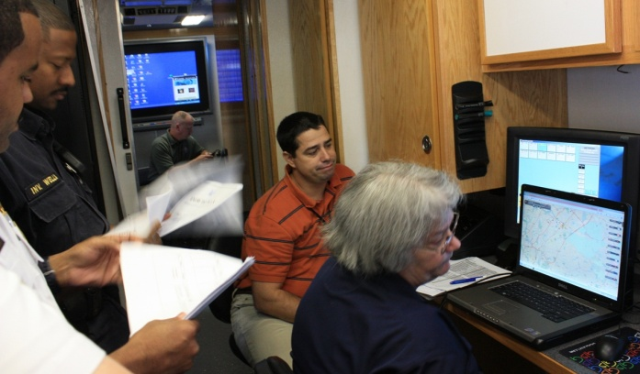
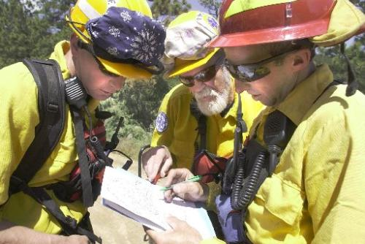

Operationalizing the United States National Grid
National Alliance for Public Safety GIS Foundation
Rand Napoli, Chairman
USNG 17R MP 56463 49541
September 13, 2014

Slide 3
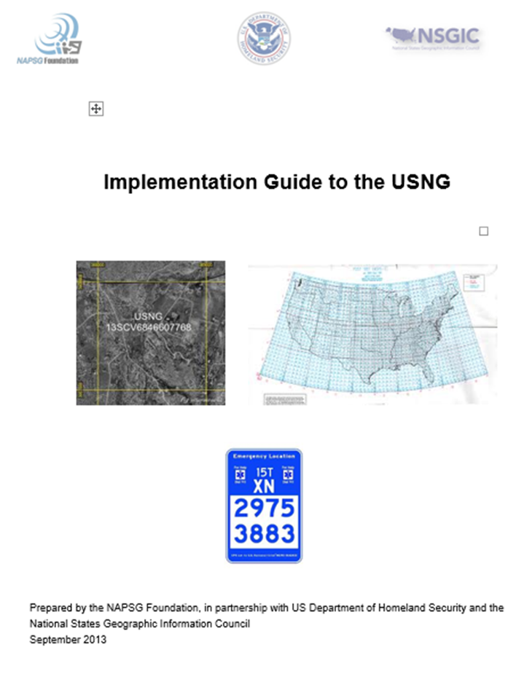
NAPSG GUIDE
Implementation Guide to the
United States National Grid

Slide 4
NAPSG USNG Implementation Guide
Workgroup Established To:
Conduct outreach focused on increasing the awareness and implementation of the USNG as an emergency response capability for field-based situational awareness and in the geospatial operating environment.
Guide is supportive of the priorities of the GeoCONOPS and other relevant templates & tools.
Notes:
1. Conduct a broad outreach effort focused on substantially increasing the awareness and implementation of the US National Grid as an emergency response capability for field-based situational awareness and in the geospatial operating environment.
a. Identify and reach out to key partners using or potentially influencing the use of USNG
b. Involve these partners in the overall process and develop a strategy to enlist their aid in implementing use of the USNG
c. Provide access to virtual training to these groups and their members

Slide 5
NAPSG USNG Implementation Guide
Workgroup Developed the Guide To:
Provide tools for effective adoption and implementation of the USNG.
The audiences includes:
Local, state, tribal & federal decision makers; emergency management and incident commanders; and geospatial practitioners & responders.
Notes:
Develop a USNG Implementation Guidance.
a. The USNG Implementation Guidance shall be broken down for three distinct audiences and provide each of them with the unique tools for effective adoption and implementation. The audiences include: state & local decision makers; emergency management and incident commanders; and geospatial practitioners & responders.
b. Post the USNG Implementation Guide free download and coordinate with appropriate third party industry partners to disseminate the Guide widely throughout the public safety community.

Slide 6
NAPSG USNG Implementation Guide
Content:
  USNG Overview
  USNG Basics
  USNG Benefits
  Implementation Guidance
  Governance
  SOP
  Training
  Maps
  Technology
  Reference Links
Notes:
Major Milestones
1. Outreach to other groups focused on USNG November 2012
2. Initial draft of USNG Implementation Guide February 2013
3. Final draft of the USNG Implementation Guide May 2013
4. Conduct virtual training session June 2013

Slide 7
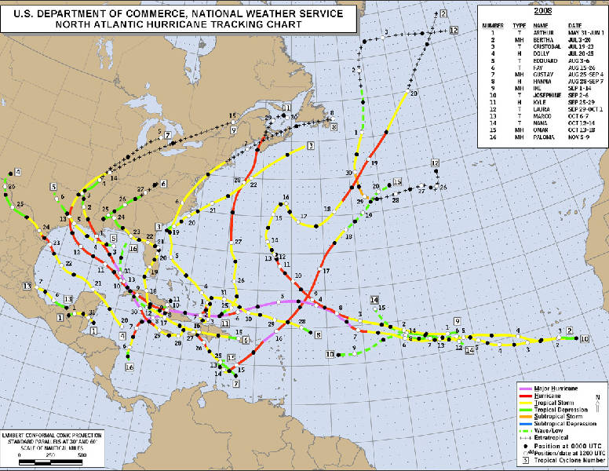

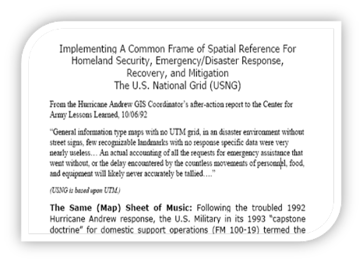
Recurring Theme
Nearly every after action report, post any large scale or regional disaster clearly indicates the need for a common grid
International Mutual Aid
Haiti
Japan
Overview
Notes:
Recommendation 51:
The plan should also provide for a unified communications network, a common grid-reference system, and standardized procedures and methods for utilizing and sharing local situational awareness acquired by search and rescue operational units.
7

Slide 8
Why Use the USNG?
The USNG provides:
  a UNIFIED language to reference points and areas
  ACTIONABLE location information in a UNIFORM format
  CONSISTENT Situational Awareness across jurisdictions, disciplines & all levels of government
The USNG facilitates:
  PrePlanning & analysis of well-defined areas of interest
  PreScripted Mission Development
  Integration of resources and unity of effort

Slide 9
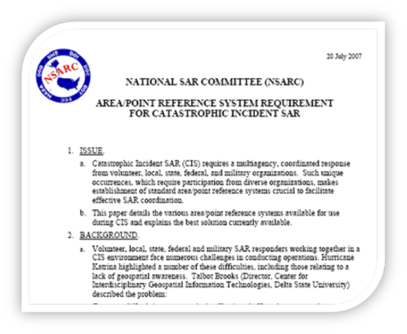
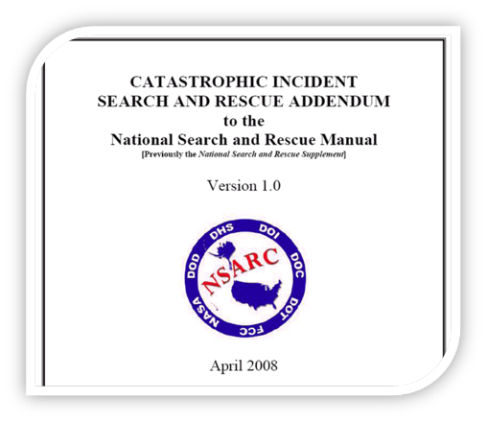
Who is Using the USNG
The Federal Emergency Management Agency (FEMA)
National Search and Rescue Teams
FDEM
States & Locals
Department of Defense

Slide 10
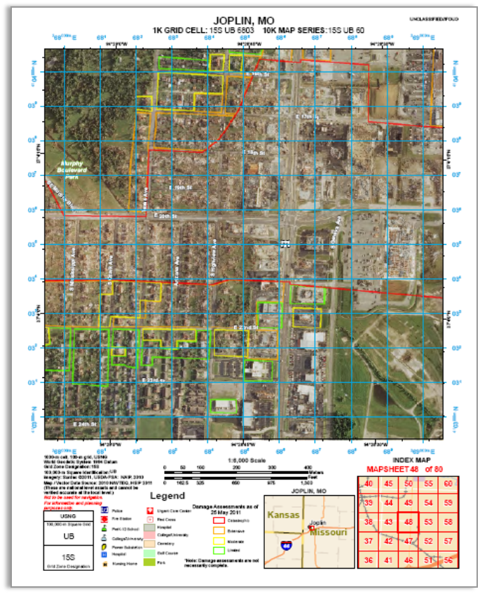

Joplin, MO

Slide 11
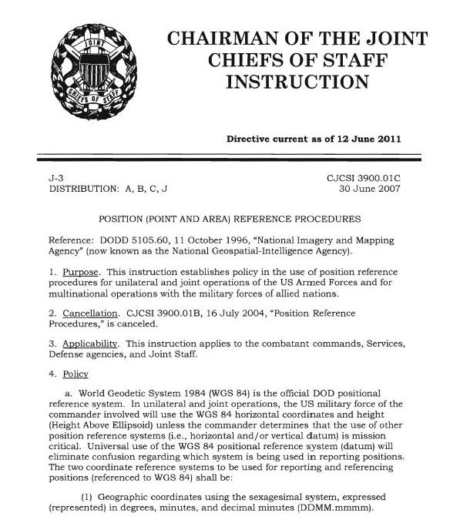
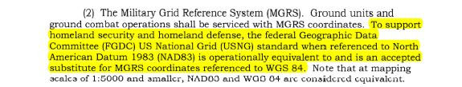
Who is Using the USNG

Slide 12
Who is Using the USNG

Slide 13
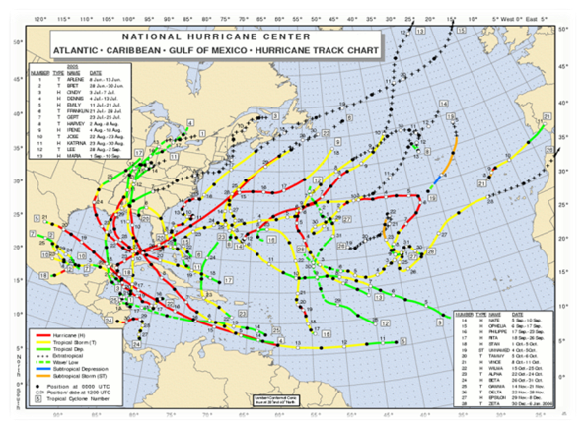
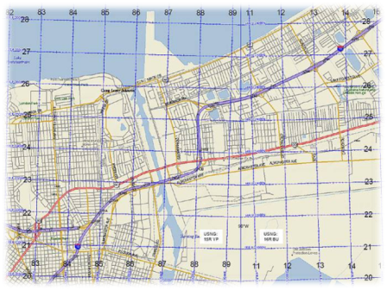
Common Grid – Unified Response
Notes:
13

Slide 14
Common Location Language
Both a point and AREA grid reference system
Uniform location language regardless of
  Jurisdiction
  Discipline
  Hazard
Notes:
14

Slide 15
Operationalizing
Mission-based Required Resource Planning
Pre-scripted Mission Development
Command and Coordination
  Common Operational Picture
  Resource Adjudication
  Resource demobilization, re-assignment, or return to service

Slide 16
USNG: Operational Areas
Catastrophic Planning & Response
The scalable nature of the grid also allows for defining levels of operation such as strategic, regional and tactical.
Strategic – 100,000m grid cells (~62 miles)
Regional – 10,000m grid cells (~6.2 miles)
Tactical – 1,000m grid (~.62miles)
Notes:
16

Slide 17
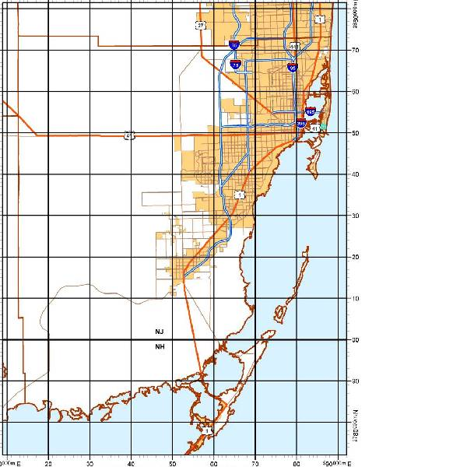
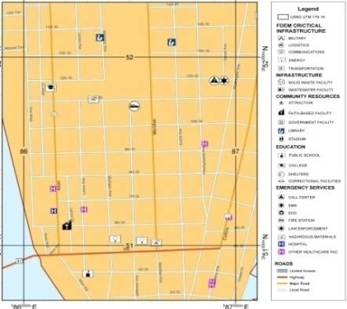
USNG-based Pre-Scripted Missions
1,000 M GRID
10,000 m Grid
100,000 m Grid
Notes:
17

Slide 18
Pre-Scripted Missions
Identify potential missions within an area of operations (assigned grid cell)
  Demographics, infrastructure, hazards
  Multi-disciplinary missions
Establish resource requirements
  Based on scenario based planning
  Based on pre-event forecasts
  Revise based on post event damage intelligence
Facilitates pre-arrival planning by command and staged or deployed resources

Slide 19
Pre-Scripted Mission: Data Analysis
Goal: Determine mission based required resources and pre-script missions based on USNG analysis
Overlay basic data layers with USNG
  Demographic data
  Critical Infrastructure Datasets

Slide 20
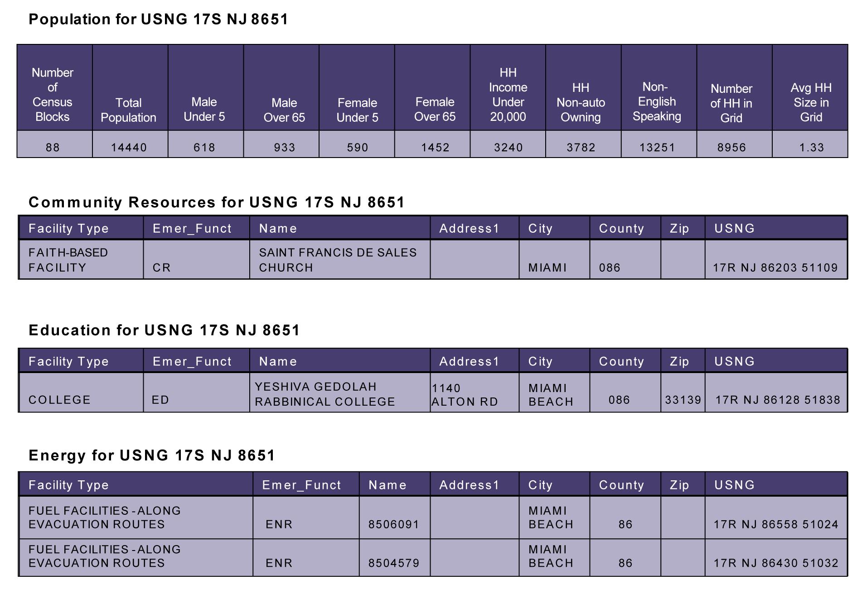
Demographics
Pre-Scripted Mission Planning

Slide 21
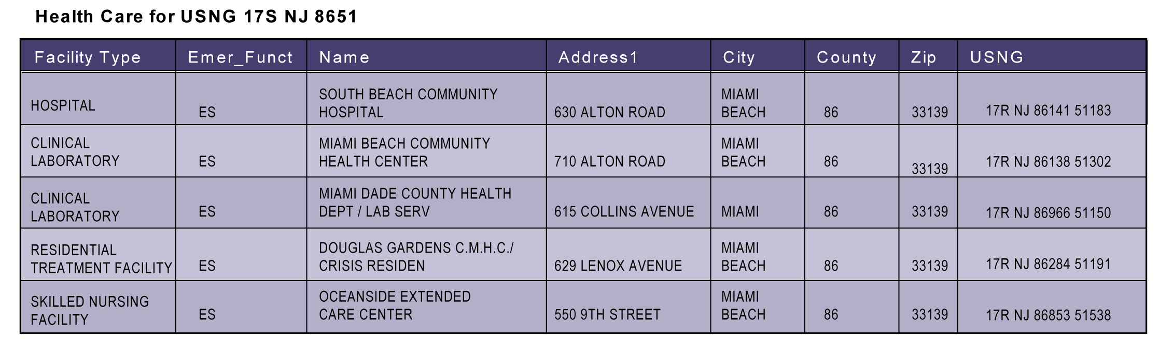
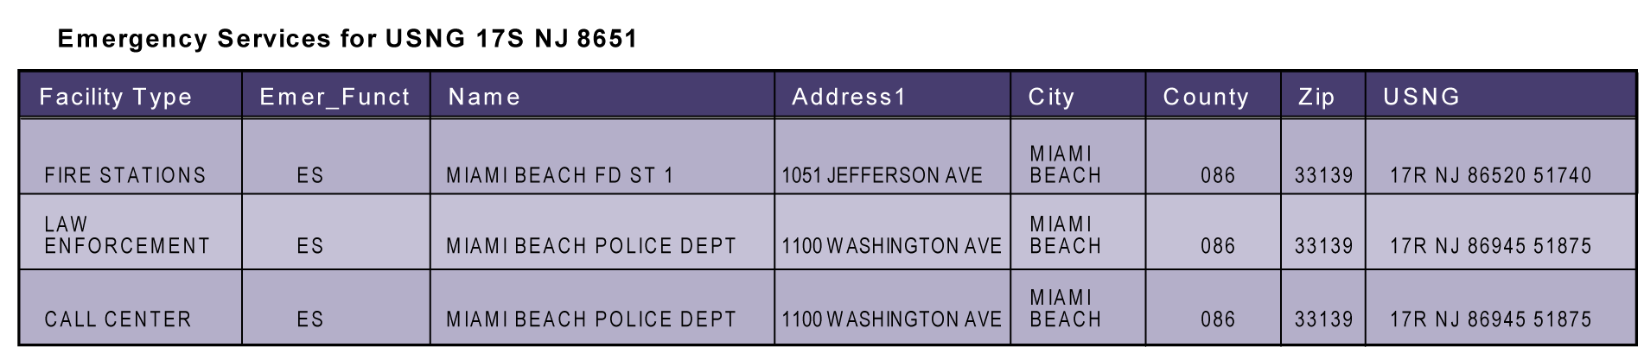
Critical Facilities
Pre-Scripted Mission Planning

Slide 22
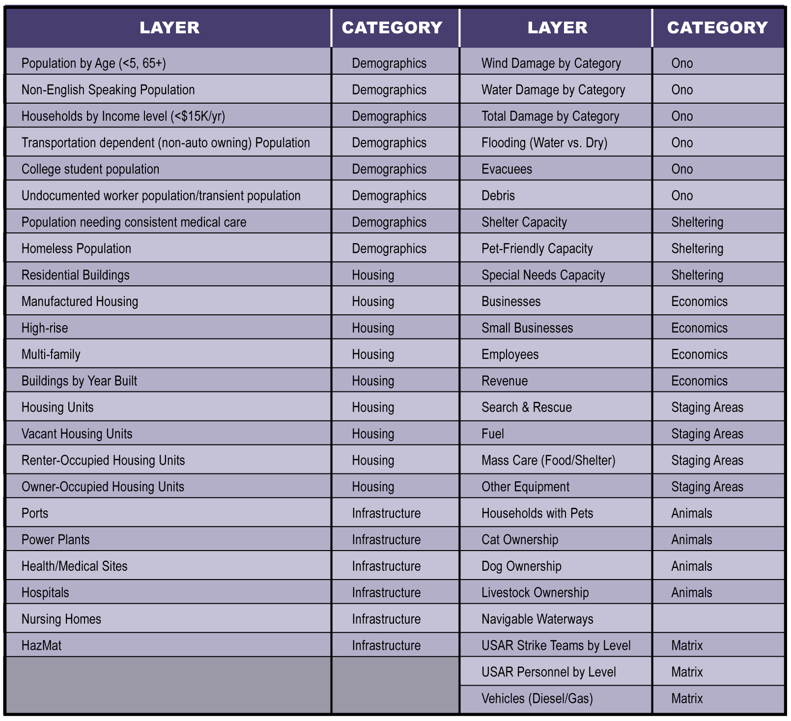
Data Layers
Pre-Scripted Mission Planning

Slide 23
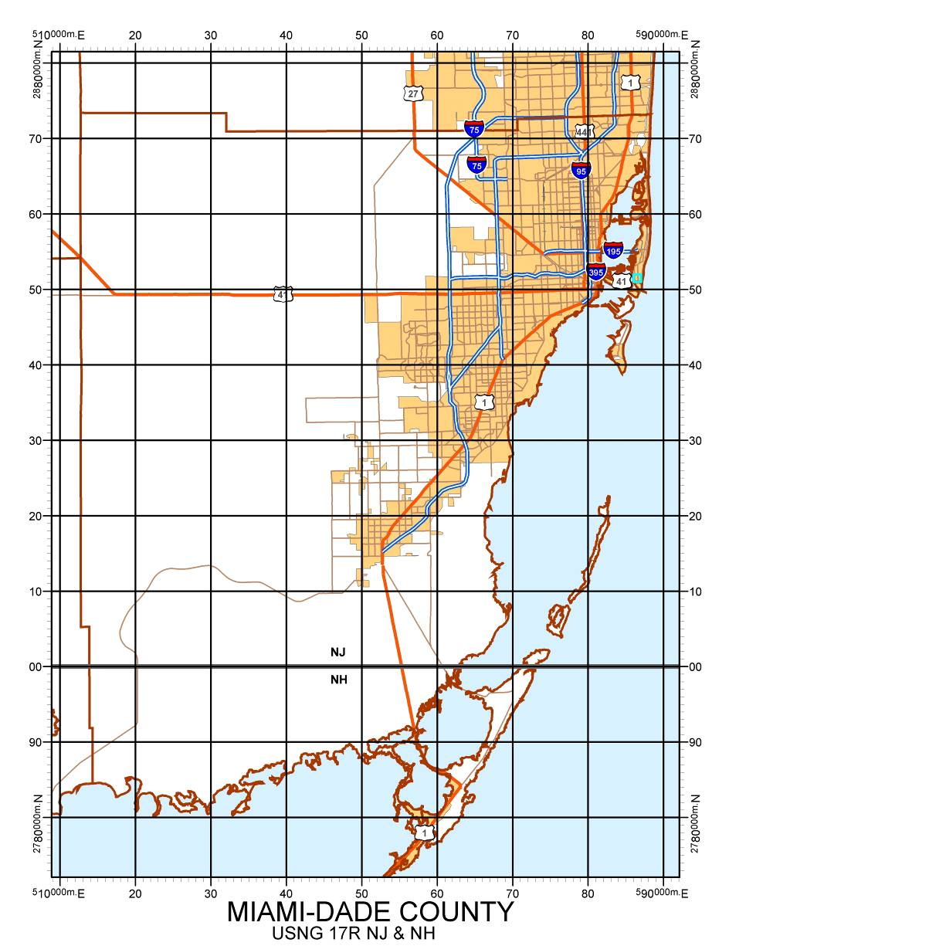
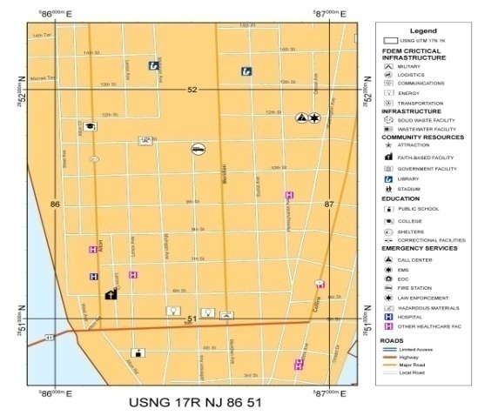
1,000 m grid square in Miami-Dade County
1,000 M GRID
10,000 m Grid
100,000 m Grid

Slide 24
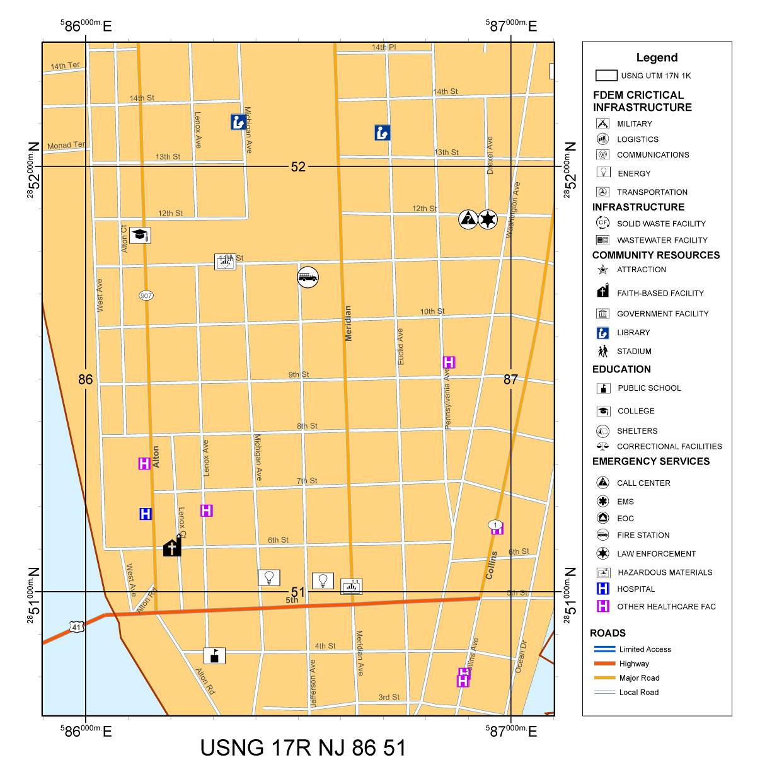
USNG: 1,000m Grid Example
Notes:
Map of USNG Grid 17S NJ 8651

Slide 25
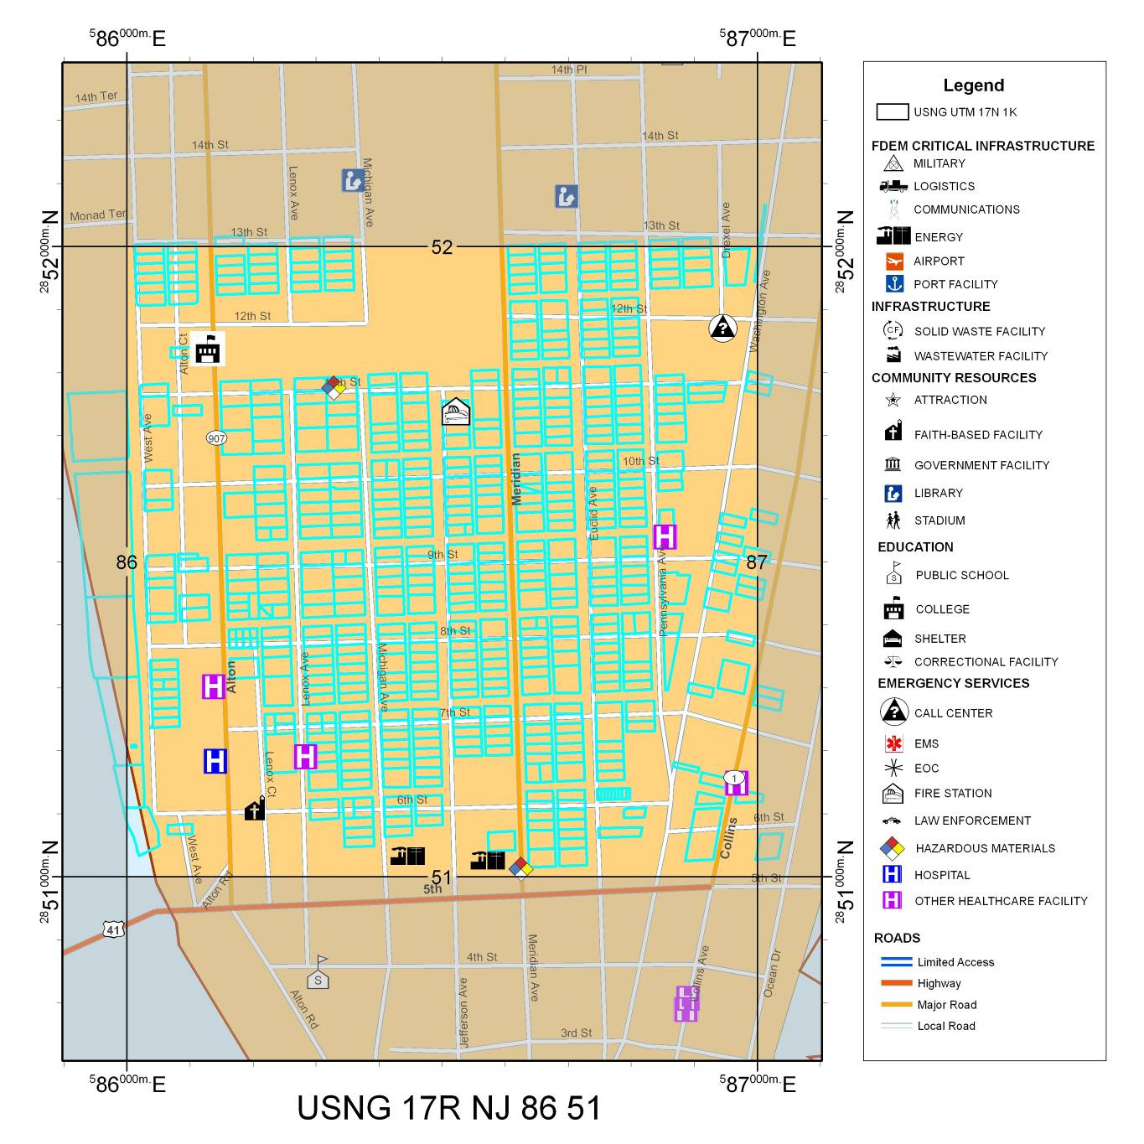
USNG: Parcel Analysis
1,000 m grid square overlaid with selected features

Slide 26
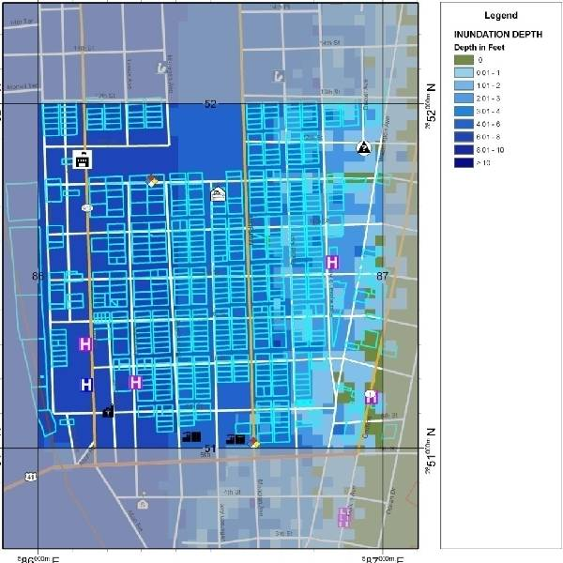
USNG: Flood Analysis
17S NJ 8651 with Storm Surge Inundation Depths

Slide 27
More Information
www.fgdc.gov/usng
http://data.geocomm.com/
http://mississippi.deltastate.edu/
http://napsgfoundation.org/resources
Notes:
27

Slide 28
Thank You!
Rand Napoli
Tel. 904.290.1006
USNG 17R MP 56463 49541
rnapoli@publicsafetygis.org
www.napsgfoundation.org

