Slide 1
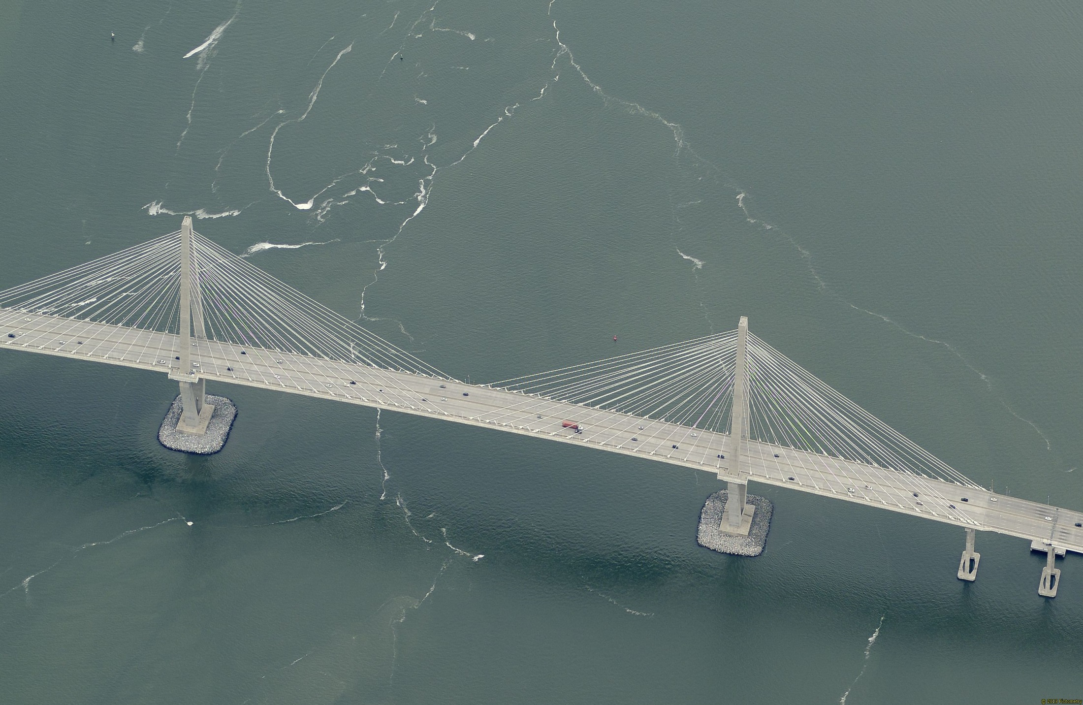
GIS & Emergency Management
City of Charleston, South Carolina

Slide 2
Introduction and why us?
Mark Wilbert
Emergency Manager
Brian Pokrant
City GIS Analyst
Why Us and Why Now?
The rest of the story
Focus is on prevention and future
Partnership of expertise

Slide 3
Timing is Everything
Recent full time emergency manager-2013
New GIS centric City Management System integrating key processes -2015
GIS Strategic Plan-2014
New Municipal Emergency Operations Center - 2015
2010 Hazus Census data – November 2014
Hazus Certified GIS Staff

Slide 4
EM Challenges in Charleston
Earthquakes
Floods
Hurricanes
Changes in Weather Behavior
Population Growth
Tourism
Vulnerable Populations
Surrounded by Water

Slide 5
The Halsey Map – High Water Line 1680 to 1860

Slide 6
Earthquake of 1886
Other Charleston Earthquakes
April 1907
September 1914
November 1952
August 1959
March 1960
July 1960
October 1967

Slide 7
Earthquakes 1660-1986 (NEIC)
1886 quake caused $120-200 million damage in 2014 dollars
Similar quake today many more lives lost

Slide 8
Hurricane Isaac – 2012 Flood

Slide 9
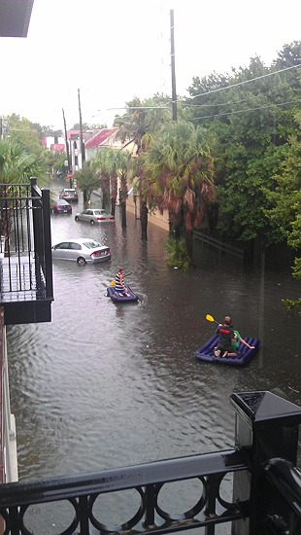
Flood of 2012

Slide 10
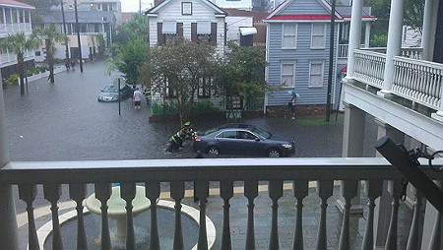
Flood of 2012

Slide 11
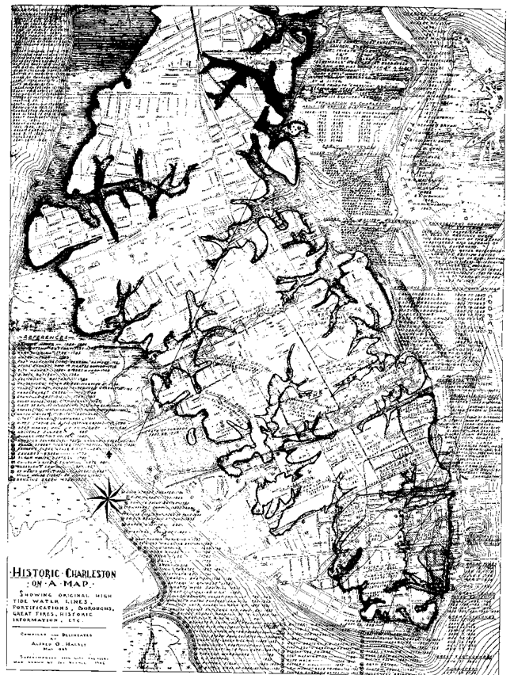
Halsey Map with 2012 Flood Image Locations
The Crosstown
(US 17)
City Market
Morris Street

Slide 12
Hurricanes that have caused major flooding
1686, 1713, 1728, 1752, 1783, 1787, 1804, 1813, 1822, 1854, 1885, 1893, 1911, 1940, 1959, Agnes (1972), Hugo (1989)
1893 and 1940 produced 8.9-9’ surge levels
Hugo produced a storm surge of 16-17’ in McClellanville
Hugo ranks 8th in terms of estimated damage by Hurricanes in the US at $7 billion dollars

Slide 13
Hugo
“Had the eye passed even 20 miles to the south, much of the Battery district of Charleston would have been overrun with water.” (weather.com)

Slide 14
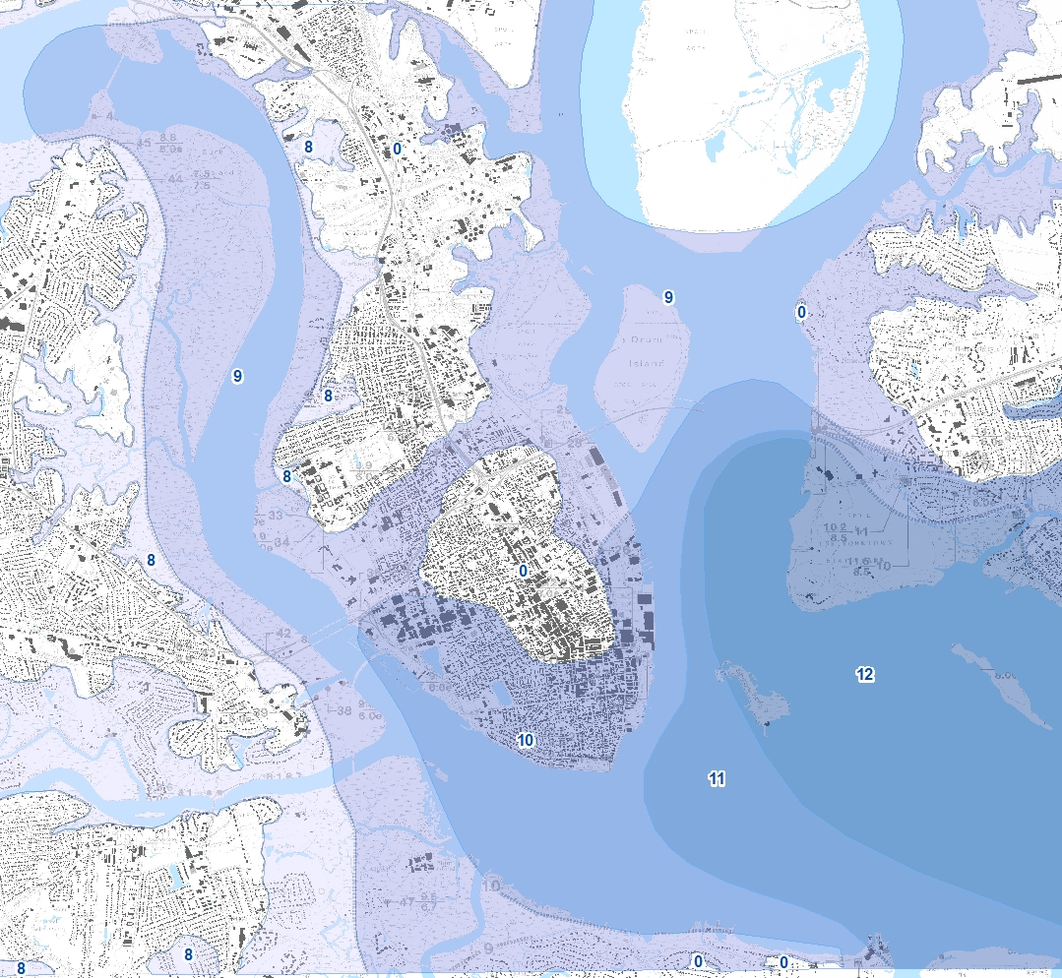
Storm Surge Map of Hugo

Slide 15
Weather Behavior, Population and Tourism
1-2 hr rainfall as important as 24 hr!
Cannot build ourselves out of this
Sea level rise in Charleston will exasperate
More frequent shallow flooding
Storm inundation will be worse given same storm scenarios
Today’s rain events are tomorrow’s emergency events
Research and modeling of some locations throughout the US are indicating that in 50 years, a 100 year flood event could be today’s 500 year event

Slide 16
NOAA Sea Level Rise Map

Slide 17
100 Year Flood Depth Grid

Slide 18
500 Year Flood Depth Grid

Slide 19
Emergency Management Cycle
Preparedness
Mitigation
Response
Recover

Slide 20
Preparedness – Are we ready?
Inventory critical assets – still in progress
Essential facilities (Police Stations, Fire Stations, Water Sources, Electrical Substations, Hospitals)
Hazmat Sites
National Register of Historic Structures
Identify debris storage/reduction sites
Identify our vulnerable populations through HAZUS modeling
Identify vulnerable infrastructure through HAZUS modeling and historical loss data

Slide 21
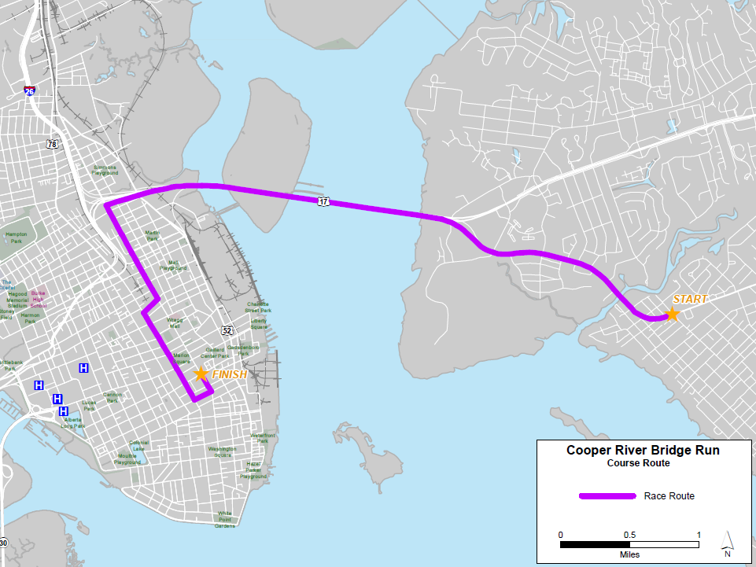
Bridge run event

Slide 22
Readiness Map
Evacuation Route
Evacuation Pickup Point
Reserved Shelter
Shelter
F
Fire Station
P
Police Station

Slide 23
Debris storage/reduction site location analysis
Debris storage/
reduction sites

Slide 24
Debris storage site location map

Slide 25
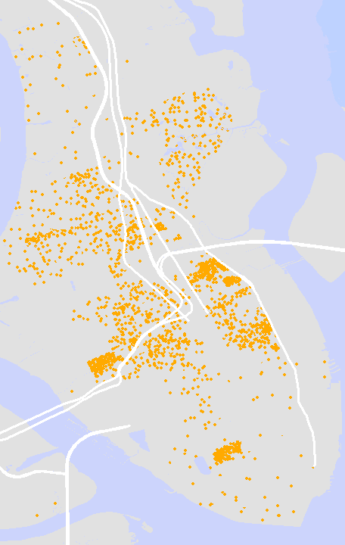
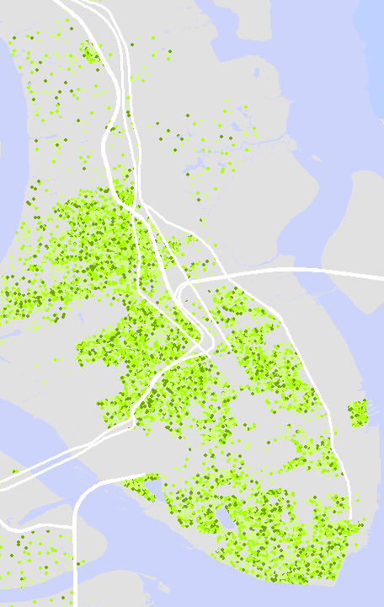
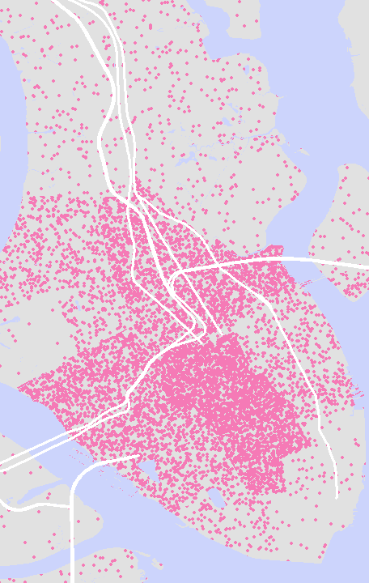
Identifying our vulnerable populations
Female head of household
with children under 18
Households by presence of
people 60 years and over
Population with income below
Poverty level – (6 college/Univ)

Slide 26
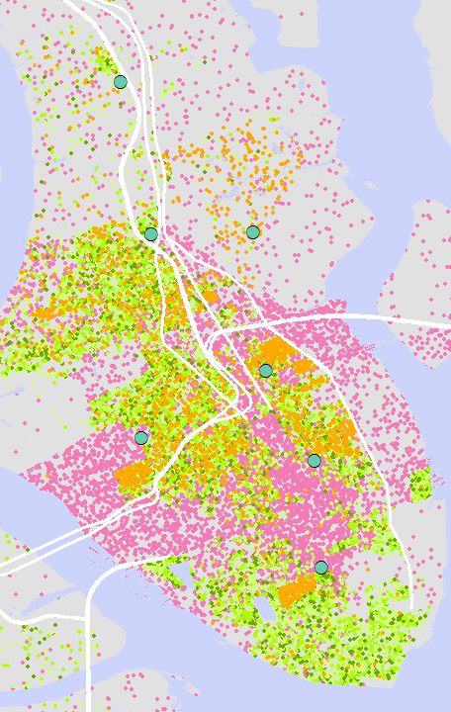
Vulnerable Populations and Evacuation Pickup Locations

Slide 27
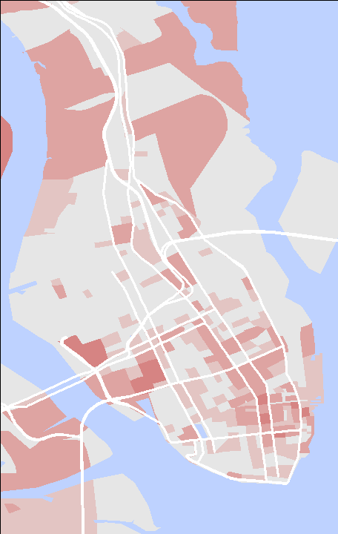
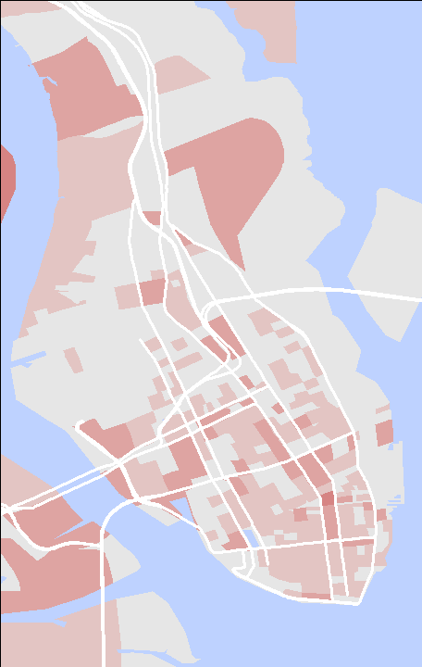
Vehicle Exposure
Daytime Exposure
Nighttime Exposure

Slide 28
Charleston: perceived vs reality
The Peninsula area is often perceived as the city (red outline)
In reality, the city is much larger
Peninsula – 8 sq. mi.
City land – 110 sq. mi.
City water – 29 sq. mi.
Home to
129,000 people
26% African American
69% European American
5% Other races
Per Capita Income $30, 700
Persons per household 2.8

Slide 29
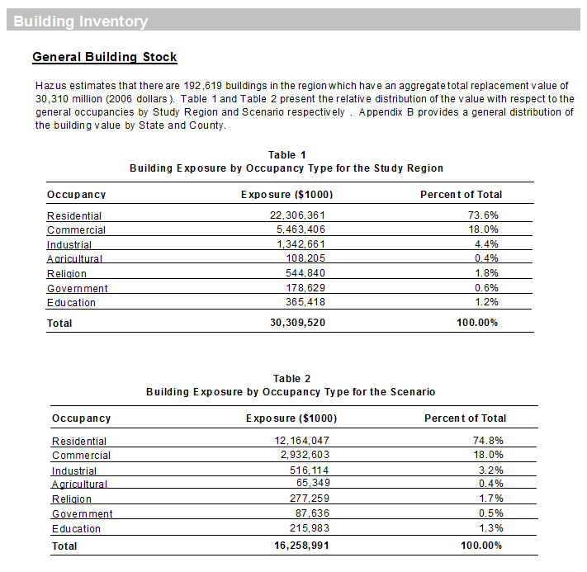
Infrastructure Exposure

Slide 30
Pre-Response
Use HAZUS to context the event
How bad can it be?
Data Driven
Greatest risks and vulnerabilities
Supports well informed decision making in preparation for an event
Using HAZUS to model wind and storm surge damages from the NWS predicted path and storm strength
Be ahead in advocating for City with County and State
Early Warning Decisions based on accepted standards
Frames discussions
Critical facility operators
Response partners
City Departments and Employees

Slide 31
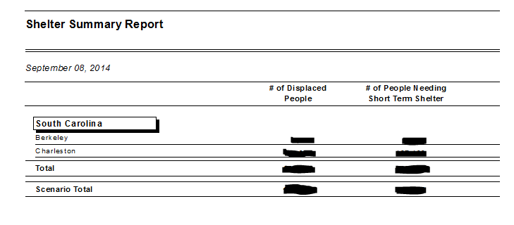
Preparing for Shelter Needs

Slide 32
Population Seeking Temporary Shelter by Census Block - 500 Year Flood
Population seeking shelter
less
more

Slide 33
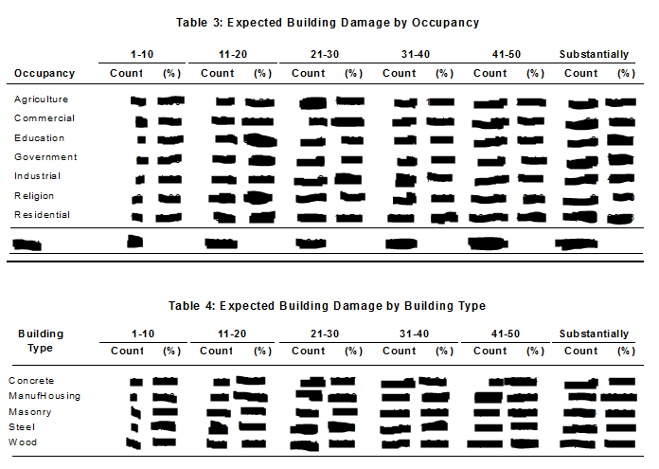
Building Stock Damage

Slide 34
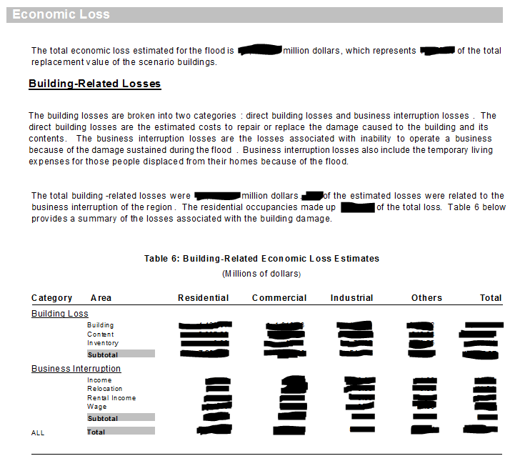
Sample HAZUS output – Historic Hugo

Slide 35
Debris removal

Slide 36
Emergency Management Cycle
Preparedness
Mitigation
Response
Recover

Slide 37
Response
Using GIS for Mapping/Recording event live
Power outages
Road/bridge accessibility
Flooding
Mapping/Recording incident damage and initial response activities
Search & Rescue
Infrastructure Damage
Windshield Surveys
Response capabilities

Slide 38
Damage assessment teams areas
Areas divided by number
of insurable structures

Slide 39
Emergency Management Cycle
Preparedness
Mitigation
Response
Recover

Slide 40
Recover
Damage Assessment
critical infrastructure
neighborhoods
Debris Removal
Getting important locations first
Power/utility restoration
Water availability
Road/bridge availability – travel routes?
Pictometry

Slide 41
Pictometry Images – Hurricane Sandy

Slide 42
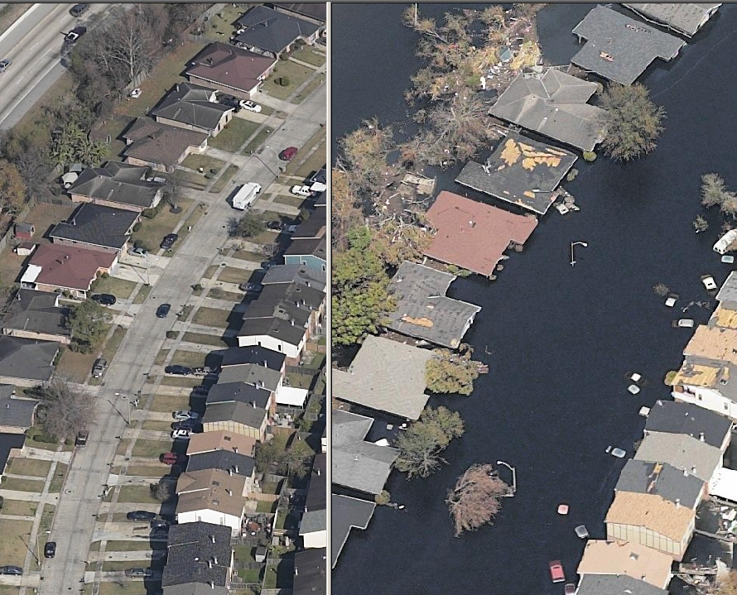
Pictometry Images – Hurricane Katrina

Slide 43
Emergency Management Cycle
Preparedness
Mitigation
Response
Recover

Slide 44
Mitigation
Running “what-if” scenarios in HAZUS to predict the effects of changes in development and building codes
Better documentation with GIS better equips City for future event preparedness and provides more opportunity for mitigation grant funding
Promotes intelligent planning towards building a more resilient community

Slide 45
Contact info
Mark Wilbert – Emergency Manager
wilbertm@charleston-sc.gov
Tracy McKee – Director of GIS
mckeet@charleston-sc.gov
Brian Pokrant – GIS Analyst
pokrantb@charleston-sc.gov
Website
http://gis.charleston-sc.gov

