Slide 1
Rising Waters - Exercise
September 14, 2016
www.napsgfoundation.org | @napsgfoundation

Slide 2
Exercise Goal
Advance skills of GIS staff and use of location-enabled decision support capabilities by decision makers and operators to promote enhanced shared understanding and operational coordination

Slide 3
Key Themes
This scenario-driven exercise is structured to explore key questions outlined below.
What pre-incident and incident level geospatial capability, products, information, and analysis are needed to support effective operational decision making throughout the disaster life-cycle?
What are the essential features and functionality of effective decision support capabilities that aid operational coordination, planning, and situational assessment?

Slide 4
Exercise Objectives
Validate and strengthen understanding of operational decision points, information requirements, and GIS capabilities required to support decision making in a flood event.
Strengthen GIS staff understanding of how to develop and deliver the right information products to decision makers at the right time to inform operational coordination in a flood event.
Strengthen Operators and decision makers understanding of GIS staff capabilities, products, and analysis that support decision making in a flood event.
Bridge terminology or communication gaps between decision makers, operators and GIS staff to better anticipate and fulfill information requirements.

Slide 5
Geospatial Preparedness Objectives
Verify common information requirements needed for effective decision making in a flood event across levels of government.
Validated or Identify data requirements needed to fulfill common information requirements in a flood event across levels of government.
Verify or Identify common features and capabilities of location-enabled decision support capabilities needed to drive action and support decision making in a flood event.
Validate or identify emerging smart practices regarding common operational coordination decision points, information requirements, and GIS capabilities that should be incorporated into national guidelines, standards, tools, and templates.

Slide 6
Assumptions
This is YOUR exercise
We are not evaluating your individual skills or knowledge
We are observing and capturing information
There is no right or wrong answer or solution
There are no right or wrong GIS products

Slide 7
Helpful Hints
Use the tools you have learned about at this Summit
  Web-based and desktop GIS solutions
  US National Grid
  HIFLD Data and GII Services
  Standardized symbology
  Standard templates and applications
Injects will be delivered digitally to the contact information you provided during registration and/or through your facilitators (as a backup)
Player action and discussion is a key part of achieving the exercise goal and strengthening mutual understanding of how GIS can be employed to change outcomes for survivors.
This is a ½ day exercise – we will not solving the whole event scenario.

Slide 8
Final Discussion and Hot Wash
Assign 1 operator and 1 GIS person to present to the larger group once done
Be prepared to discuss:
  triggers indicating what geospatial capabilities are needed to support disaster operations for this incident validated or identified?
  Given the scenario, simulated jurisdictions, and available GIS capabilities, what support, analysis or products did operators indicate they would use or request? (D- 24, D+ 0, D+ 24, beyond)
What information did GIS participants indicate needing to know prior to making or fulfilling a request?

Slide 9
Final Discussion and Hot Wash
Did GIS practitioners produce an enhanced and predictive consequence assessment that effectively supported operator decision making? (i.e., Did the products inform and change or affirm decisions using sound location-enabled analysis?)
Did GIS practitioners successfully incorporate operator-driven critical information points that successfully aided in operational decision making?
  If yes, what critical information points were incorporated and why did they prove effective?
  If no, why not? What challenges were experienced?
Did GIS practitioners successfully incorporate USNG to identify areas of interest, describe areas of responsibility, and communicate consequences to increase accuracy or confirm planning assumptions to support each discipline? (e.g., rather than communicate projected consequences by entire county, city – were GIS practitioners able to use USNG to “zero” in on affected areas?)

Slide 10
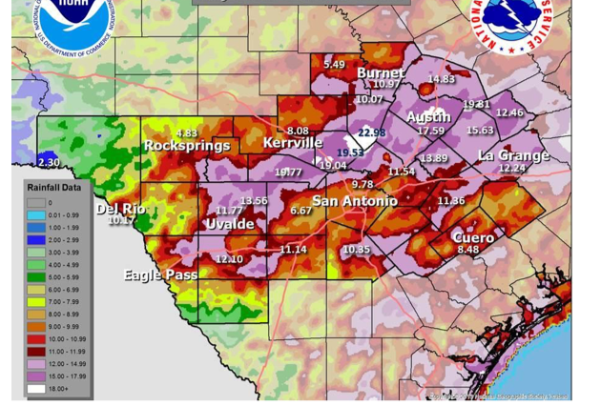
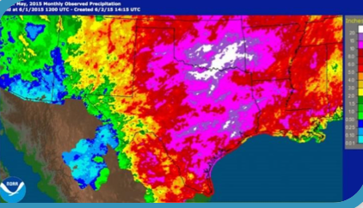
Scenario

Slide 11
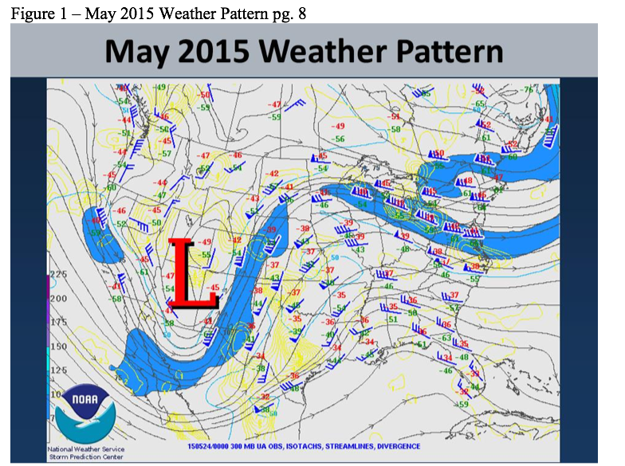
Pre-Incident
Late June severe flash flooding from a stalled regional storm system flooded Highway 67 with three feet of water southwest of Cleburne, TX.
Rural roads saw flooding of one to two feet resulting in several swift water rescues.
Most locations across south-central TX have received well-above normal rainfall, saturating soils.
Current conditions will result in any new rainfall, especially heavy rain, becoming run-off directly into rivers, streams, and flash-flood prone areas.

Slide 12
Flood Potential Forecast
A persistent area of low pressure is expected over the western U.S. that is likely to bring multiple rain events through the end of the week and into the weekend.
As much as 12 inches of rain over a 6-hour period is possible over the upper reaches of the Blanco River watershed.
Rainfall may be heavy at times with upwards of 4” per hour as thunderstorms merge/regenerate over southern Blanco and eastern Kendall counties.
Widespread rainfall of 6-8 inches is possible across Kendall, Blanco, Hays, and portions of Comal.
Most rainfall is expected throughout today and into the overnight hours of early Thursday morning, leading to potential rapid rise (2-3ft or more per hr) in Blanco and San Marcos rivers.

Slide 14
Demographics
Jurisdiction | Housing Units | Pop (2012) | Under 5 | 5 to 19 Years of Age | 20 to 64 Years of Age | 65+ Years of Age
Blanco | 1,849 | 781 | UNK | UNK | UNK | UNK
Canyon Lake | 11,775 | 22,496 | UNK | UNK | UNK | UNK
Wimberley | 1,482 | 2,760 | UNK | UNK | UNK | UNK
San Marcos | 18,179 | 47,433 | UNK | UNK | UNK | UNK
Martindale | 462 | 1,145 | UNK | UNK | UNK | UNK
Luling | 2,115 | 5,503 | UNK | UNK | UNK | UNK

Slide 15
Accessing NAPSG ArcGIS Online Accounts
Go To: http://www.arcgis.com
Username: ngps_firstnamelastname
Password: ngps2016
Credit Allocation: 20 per user
Role: Publisher

Slide 16




Exercise Groups (Morning)
Decision Makers & Operators FEMA / Blanco County Wilson | Decision Makers & Operators Texas / Hays County Lackey
GIS Practitioners FEMA / Blanco County Rast | GIS Practitioners Texas Hays County Sellers

Slide 17




Exercise Groups (Morning)
Hays County Wilson | Blanco County Lackey
FEMA Rast | Texas Sellers

