Slide 1
Integrated Public Alert and Warning System
Mark Lucero, Chief Engineer
IPAWS Division
mark.lucero@fema.dhs.gov
202-646-1386
August 8, 2017

Slide 2
Agenda
What is IPAWS?
How Does IPAWS Work?
How is it Being Used Today?
Wireless Emergency Alerts Improvements

Slide 3
Tips for a Good Presentation
Establish credibility
Tell a joke
Don’t say “um” or “uh”

Slide 4
Establish Credibility

Slide 5
Agenda
What is IPAWS?
How Does IPAWS Work?
How is it Being Used Today?
Wireless Emergency Alerts Improvements

Slide 6
IPAWS Federal Guidance
Policy:
Executive Order 13407 - Public Alert and Warning System
Establishes policy of the United States to have an national warning system used by government officials at all levels of government to alert and warn people of all hazards
Law:
Public Law 114-143, The IPAWS Modernization Act
Enacts to law the policy statement and similar requirements found in Executive Order 13407
Section 706 of 47 U.S.C. 606, The War Powers Act
Provides for Presidential access to commercial communications during “a state of public peril or disaster or other national emergency”
Public Law 93-288, The Stafford Act
Sec. 202. Disaster warnings – directs FEMA to provide technical assistance to State and local governments to insure that timely and effective disaster warning is provided
Regulation:
47 CFR Part 11 — Emergency Alert System (EAS)
Provides for alert and warning on private sector radio and television infrastructure
47 CFR PART 10 — Wireless Emergency Alerts (WEA)
Provides for alert and warning to devices on wireless carrier networks

Slide 7
The Evolution of Emergency Alerting
Notes:
Past, Present, Future
Note that subscription-based alerting should be in there circa 2000 and beyond

Slide 8
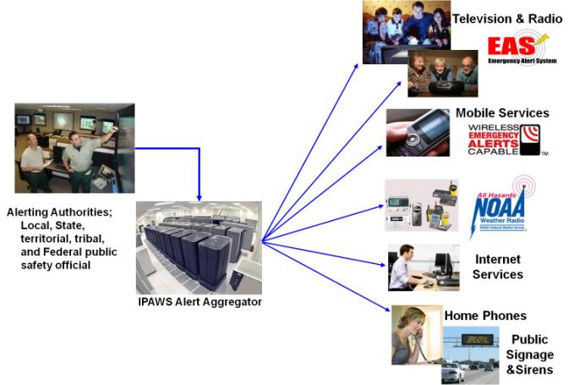
IPAWS Vision
“Timely Alert And Warning To American Citizens In The Preservation of Life And Property”
Facilitate single emergency alert message delivery to all available public dissemination channels
Easier to use by public safety/alerting authorities
Improves and Enhances emergency alerting capability in two critical ways:
Reliability that citizens receive alert via at least one path
likelihood that citizens react to emergency alerts

Slide 9
Agenda
What is IPAWS?
How Does IPAWS Work?
How is it Being Used Today?
Wireless Emergency Alerts Improvements

Slide 10
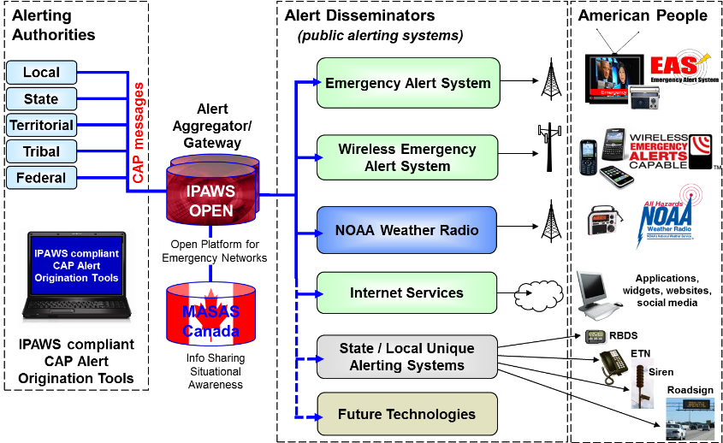
IPAWS Architecture
Notes:
AlertSense
On-The-Go Alerting
Comlabs EMnet
GSS Alert Studio
NC4 E Team
Federal Signal CenterPoint Dashboard
Inspiron WENS
Asher Group Hyper-Reach
Monroe DASEOC
Interop Solutions Paraclete
Geo-Comm GeoLynx
Nixle
ECN CodeRED
AtHoc IWSAlerts
Ping4Alerts!
LEAP Portal
Regroup Mass Notification
Everbridge

Slide 11
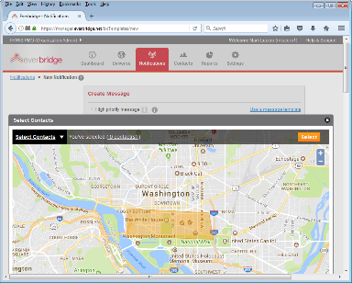
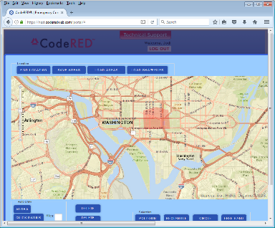
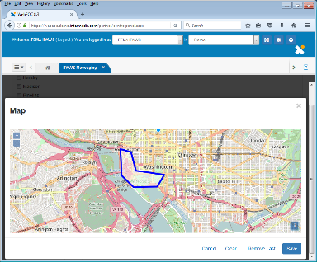
Creating an IPAWS Alert

Slide 12
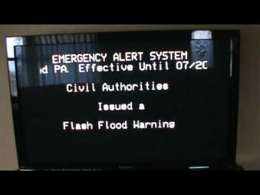
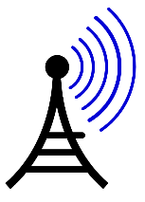
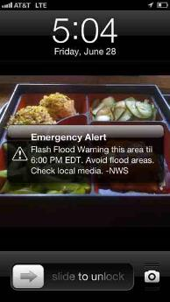
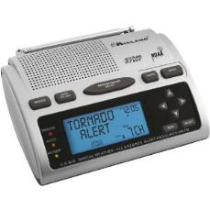
Alert Dissemination
EAS
Broadcast
Large footprint
County-based
WEA
Broadcast
Medium footprint
Polygon based
NOAA Weather Radio
Broadcast
Large footprint
County-based
http://wset.images.worldnow.com/images/24768116_BG1.jpg
http://www.weathernationtv.com/app/uploads/2017/02/noaa-weather-radio-300x212.jpg
https://i.ytimg.com/vi/Y3m-HdhGsQo/hqdefault.jpg

Slide 13
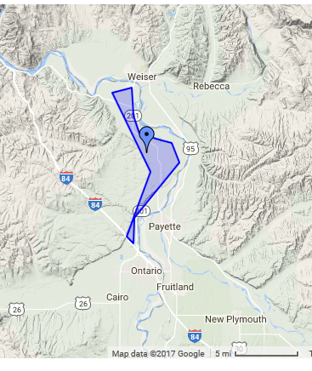
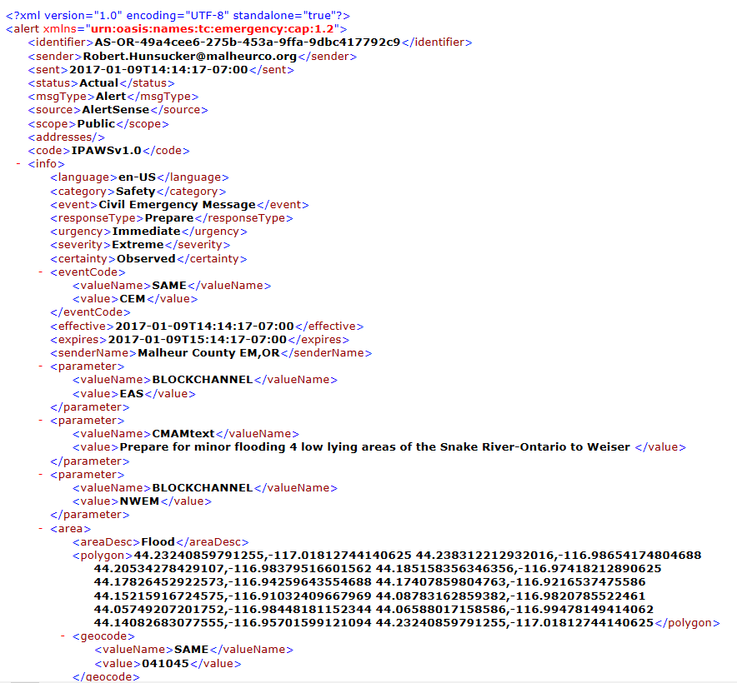
A Little More Detail...

Slide 14
Agenda
What is IPAWS?
How Does IPAWS Work?
How is it Being Used Today?
Wireless Emergency Alerts Improvements

Slide 15
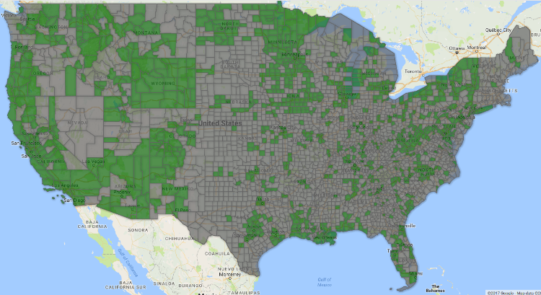
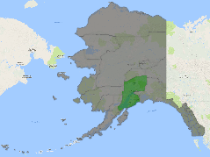
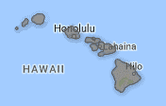
Alerting Authorities (as of August 3, 2017)
Complete
833 Local
65 State-wide
16 Federal
3 Tribal
2 Territory

Slide 16
Current Usage and Statistics (as of August 3, 2017)
33,408
Total Wireless Emergency Alert (WEA) messages sent
10
Flood alerts sent by state/local EMAs
17,482
Flash Flood Warnings sent by NWS
Data collected since 12 APR 2012
NWS = 31,695 total alerts
NCMEC = 1,050 total alerts
State/local = 663 total alerts

Slide 17
How are we doing?

Slide 18
Agenda
What is IPAWS?
How Does IPAWS Work?
How is it Being Used Today?
Wireless Emergency Alerts Improvements

Slide 19
Background of WEA Enhancements
2006 – WARN Act passed by Congress
2008 – Original WEA rules and regulations
2012 – WEA system operational
2013 – CSRIC IV review rules, recommend changes
3 of 31 members from emergency management discipline
Submitted final report to FCC October 2014
2015 – CSRIC V recommended additional changes
10 of 48 members from emergency management discipline
Submitted final report to FCC September 2016
2016 – New WEA rules and regulations

Slide 20
WEA Improvements
Increase message length from 90 to 360 characters
2.5 years (May 2019)
Add new alert category, “Public Safety Messages”
2.5 years (May 2019)
Support URLs and phone numbers
30 days for text URLs and phone numbers (Nov 2016)
1 year for “clickable” URLs and phone numbers (Nov 2017)
Spanish language WEA
2 years (Nov 2018)
WEA test code
2.5 years (May 2019)
https://apps.fcc.gov/edocs_public/attachmatch/FCC-16-127A1.pdf

Slide 21
FCC Further Notice of Proposed Rulemaking (a.k.a. Under Consideration)
Defining the Modes of Participation in WEA
What do “in whole” and “in part” really mean?
Infrastructure Functionality
Is WEA really available everywhere there’s coverage?
Alert Message Preservation
Review old messages on the phone
Earthquake Prioritization
Alert delivery in less than 3 seconds, or your pizza is free
Disaster Relief Messaging
Many-to-one messaging
Multimedia Alerting
Cell broadcast images to phones
Multilingual
Beyond English and Spanish
Matching the Geographic Area
Reach 100% of phones in targeted area with no more than 0.1 mile overshoot
WEA on 5G networks
https://apps.fcc.gov/edocs_public/attachmatch/FCC-16-127A1.pdf

Slide 22
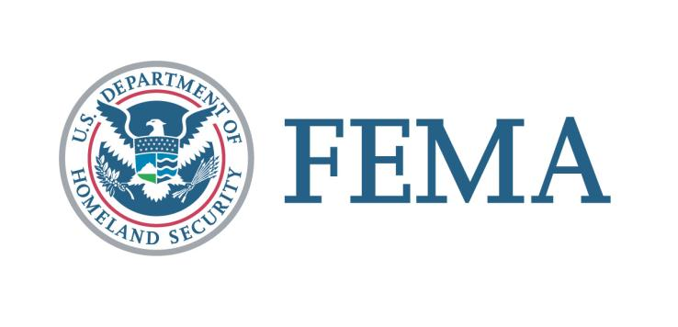
ipaws@fema.gov

Slide 23
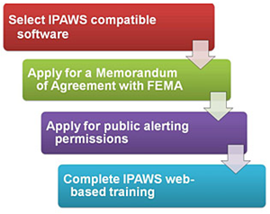
IPAWS Public Alerting Requirements
Obtain an IPAWS-compatible alerting tool
Complete a Memorandum of Agreement
Fill out the MOA Application (link below)
FEMA will create an MOA for you to sign
With a signed MOA, FEMA will set up your COG and send you a certificate to “digitally sign” your alert messages
Complete the “Public Alerting Application”
Coordinate with the state and obtain signature
Complete IPAWS web-based training
With a signed “Public Alerting Application” and training certificate, FEMA will enable your alerting permissions and you’re good to go
www.fema.gov/how-sign-ipaws

Slide 24
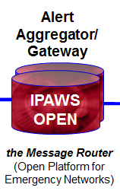
Alert Aggregation
What the Aggregator does:
Authenticates sender
Web Service Security
Digital Signature
Validates CAP message
Verifies permissions
What alerts can you send
Where can you send them
How can you send them
Non-repudiation, message integrity
Gateway to EAS, WEA, NOAA WX

Slide 25
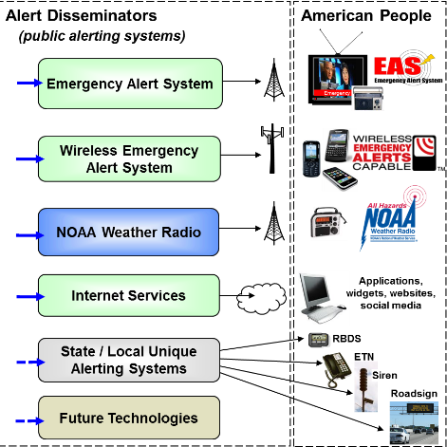
Alert Dissemination
Emergency Alert System
TV, Radio, Cable, Satellite
~20,000 connected via EAS Feed
Wireless Emergency Alerts
Opt-in Carriers
61 connected via Fed Alert Gateway
National Weather Service
NOAA Weather Radio/HazCollect
1000 WX transmitters
Interoperating Systems
72 connected via Public Alert Feed
Notes:
1 911 C.A.S.P.E.R. Systems
2 Air Capital Media, LLC
3 Alcatel-Lucent
4 American National Red Cross
5 AmikaMobile
6 Asqee, SPC
7 AtHoc, Inc.
8 ATI Systems, Inc.
9 Avalution Consulting, LLC
10 Broadcast Television Group, LLC
11 Burli Software, Inc.
12 Callaway Graphic Software, LLC ( NewsChief Display System )
13 Canada MASAS
14 Carnegie Mellon University Silicon Valley
15 Caryl Technologies
16 Centre for Security Science, Government of Canada
17 City of Lakewood, Colorado
18 Communications & Power Engineering (dba CommPower), Inc.
19 Deaf Link
20 DHS Domestic Nuclear Detection Office (DNDO)
21 DHS Geospatial Management Office
22 Dotomi, a ValueClick Company
23 EZ Automation
24 Facebook
25 FEMA External Affairs (FEMA App)
26 FEMAC
27 Flagpole Inc., dba TwitZip
28 For IPAWS Use (FEMA DMSE)
29 Gary A. Ham dba grandpaham.com
30 Geo-Comm, Inc.
31 GSSNet - AlertFM
32 Icon Enterprises dba CivicPlus
33 Indji Systems
34 Interop
35 Jump2Go
36 KDEE Technology, LLC
37 MAX Smart Home, LLC
38 MIR3, Inc.
39 MyStateUSA, Inc.
40 National Public Radio (NPR)
41 Noggin IT Inc.
42 Oklahoma Interactive
43 Omnilert, LLC
44 Phillip Grigalanz
45 PIER Systems, LLC
46 Public Alerter
47 QuickSeries
48 Rapid Notify
49 Rave Wireless, Inc.
50 Robotic Paradigm Systems
51 SafeT, Inc.
52 Samsung Information Systems America, Inc.
53 Savi Technology
54 Singlewire Software
55 Skitter, Inc.
56 SOCIFI
57 Spectacular Media
58 Spectrum Solutions and Services
59 Swan Island Networks, Inc.
60 Syn-Apps LLC
61 TechRadium Inc
62 The Weather Channel Companies
63 Thunder Eagle Inc
64 University of Hawai'i - Pacific Disaster Center
65 Versitell
66 Vizrt Inc
67 Warning Aware, LLC
68 Weather Message Software, LLC
69 Weather4Me Alerts Platform (TriState Alerts)
70 WHDT World Television Service
71 Wisemen Multimedia, LLC
72 WRAL-TV, Capitol Broadcasting Company, Inc.

Slide 26
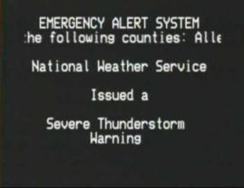
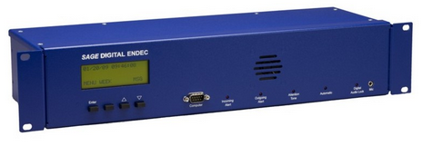
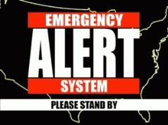
Emergency Alert System Capabilities
All radio/TV providers must monitor IPAWS-OPEN
Equipment installed in all TV and Radio providers monitor for valid and relevant alert/warning messages
Audio announcement and text display interrupts programming

Slide 27
NOAA Weather Radio Capabilities
Non Weather Emergency Messages through the NOAA HazCollect system
1000 transmitters (162.400-162.550 MHz)
Can wake up radios in the middle of the night
Many schools have them
NOAA is Currently Updating System/Sign-Up

Slide 28
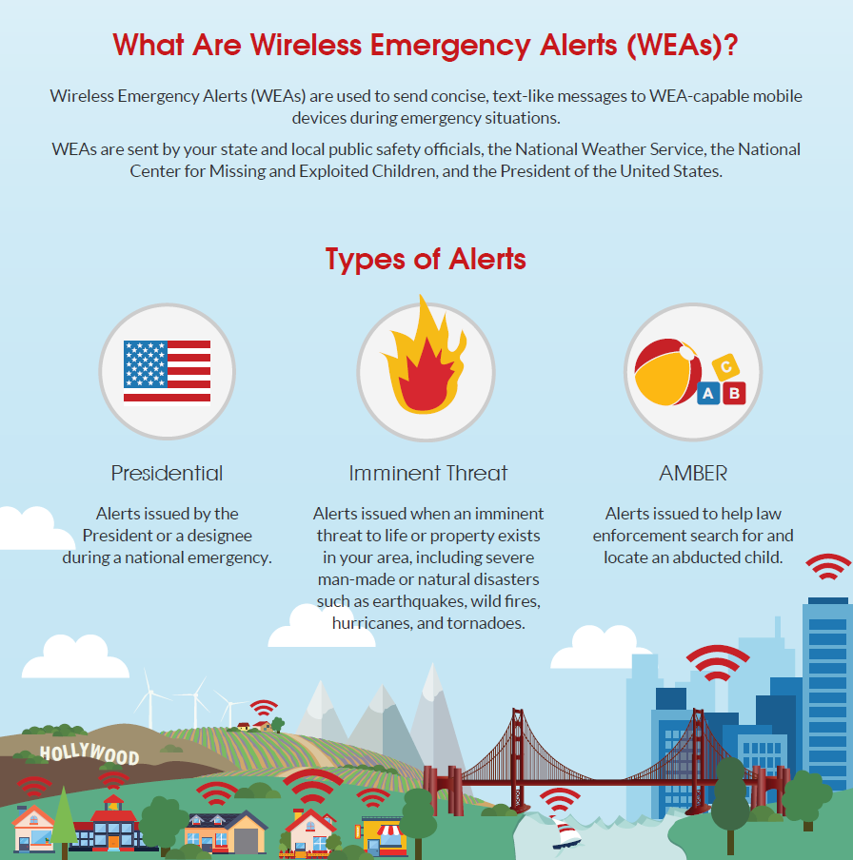
www.calalerts.org

Slide 29
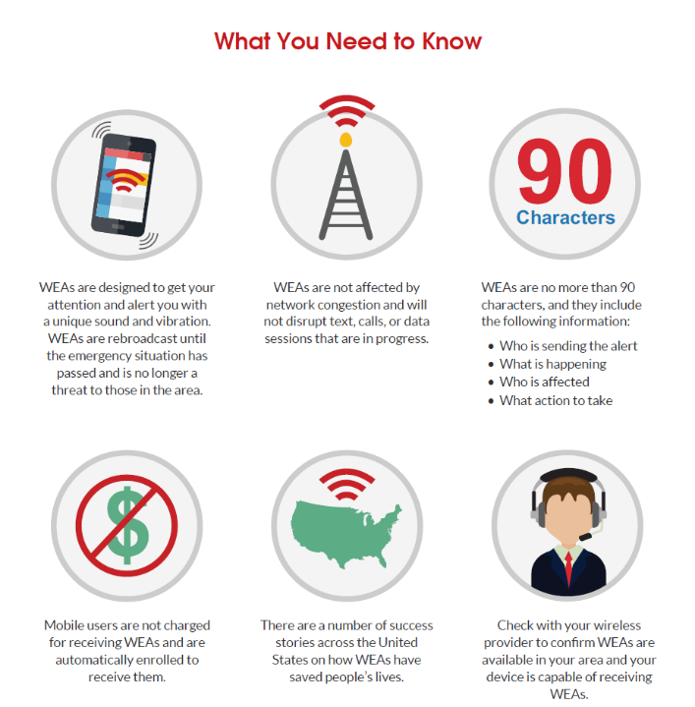
www.calalerts.org

