Slide 1
National Geospatial Preparedness Summit Department of Homeland Security Enterprise Geospatial Capabilities
U.S. Department of Homeland Security
Geospatial Management office
Michael Donnelly (Acting deputy director)

Slide 2
Agenda
How Homeland Security Partners are using
What we (GMO) do
Core Offerings
Geospatial Information Infrastructure (GII)
What GII can offer – Applications and GeoData
GeoCONOPS
GII Portal – Token - UserName
GII Training Documents

Slide 3
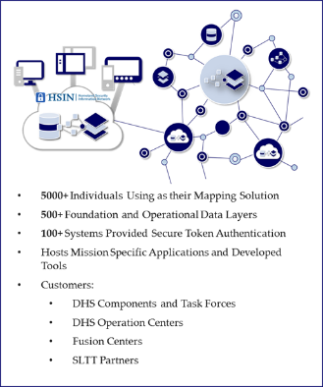
HSE Partners
Supporting SEAR and NSSE Events
Presidential Inauguration – 150+ geospatial layers, 15+ FSLTT Partners
BRIC Fusion Center – Sail Boston
National Guard Bureau – Ardent Sentry Exercise
State of West Virginia - National Scout Jamboree
Oregon Network Information System (ORNIS) – network of Oregon Counties
GIS PORTAL
GIS SERVER
DHS CONTENT
AND PRODUCTS

Slide 4
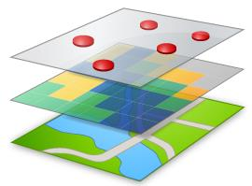
Fusion Center Support
Fusion Centers utilizing capability in support of the Special/Law Enforcement Sensitive Events
Controlled access and two-way flow of mission critical geospatial information and derived products
Data products delivered to authorized users, on any authorized device
Increases National Situational Awareness for critical events
Scalable for all missions and additional partners
DESKTOP
WEB
DEVICE
AGOL/Portal
AGOL/Portal
AGOL/Portal
GII PORTAL
AGOL/Portal
DHS CONTENT
AND PRODUCTS
GIS SERVER
DHS CONTENT
AND PRODUCTS
GIS SERVER
4

Slide 5
What we do
The GMO provides homeland security operators nationwide the secure reliable platform and tools they need for geospatial analysis, visualization, mapping, and collaboration on diverse sets of mission critical data.
Enterprise Access to Mission-Essential Geospatial Data
Analysis, Visualization and Collaboration
Training and Operational Support
Provides enterprise access to mission essential geospatial data
Supports and maintains DHS geospatial applications
Maintains a shared geospatial architecture
Synchronizes intergovernmental policies, strategies, tools, and services
Increases access to and sharing off geospatial information
Provides geospatial visualization through GeoCoding as a Service
Supports interactive and heat mapping
Collects and provides access to imagery, base maps, operational data, and foundation data
Provides GeoTechnical Support as a Service
Builds geospatial tradecraft
Standardizes operating procedures
Provides field self-service applications, tools, and services

Slide 6
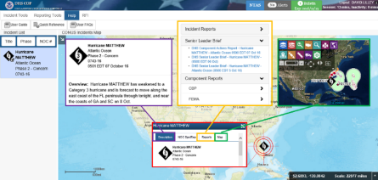
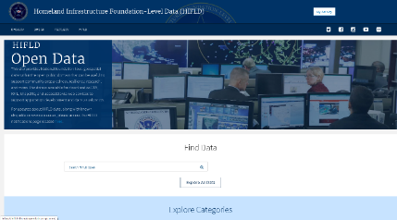
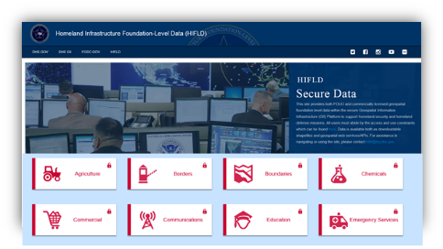
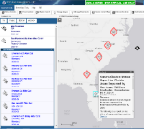
Core Capabilities
DHS NOC COP Application
Homeland Security Infrastructure-Level Data (HIFLD)
https://gii.dhs.gov/hifld/data/open
https://gii.dhs.gov/hifld/data/secure
Homeland Security Enterprise (HSE)
Geospatial Concept of Operations (GeoCONOPS)

Slide 7
DHS Geospatial Information Infrastructure (GII)
Sensitive But Unclassified (SBU)-level platform to host shared geospatial enterprise applications, tools, and information
Available to all users across the entire homeland security/defense enterprise (Federal, State, Local, Tribal and Territories)
Search, discover and access:
Imagery & Base Maps
DHS Operational Data
Foundational Data
Store and share geospatial information
Private or public based on requirements
Create and share derived geospatial products
Access existing common applications and services
Geocoding, DHS COP, etc.
Easily build interactive maps and custom apps
Field Collection, Story Maps, Heat Maps
Tiered service model for support: Full, Assisted, Self
DESKTOP
WEB
DEVICE
GII Portal: https://gii.dhs.gov/gii/

Slide 8
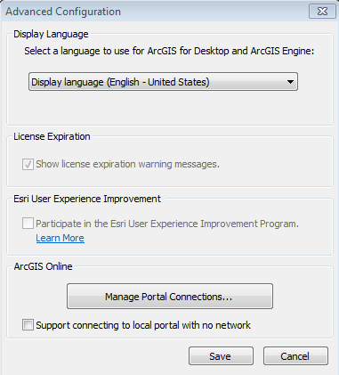
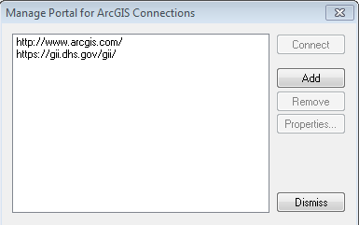
How to Access GII Applications and Geodata Services
Homeland Security Information
Network (HSIN) User Account:
GII Portal: https://gii.dhs.gov/gii
Desktop Access
Mashup GII data in ArcMap
Publish services to GII
GII Secure Token or Username
AGOL/Portal connection
UDOP connection

Slide 9
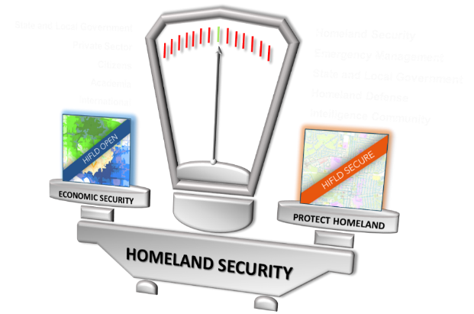
What does HIFLD Provide?
ACCESS to over 400 critical infrastructure geospatial layers
Schools
Police Stations
Refrigerated Warehouses
Cell Towers
And so much more!
DECOUPLED FOUO and licensed data from public open data
AVAILABLE as web services or downloadable files
***Previously known as HSIP

Slide 10
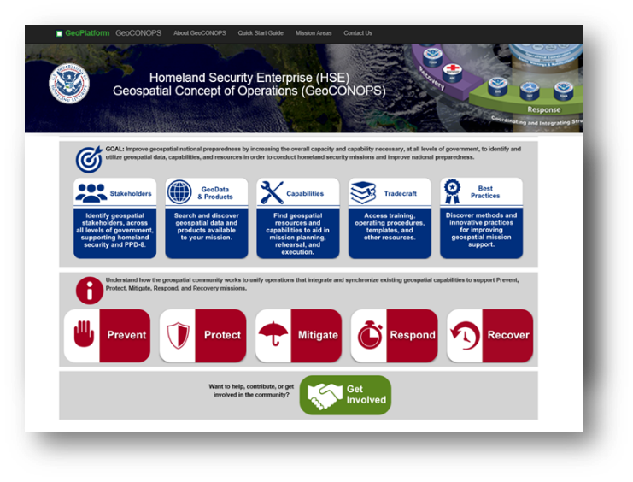
GeoCONOPS
Identify geospatial stakeholders, across all levels of government, by mission or organization
Find geospatial resources and capabilities to aid in mission planning and support (i.e. mission blueprint)
Enable analysts to easily search and discover geospatial data or products available to their mission
Understand how the geospatial community interacts/coordinates to support a diverse mission set through use cases

Slide 11
Contacts and Questions
For general GII inquiries:
DHS_GCOE@hq.dhs.gov
Request HSIN account to access GII services:
DHS_GCOE@hq.dhs.gov
Include First Name, Last Name, Organization, and Email Address
Access to GII Portal: https://gii.dhs.gov/gii
GMO Deputy Director
Michael Donnelly
Michael.Donnelly@hq.dhs.gov

