Slide 1
Center for advanced public Safety
Brief Overview of the
Laura Myers, PhD
Director and Sr. Research Scientist
Darrell Arnold, MPA
Social Science Research Coordinator
Sara Gallman, M.S.
Project Coordinator

Slide 2
Caps personnel
Approximately 100 people
5 core faculty members
70+ professional staff
Research engineers
Software developers
IT personnel
25+ students
GRAs
UG interns
Faculty
Computer Science and other disciplines
Developers
Most have Masters in Computer Science
Students
Interning with selected staff mentors
Skilled in MS .NET
& other languages

Slide 3
CAPS Partners & Sponsors
Federal Sponsors
Federal Motor Carrier Safety Administration
National Highway Traffic Safety Administration
Federal Highway Administration
Bureau of Justice Assistance
Office of Justice Programs
Department of Homeland Security
Department of Health and Human Services
National Oceanic and Atmospheric Administration
Other States
Mississippi
Arkansas
New Mexico
Georgia
Wyoming
Nevada
Puerto Rico territory

Slide 4
CAPS Technology
Numerous live production systems:
Electronic citations (AL, MS, AR)
Electronic vehicle crash reporting
Electronic I/O reports
Electronic ambulance run reports
Commercial vehicle enforcement systems
Criminal data query systems (NCIC, LETS)
Data analysis and geographic information systems (several states)
Authentication management for all AL law enforcement
State Vehicle Titling System
State Vehicle Registration Repository
State Vehicle Online Insurance Verification System
State Food Assistance Application System
State Children’s Insurance Application System
Many other systems deployed to date

Slide 5
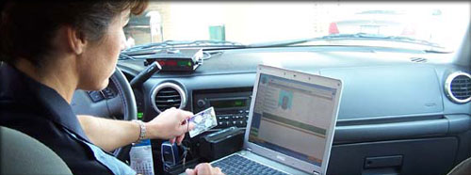
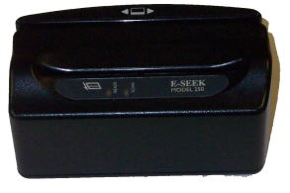
Mobile Officers Virtual Environment
MOVE
eCitation
eCrash
ULTRA Uniform Crime Reporting
LETSgo
NCIC Mobile
Automatic Vehicle Locator (AVL)
License Plate Reader
(TRACE)
ASPEN
Commercial Vehicle Information
Field Reporting/ SAR
Computer
Mag Strip/Bar Code Scanner
Printer
GPS

Slide 6
Sampling of CAPS GIS-Related Applications
Nationwide coverage, including several other countries
Comprehensive crash data analysis tool. Client and web-based installs
15k+ installs in AL
eCite, eCrash, eForms
Part of the MOVE software suite
Works with or without GPS hardware
Robust web-based data analytics tool for mapping citation, crash, & crime data.
Includes real-time and historical AVL layers

Slide 7
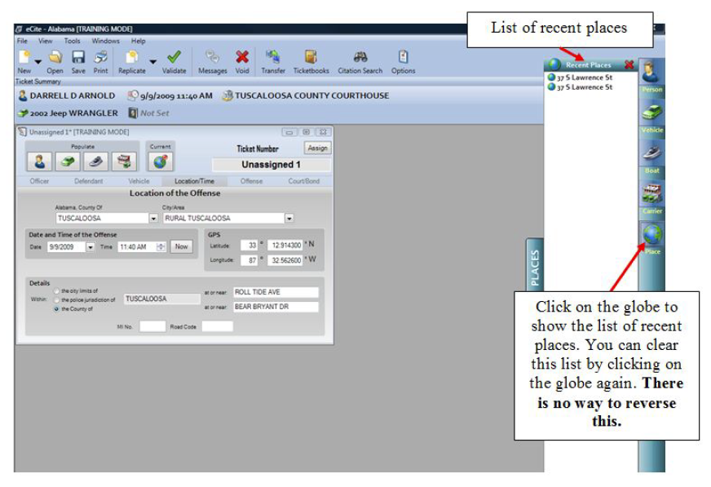
GIS Process
MOVE, eCite, eCrash, eForms, and MapClick

Slide 8
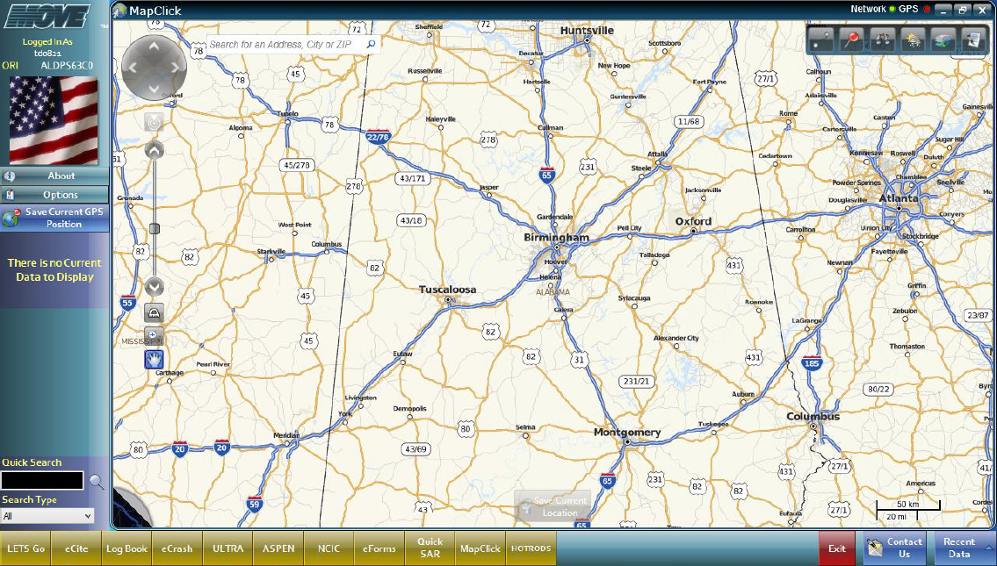
GIS Process

Slide 9
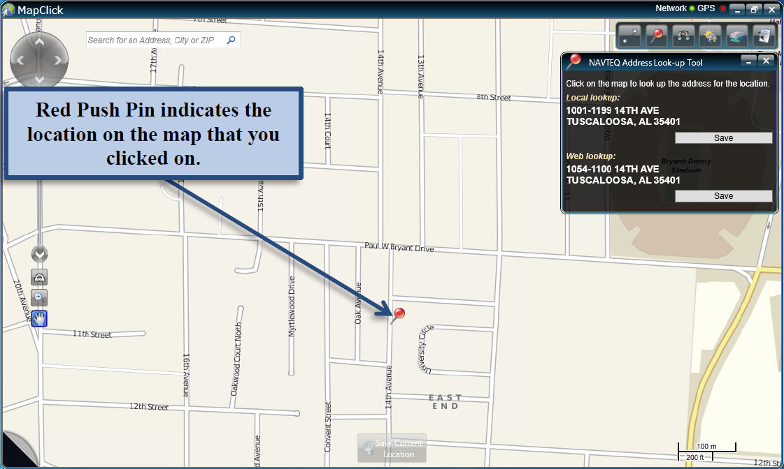
GIS Process

Slide 10
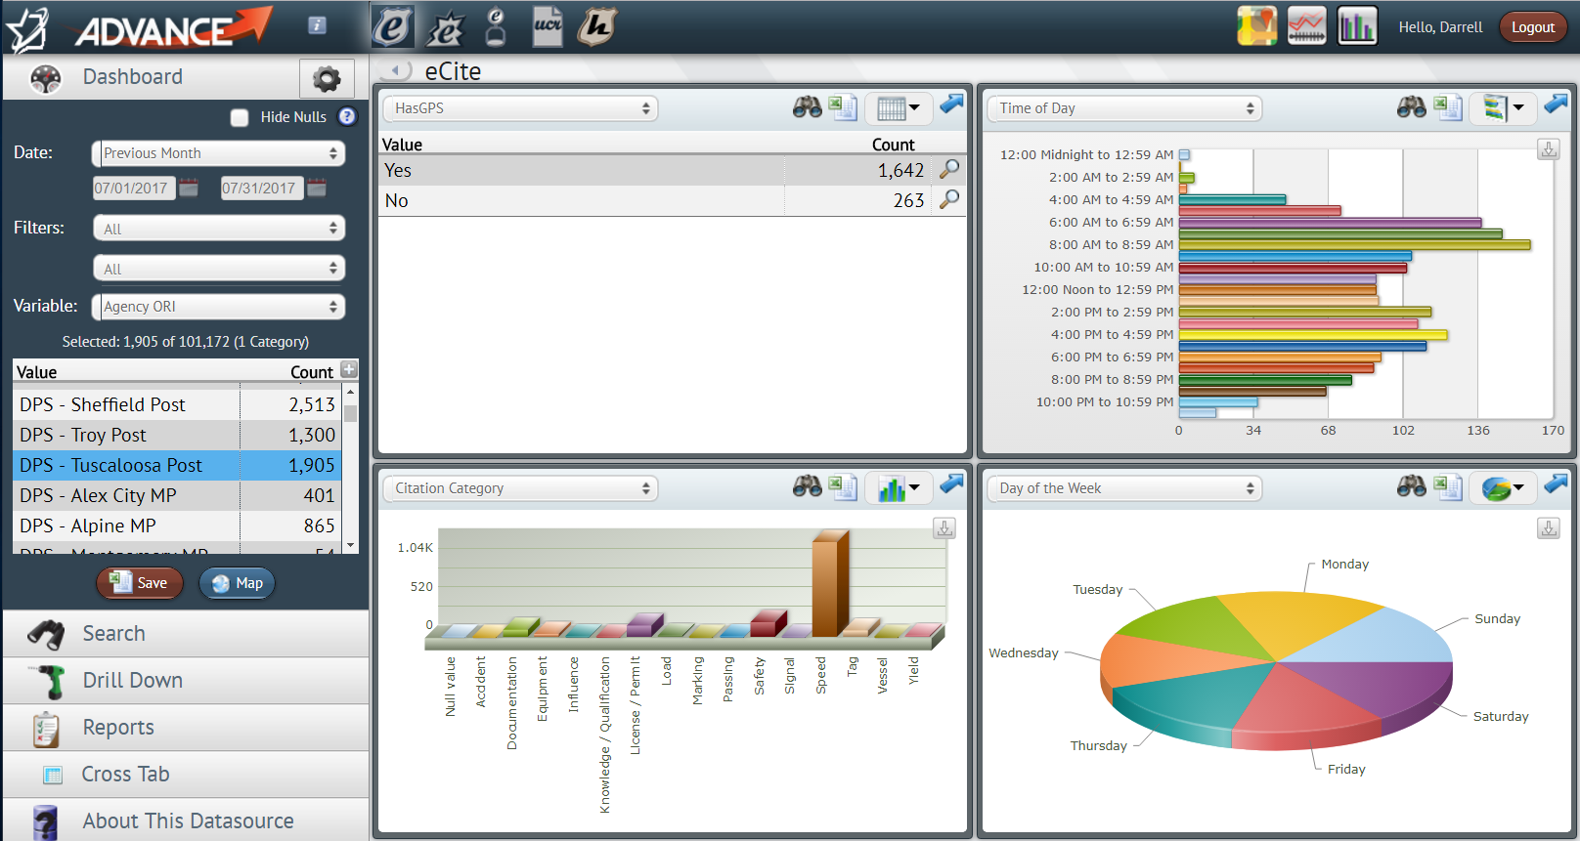
ADVANCE

Slide 11
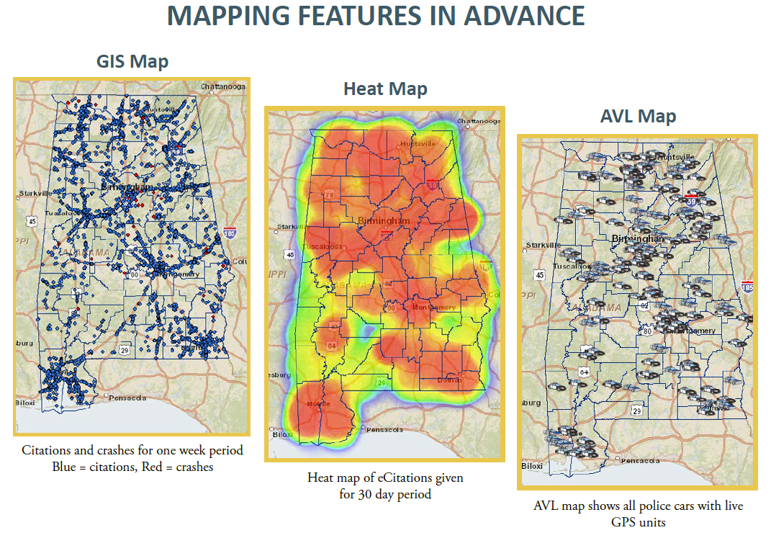
ADVANCE

Slide 12
THANK YOU
Laura Myers - Director
laura.myers@ua.edu
Darrell Arnold
darrell.arnold@ua.edu
Sara Gallman
sara.gallman@ua.edu

