Slide 1
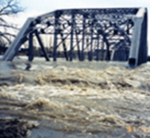
USGS Capabilities - Emergency Response Resources - NAPSG 2017
Lance Clampitt
406-994-6919 / lsclampitt@usgs.gov
USGS - National Geospatial Program
Notes:
Introduction Slide

Slide 2
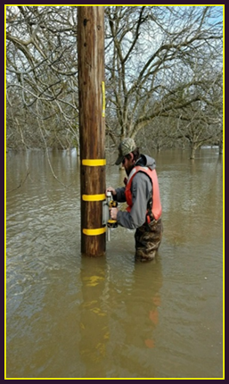
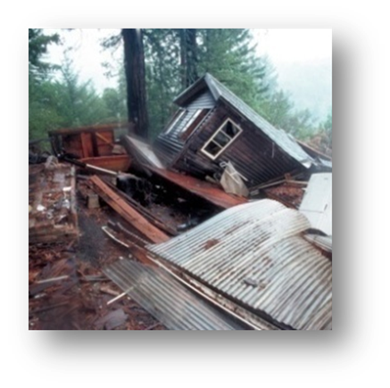
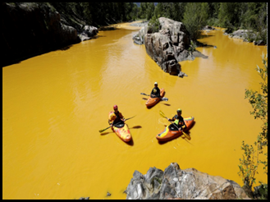
Mission Support Teams
Coastal Storm Response Team
Inland Flood Team
Geospatial Information Response Team
Coordinate Communicate Acquire Archive Distribute
Hazards Data Distribution System (HDDS)
Collection Management Tool (CMT)
International Charter (IC)
Web Mapping Application (DCPR)

Slide 3
Hazards Data Distribution System (HDDS)
Features
Interactive map-based interface
Search by event, location, date
Ingested Data format is
GeoTIFF / Compressed JPEG
Metadata export in multiple formats (e.g. CSV, KML, SHP, etc.)
Access to ‘Public’ and ‘Restricted’ datasets (EE login)
Bulk delivery capability via downloadable web-based client
On-demand WMS delivery – “GIS Services” (Ingested Data Only)
Data and product loading capability – ie user push to HDDS for sharing
Collection Management Tool – Data Acquisition Request
Notes:
Output Files from EIS
Full-resolution Imagery (reformatted to geotiff)
Image browse (thumbnail) graphic
Compressed low/medium quality imagery (40%/90% JPG-compressed)
includes .jpg and .jpw (world) file
Shapefiles (GIS-based representation of HDDS holdings; aggregated by dataset)
Metadata (aggregated by dataset except where noted below)
Comma Separated Values (CSV)
Federal Geographic Data Committee (FGDC) – file based
Keyhole Markup Language (KML) format (v2.1)
Extensible Markup Language (XML) format (v1.0)
Native imagery – contains original file packaging and format from vendor
Data Push / Product Loading Capability:
USGS FTP(S) server: datasharingportal-incoming.cr.usgs.gov
user name: eo_ops
passwd: (will provide)
folder: The_National_Map

Slide 4
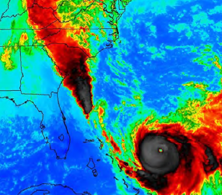
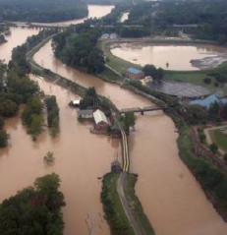
Geospatial Data supporting – Hurricane Joaquin / Inland Flooding
Hazards Data Distribution System
Total Imagery Products = 9,358
Total Map Products = 87
Total volume is 3 TB.
Public
Imagery Products
AERIAL_CAP 3977
AERIAL_NOAA 2973
EO_USGS 10
LANDSAT_OLI_USGS 16
TERRA_ASTER_NASA 2
Sentinel1 5
Map Products
ANG_Flood_Maps 7
ANG_Population_Density 1
FEMA_USGS_Prelim_Extents 1
NASA_Soil_Moisture 44
NGA_Damage_Assessment 14
US Forest Service 2
Restricted
Imagery Products
SPOT_DOD 15
WORLDVIEW1_NGA 18
WORLDVIEW2_NGA 916
WORLDVIEW3_NGA 1394
PLEIADES_DOD 4
RADARSAT2_DOD 5
SPOT_DOD 28
TERRASARX_DOD 5
Map Products
DOD_Flood_Polygons 7
FEMA_Flood_Extent 10
NGA_Damage_Assessment 1
Notes:
Hurricane Joaquin 2015
Example of products and total volume supported by HDDS for 1 event (Hurricane Joaquin)

Slide 5
Collection Management Tool (CMT)
Features
Enter, review, or update a Data Acquisition Request (DAR)
AOI can be entered as text coordinates, interactive map, or KML/SHP
View other submitted DARs (public only)
View HDDS coverage status
http://cmt.usgs.gov/

Slide 6
International Charter ‘Space and Major Disasters’
W hat is the International Charter?
An International Agreement among space agencies
to provide space-based data and information to support relief efforts in the event of emergencies caused by major disasters
Universal Access adopted in 2012 provides access and
use to National Disaster Management Authorities
International Charter ‘Space and Major Disasters’
http://www.disasterscharter.org/
Notes:
NOAA one of the first members – joined in 2001. In 2005 the USGS joined.
Universal Access adopted in 2012 provides IC access to any National Disaster Management Authority.
USGS can activate on behalf of state / local yet must be activated by “National” management authority meaning federal agency.
Previously only bodies authorized to directly request the Charter to be activated are the Authorized Users - AUs (typically civil protection agencies, governmental relief organizations, or other authorities with a mandate related to disaster management).

Slide 7
Number of Activations
November 2000 to April 2016: 486 Charter Activations

Slide 8
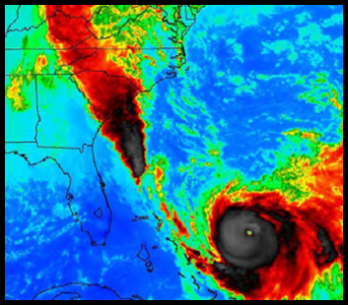
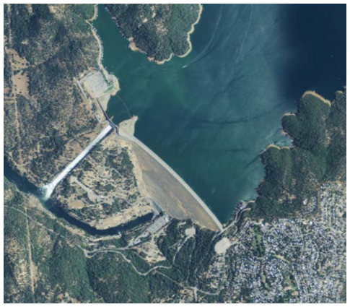
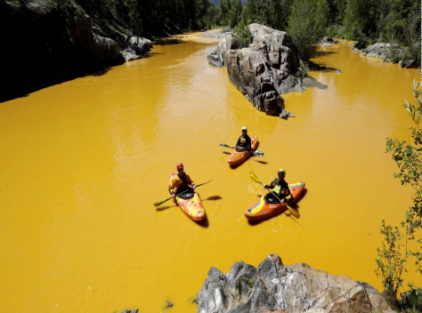
Disaster Coordination Preparedness & Response
(DCPR) Web Maps
Purpose: provide Bureau situational awareness / resource management
Platform
ArcGIS On-line
Web Map / Application
Data
USGS - National Map Base Layers
Mission Area Layers (Floods, Volcano, Earthquake……
Partner Data (Other Feds, State Agencies, NGO’s)
Event Specific Acquired Data
Notes:
Gold King 08/2016 / Lumberton NC, Hurricane Matthew 09/2016 / Oroville Dam, CA 02/2017 /
AGOL Web Map / Open to Public /
Base Data: TNM Data, US Topo and Enhanced Elevation data indexes, Stream gages / National Hydrography Dataset, Boundaries…….
Mission Area Data: water level sensors…… (flood response / monitoring)
Partner Data: Civil Air Patrol imagery, NOAA imagery, State imagery
Event specific Data

Slide 9
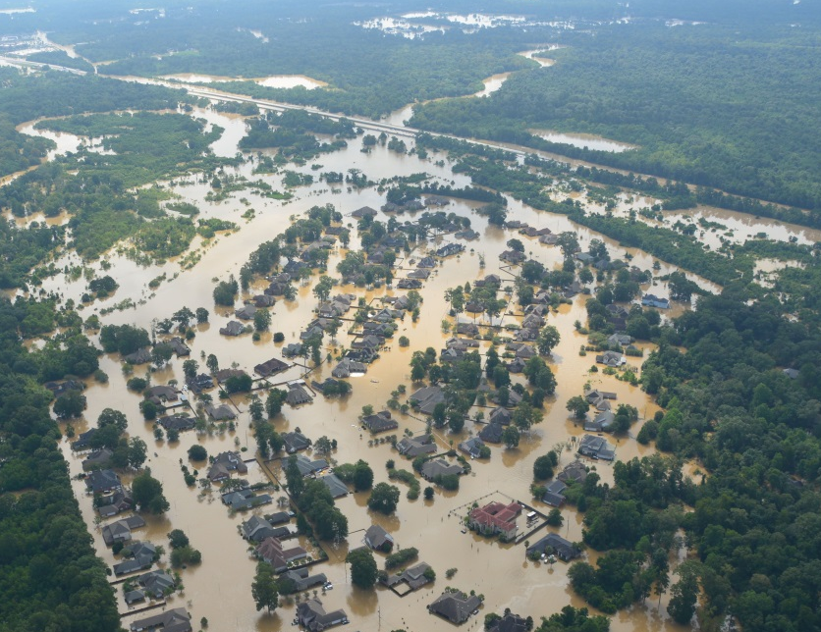
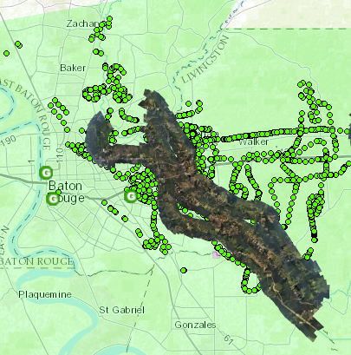
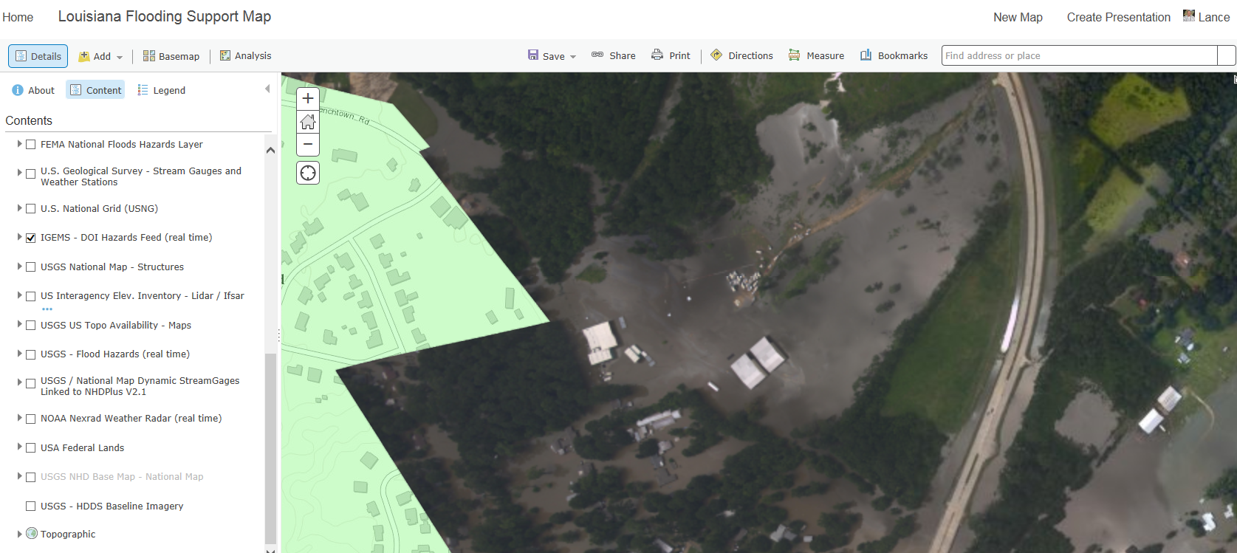
Web Mapping Application
Supporting Disaster Response
Notes:
The USGS also supports each major disaster with a web mapping service that acts as a coordination and information portal and supports USGS Management decisions.
We provide USGS base data along with partner data (FEMA, NOAA, USAF-CAP) to provide current situational awareness for our managers and field crews.
This resource has been a huge asset in planning and conducting High Water Mark and Sediment surveys. Base data layers include IGEMS, NHD, Elevation Interagency Inventory, stream gages, USGS facilities, USNG.

Slide 10
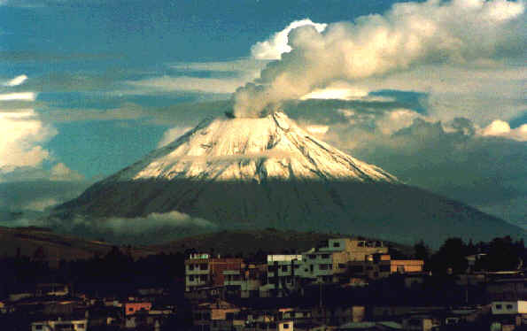
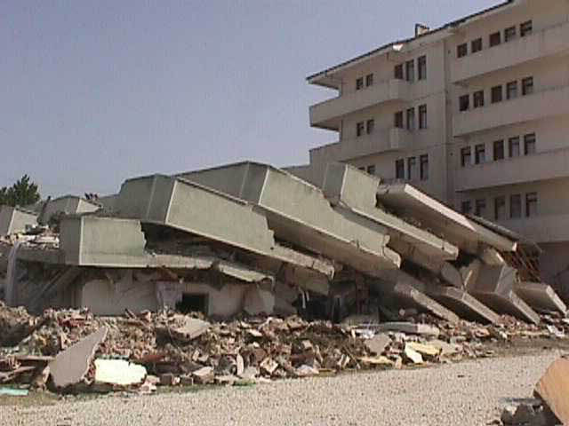
Disaster Coordination Preparedness & Response (DCPR) Hazards Data Distribution System (HDDS) Operations Support
Fiscal Year 2016 (51 events)
Domestic: 32
International: 19
Included:
Typhoon Haima, Philippines
Hurricane Matthew (Caribbean/US)
Earthquake (Exercise) Cascadia Rising
Flood in Southern US
Earthquake in Japan
Fires in Canada
Fiscal Year 2017 through April 1 (38 events)
Domestic: 21
International: 17
Included:
Hurricane Matthew (Caribbean/US)
New Zealand Earthquake
Oroville CA Dam
Exercise Patriot South (MS)
Missouri/Tennessee Tornadoes
Peru Floods

Slide 11
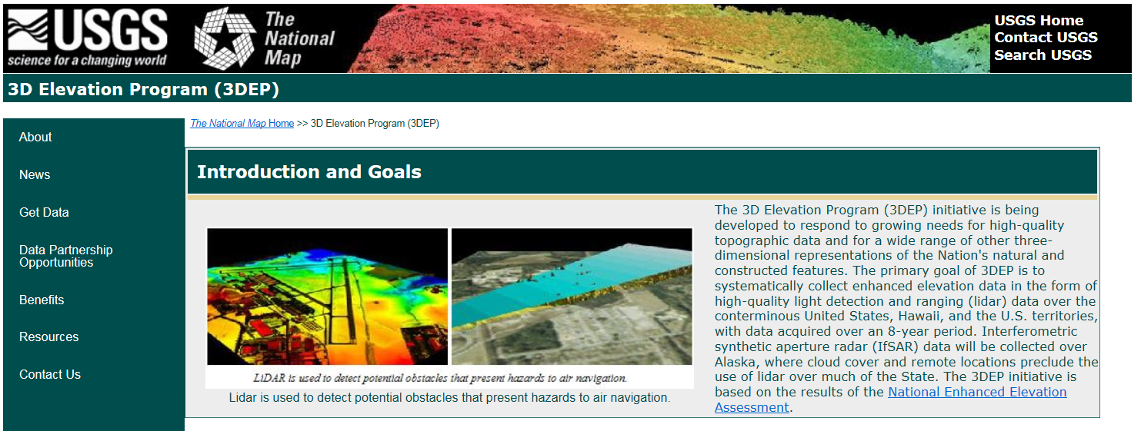
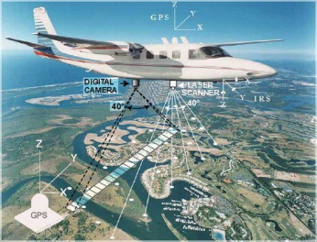
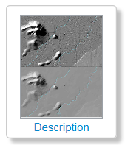
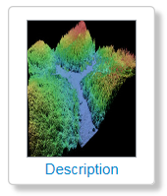
3D Elevation Program (3DEP)
https://nationalmap.gov/3dep/
3D Elevation Program
3DEP Viewer
Elevation Model (3DEP)
Elevation Source Data (3DEP)

Slide 12
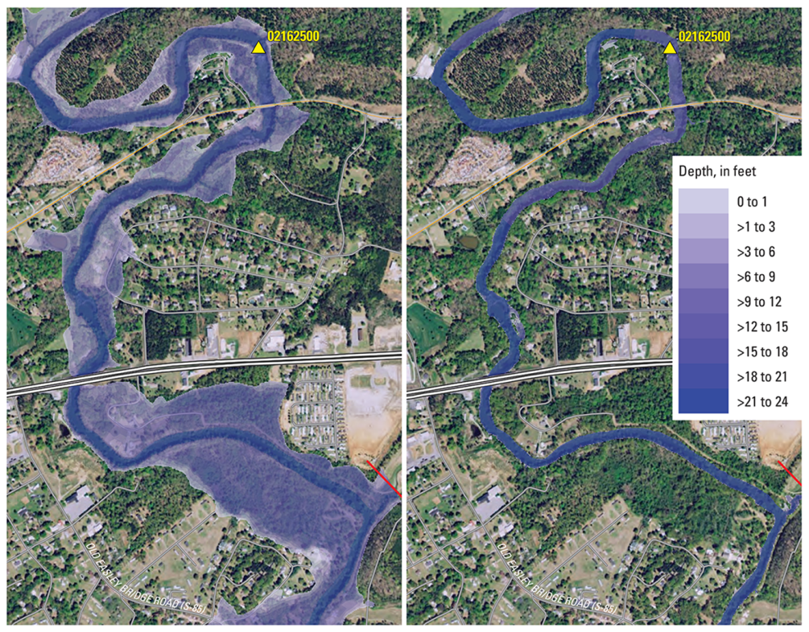
3DEP for Flood Risk Management
Conservative annual benefits estimated at $502M
Producing much higher quality flood maps, including Flood Insurance Rate Maps
Managing dam and levee safety programs reducing flood risks
Improving hydrologic modeling and flood forecasting
Improving State and local government flood risk management and response
Improving storm water facilities and dam design
Extracting building footprints and identifying the finished floor elevation in order to quantify potential damages based on flooding depths
Lidar aids hydraulic modeling to determine flood-inundation on the Saluda River, near Greenville, SC

Slide 13
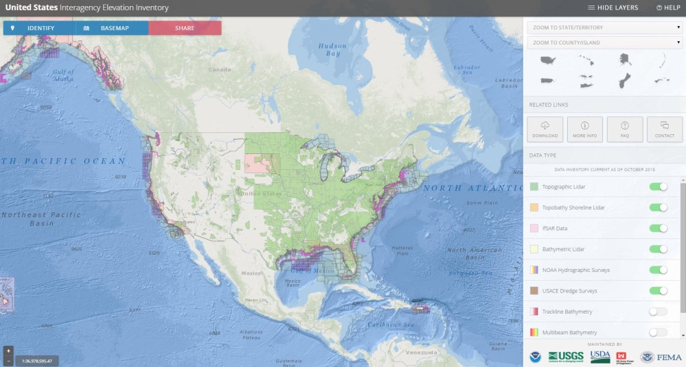
U.S. Interagency Elevation Inventory
Where has lidar data been collected?
Interagency Collaboration – USGS, NOAA, other Federal agencies
Active updates are critical to assessing progress toward 3DEP goals
coast.noaa.gov/inventory
Notes:
www.csc.noaa.gov/inventory
The USGS us actively involved in updating the inventory. Two of our 3DEP Team Members actively work with our National Map Liaisons as well as the other Federal Agencies listed here to assure a precise accounting of available data.

Slide 14
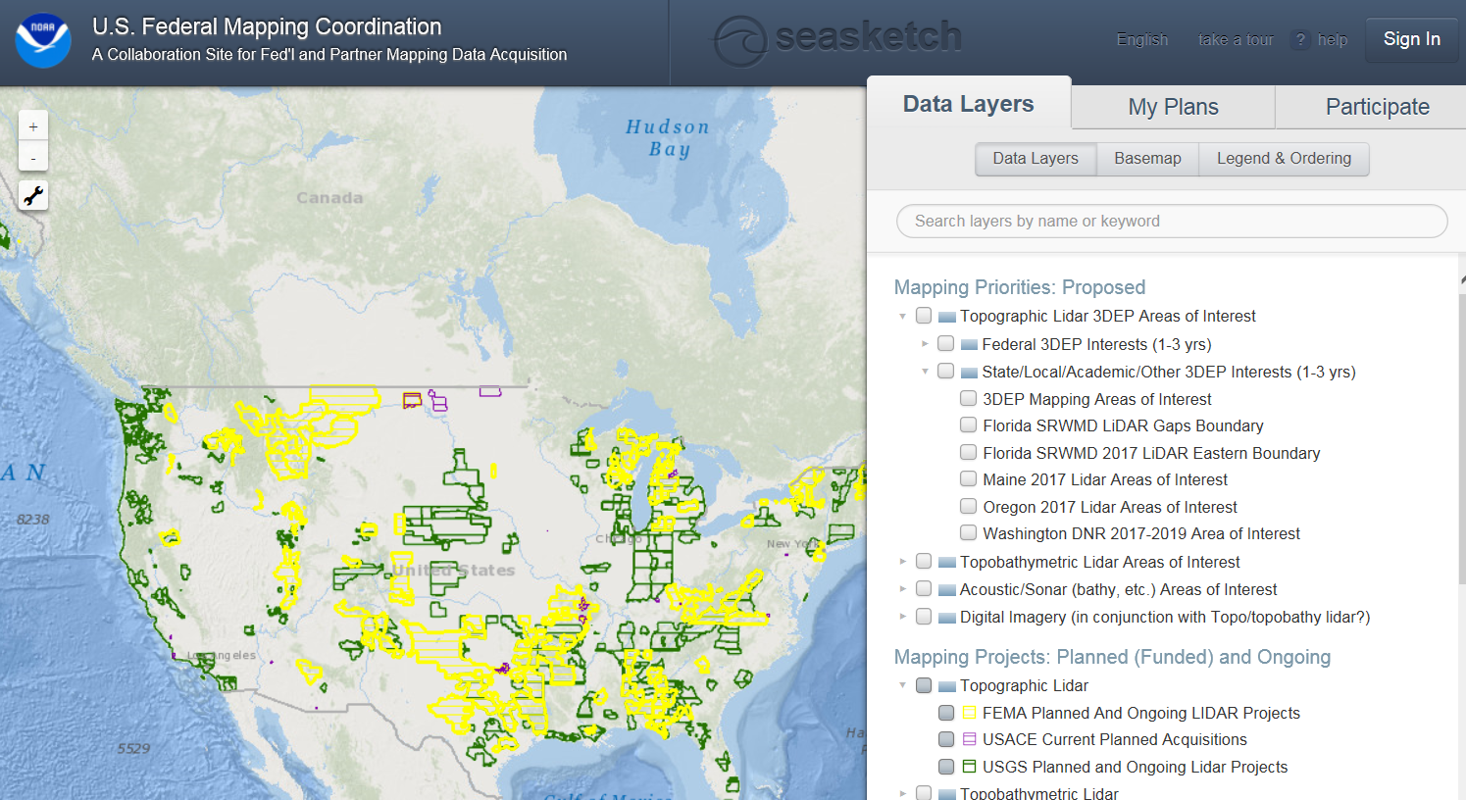
Federal / Public 3DEP Project Collector Tool
Collector Tool: https://survey.geoplatform.gov/index.php/survey/index/sid/782514/newtest/Y/lang/en#
SeaSketch: http://www.seasketch.org/#projecthomepage/5272840f6ec5f42d210016e4/about
Notes:
www.csc.noaa.gov/inventory
The USGS us actively involved in updating the inventory. Two of our 3DEP Team Members actively work with our National Map Liaisons as well as the other Federal Agencies listed here to assure a precise accounting of available data.

Slide 15
Solicitation for 3DEP Partnerships
2017 Broad Agency Announcement for FY18 Projects
Target Release Date: August 15th
Initial Proposal Due Date: October 20^{th,}
Decisions November – January (based on the availability of funding)
Public Webinar Dates:
August 10, 2017 at 1pm ET - Registration Required
August 17, 2017 at 3pm ET - Registration Required

Slide 16
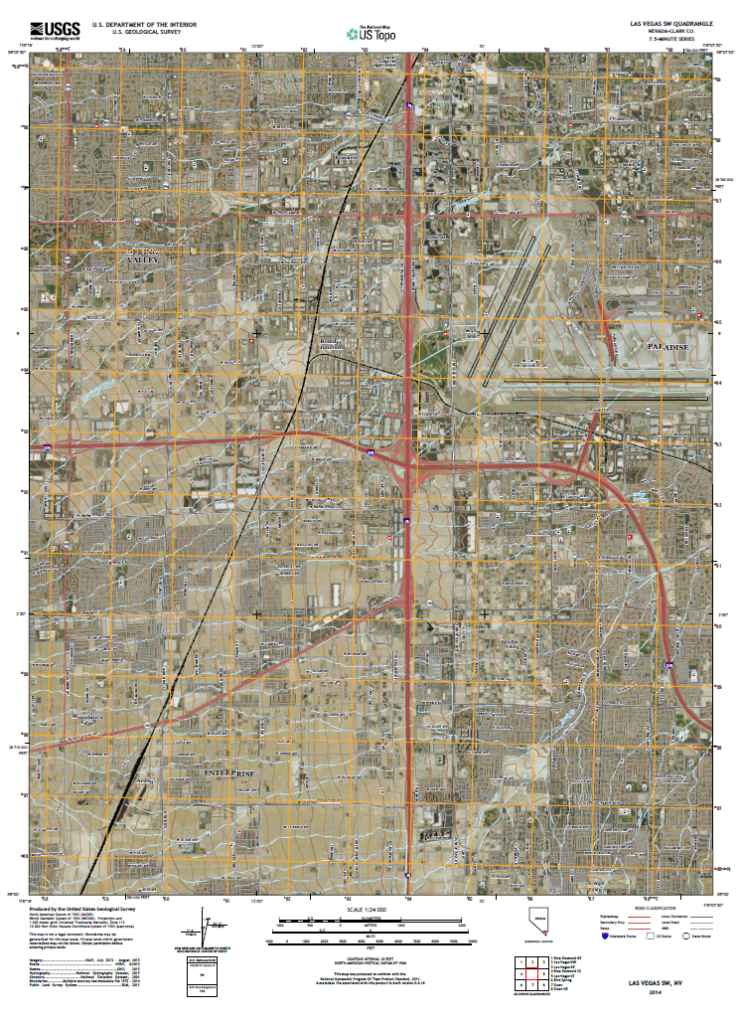
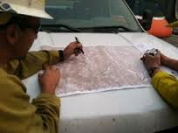
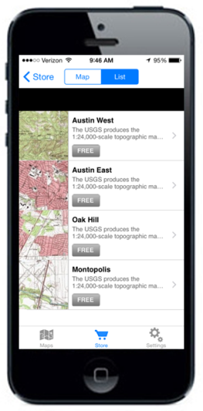
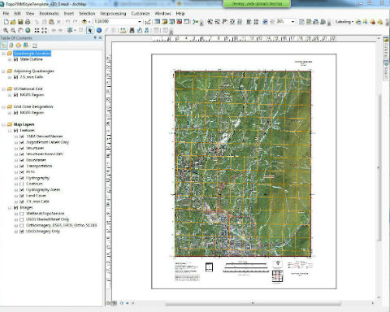
U.S. Topo Map http://nationalmap.gov/
US Topo flavors
Digital PDF Maps / (GeoTIFF 2017)
Vector Data Product - “GIS Ready”
Mobile Download / Use
Hard Copy
Notes:
U.S. Topo – incorporates most of the standard layers found on a map along with optional imagery background and a selection of reference systems including UTM and MGRS. Updated at least every 3 years. Free download
The Topo Combined Vector - product is one specific type of staged product. This product is staged at a 7.5-minute footprint that corresponds with a single US Topo Map extent. Among other themes it will include Elevation Contours, Government Units (Boundaries), Land cover polygons, Structures, Transportation, Hydrography, and TNM Derived Names. The 7.5-minute map cell feature class is also included. The Topo Combined Vector Product is intended for a variety of GIS and cartographic applications, including direct use with the Topo TNM Style Template: https://viewer.nationalmap.gov/basic/
The template is provided as an Esri-specific solution (ArcGIS v10.0 map document (mxd)) for the benefit of USGS earth scientists and other scientific professionals who have a requirement for symbolized and annotated topographic base map layers to support advance Geographic Information System (GIS) analysis and mapping.
Mobile Apps: Android = AlpineQuest, OruxMaps, GaiaGPS / IOS = , Avenza (PDF), Galileo Offline Maps
Mobile Download Client: http://viewer.nationalmap.gov/beta/mobile_client/index.html#/datasets
Defense Logistics Agency and the USGS have partnered to provide a “hard copy” bulk delivery option for US Topos to support disaster response.
HTMC – TopoView. available in both GeoPDF and GeoTIFF. Use TopoView to locate and download

Slide 17
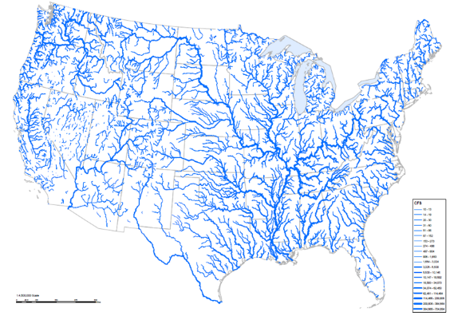
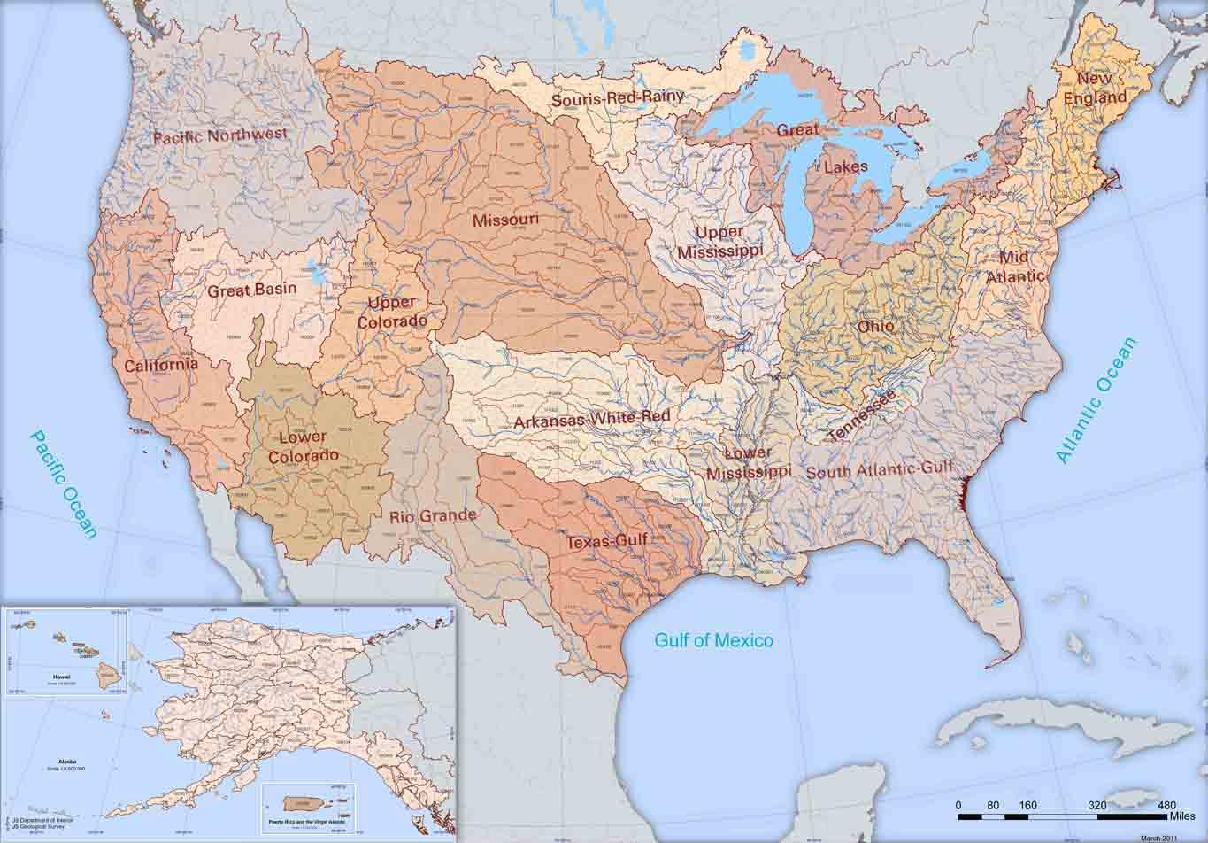
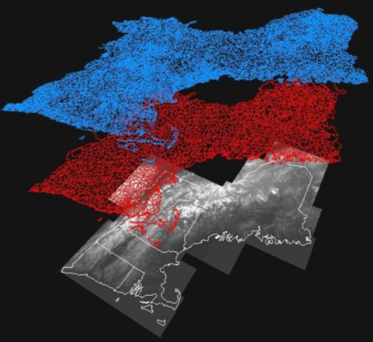
USGS National Hydrography Datasets
National Hydrography Dataset (NHD)
Watershed Boundary Dataset (WBD)
NHDPlus High Resolution (NHDPlus HR)
Incorporates many of the best features of the NHD, WBD and 3D Elevation Program (3DEP) data to extend the hydro network across the landscape and enhance modeling
Catchment areas create a seamless, scalable hydrologic framework
Map and model the flow of water and related attributes across the landscape
Can be generalized to many different scales
NHDPlus HR Beta completed for CONUS in 2018
NHD
WBD
3DEP
Notes:
The National Hydrography Dataset (NHD) and Watershed Boundary Dataset (WBD) are used to portray surface water on The National Map. The NHD represents the drainage network with features such as rivers, streams, canals, lakes, ponds, coastline, dams, and stream gages. The WBD represents drainage basins as enclosed areas in eight different size categories. The NHD is more than blue lines on the map – it is a powerful database that contains a flow network that allows for modeling and tracing water downstream or upstream. The NHD and WBD use an addressing system based on reach codes and linear referencing to link specific information about the water such as water discharge rates, water quality, and fish population.

Slide 18
Notes:
Why is NHD maintenance important – NHDPlus 100K is the backbone for many applications including the ICWater application.
ICWater can stand alone as a GIS enabled application or it can plug-in to other existing incident command tools such as the COBRA platform, DTRA Consequences Assessment Tool Set (CATS), the Federal Emergency Management Agency’s HAZUS system and EPA’s Emergency Response Analyzer. Contact Bill Samuels of Leidos for more information: 703-676-8043 / samuelsw@saic.com

Slide 20
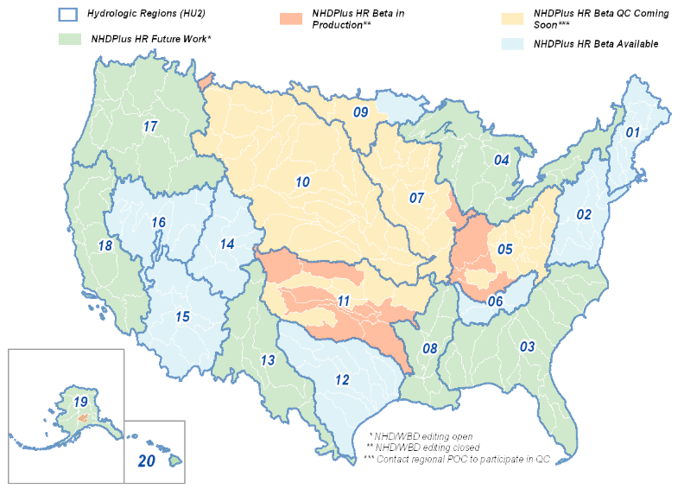
NHDPlus HR Beta Status
First Beta datasets released in April, 2017
Beta completed in 2018 for CONUS, followed by AK, HI, and territories
Users invited to QC Beta datasets
QC feedback used to update and improve the next dataset release
As of June 29, 2017
https://nhd.usgs.gov/NHDPlus_HR.html
Notes:
The NHDPlus HR is built using:
The National Hydrography Dataset High Resolution data at 1:24,000 scale or better
The 1/3 arc-second (10 meter ground spacing) 3D Elevation Program data
The nationally complete Watershed Boundary Dataset
NHDPlus HR data is currently available in Beta version for selected hydrologic regions from the Get Data Products and Map Services page and The National Map Download viewer.
There's a chance we'll release Region 10 before August 8th, 2017.

Slide 21
National Geospatial Program Data and Information
https://viewer.nationalmap.gov/launch/
Notes:
The USGS-National Geospatial Program offers data, data services and applications that support oil spill response as well as other natural and human caused hazards events. The main portal for this information is: The National Map, Data Download and Visualization site at: https://viewer.nationalmap.gov/launch/
Mobile Download Client – usable on any mobile device. Data formats are the same as main viewer / download site.

Slide 22
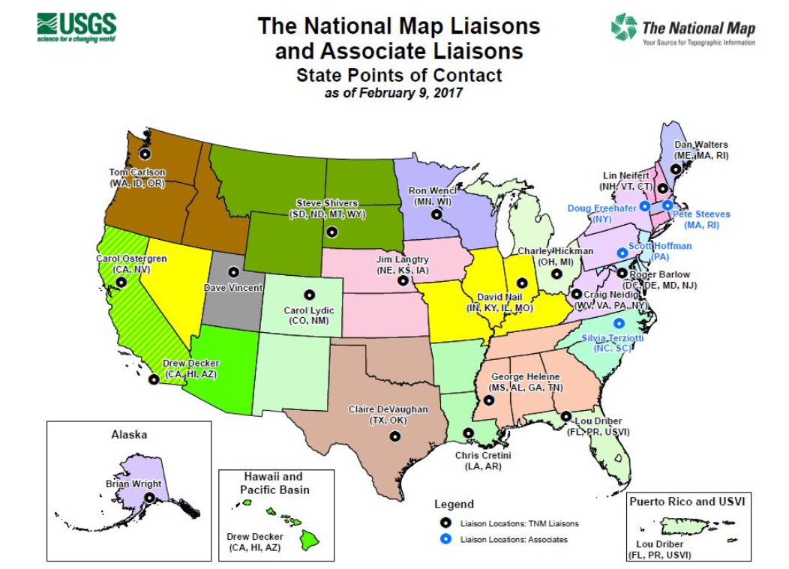
USGS National Map Liaisons
https://liaisons.usgs.gov/geospatial/
Notes:
NGP contacts for each state.

Slide 23
Questions & Discussion

