Slide 1
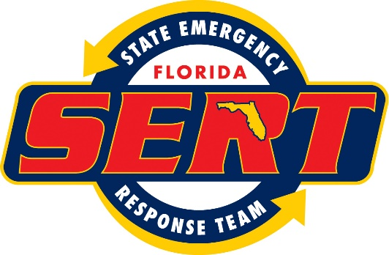
Resources Typing and Mission Ready Packaging GIS Resources:
Richard Butgereit, GISP
Richard.Butgereit@em.myflorida.com
Chief Information Officer
850-851-4701
Florida Division of Emergency Management

Slide 2
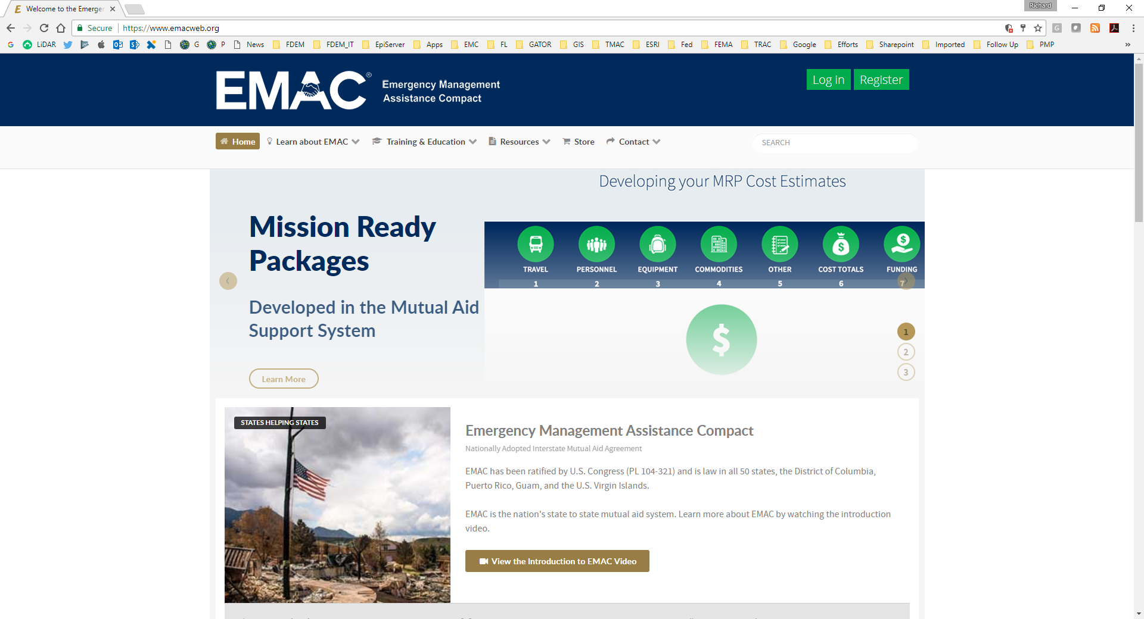
Mutual Aid
https://www.emacweb.org
Notes:
EMAC, the Emergency Management Assistance Compact is an all hazards - all disciplines mutual aid compact that serves as the cornerstone of the nation's mutual aid system.
EMAC offers assistance during governor-declared states of emergency or disaster through a responsive, straightforward system that allows states to send personnel, equipment, and commodities to assist with response and recovery efforts in other states. Through EMAC states can also transfer services (such as shipping newborn blood from a disaster-impacted lab to a lab in another state) and conduct virtual missions.

Slide 3
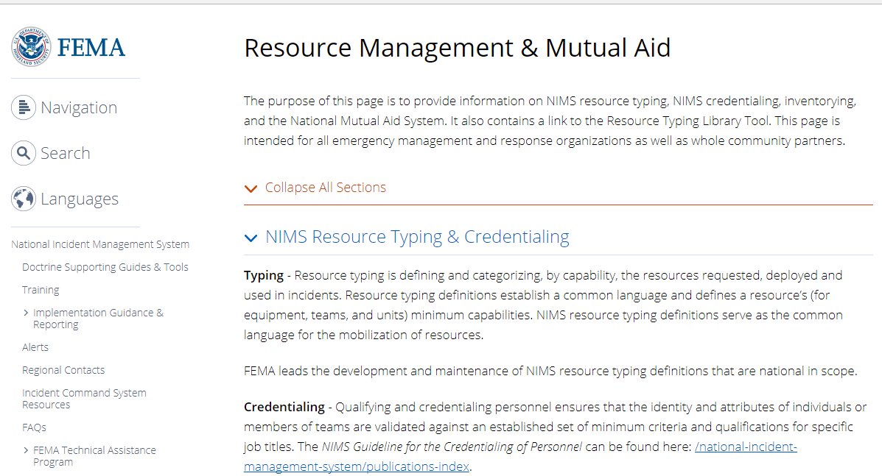
NIMS Resource Typing
https://www.fema.gov/resource-management-mutual-aid
Notes:
NIMS is the National Incident Management System. Resource typing is defining and categorizing, by capability, the resources requested, deployed and used in incidents. Resource typing definitions establish a common language and defines a resource’s (for equipment, teams, and units) minimum capabilities. NIMS resource typing definitions serve as the common language for the mobilization of resources.
Typed resources are available online through the Resource Typing Library tool available at https://rtlt.preptoolkit.fema.gov.

Slide 4
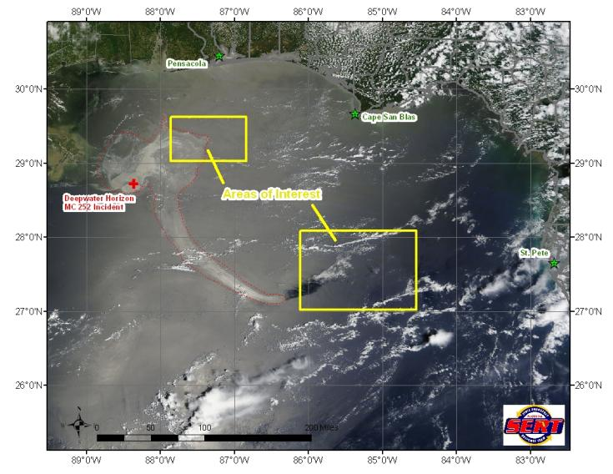
Deepwater Horizon Response
Satellite imagery from 05/17/2010 displaying 2 areas of interest.
Notes:
Let’s relate some of the issues here to the experiences of an emergency management GIS professional.
Summer of 2010, Deepwater Horizon disaster happens off of coastal Louisiana, affecting the entire gulf coast.
Florida turns to EMAC to seek backfill of GIS positions at the State EOC as staff are now deployed to Mobile Incident Command Post.

Slide 5
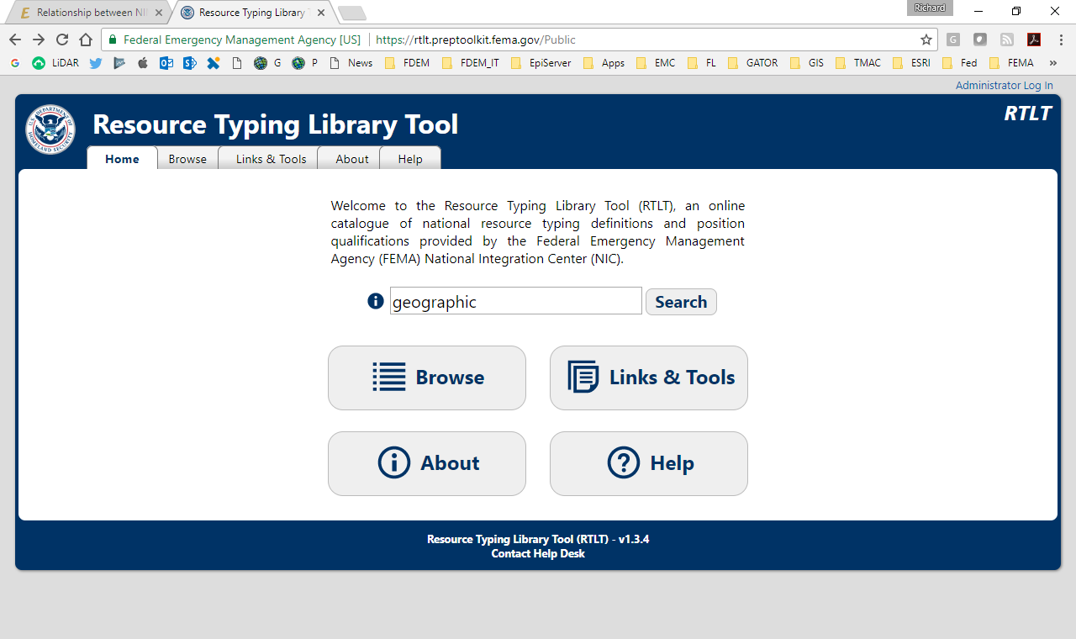
Resource Typing Library Tool
https://rtlt.preptoolkit.fema.gov
Notes:
Turning to the Resource Typing Library Tool, a user can search for “geographic” to find applicable resources types….and…

Slide 6
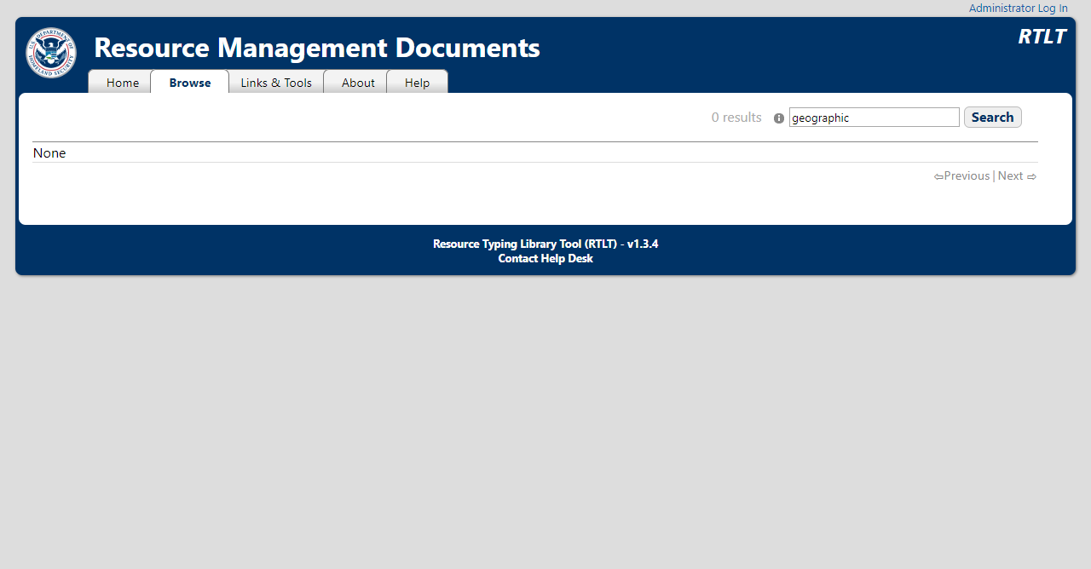
Resource Typing Library Tool
https://rtlt.preptoolkit.fema.gov
Notes:
Despite great, existing models from the National Wildfire Coordinating Group and the DHS Geospatial Con-Ops…
Despite efforts completed back in 2013 by the FEMA National Integration Center -- efforts that included stakeholders like myself representing state government, and along with local government national organizations like NAPSG, and others…
Even though since 2011, FEMA itself also has well developed task books for Geographic Information System Manager, Geographic Information System Specialist, Geographic Information Unit Leader, and Remote Sensing Specialist….
There are no GIS resources typed in the library.
(NOTE: search performed 08/04/17 for “geographic”, “geospatial”, and “GIS”)

Slide 7
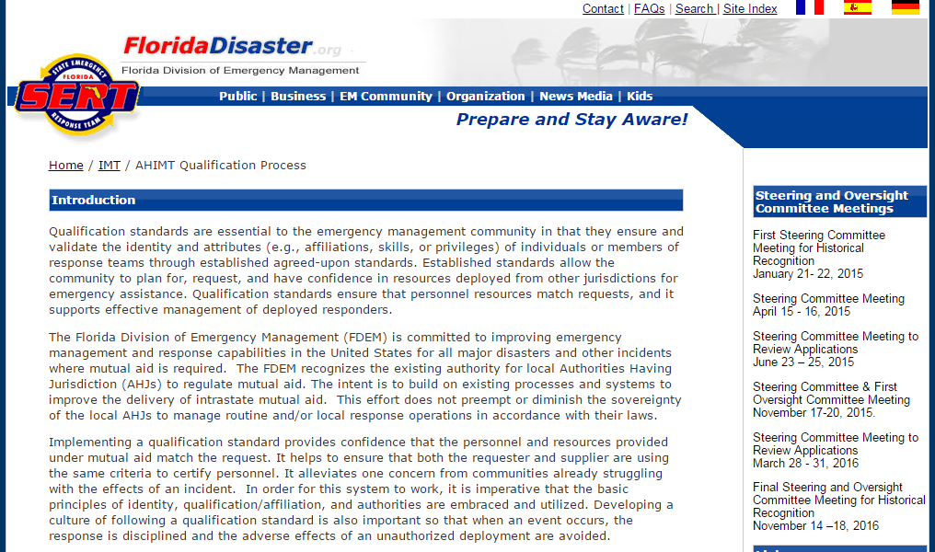
All Hazards Incident Management Team
http://www.floridadisaster.org/ahimt
Notes:
Here’s another example of some of the challenges with GIS resource typing…Florida recently embarked upon an effort to build-out credentialed All Hazards Incident Management teams.

Slide 8
AHIMT
Historic Recognition – phase 1
Over 100 individuals
Qualified 15 positions
Task Book – phase 2
~30 more applications
Notes:
During the first phase of this effort, “historic recognition” was used to “grandfather” in experienced emergency managers in Florida. Over 100 individual applied for and were approved for 15 different positions.
Phase 2 of this process, requiring application, training, and task books to track and demonstrate knowledge and capabilities is now underway.

Slide 9
AHIMT
http://www.floridadisaster.org/ahimt
NO GIS POSITIONS!!!
Notes:
With this process – there are no GIS positions defined and credentialed – though most of the Incident Commanders I know who lead these teams plan to bring along a GIS resource specialist when they deploy.

Slide 10
NAPSG Position/Team Resource Types
GIS professionals and staff that are dedicated to supporting the public safety mission require a unique combination of knowledge, skills, and abilities in order to effectively support emergency operations.
Establishing minimum criteria and qualifications for GIS personnel and teams for the Nation is critical to building the Public Safety GIS Workforce.
NAPSG developed the first version of Position Qualification Sheets & Resource Types/Packages for Public Safety GIS
Notes:
So what do we do? In 2015, NAPSG developed the first version of Position Qualification Sheets and Resource Types/Packages for Public Safety GIS

Slide 11
Position/Team Resource Types
https://www.napsgfoundation.org/all-resources/qualifications-and-credentialing
Level | Position
Basic 1 | Field Data Entry Technician
Basic 2 | GIS Technician
Intermediate 1 | GIS Analyst
Intermediate 2 | GIS Team Leader
Advanced | GIS Supervisor
Resource Type: GIS Map Support Team
Notes:
Here’s a list of the position and team resources…

Slide 12
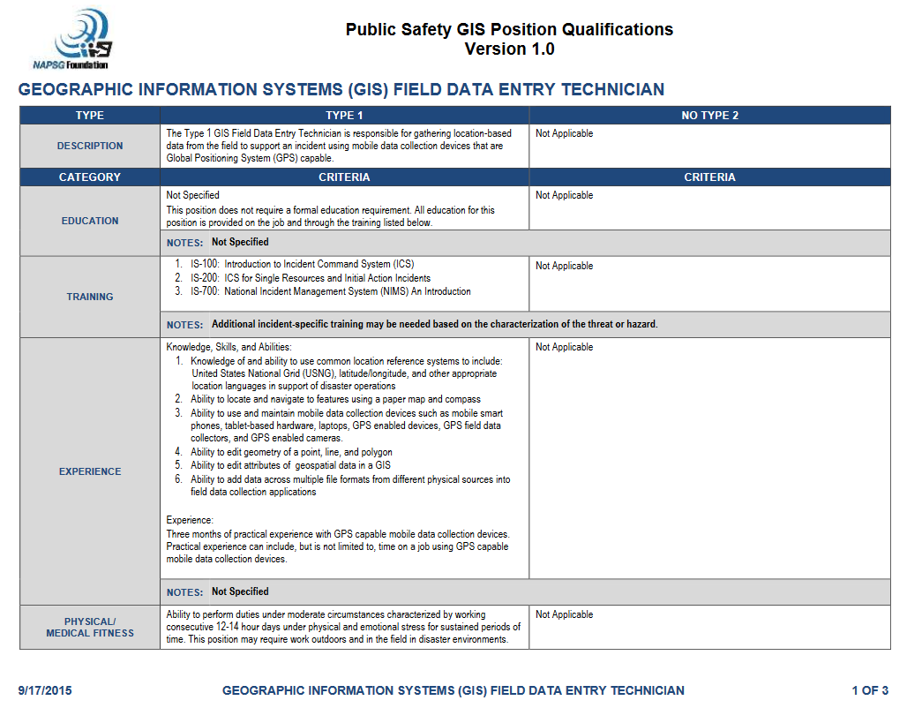
Position/Team Resource Types
Notes:
Here’s a review of the qualifications for a technician.

Slide 13
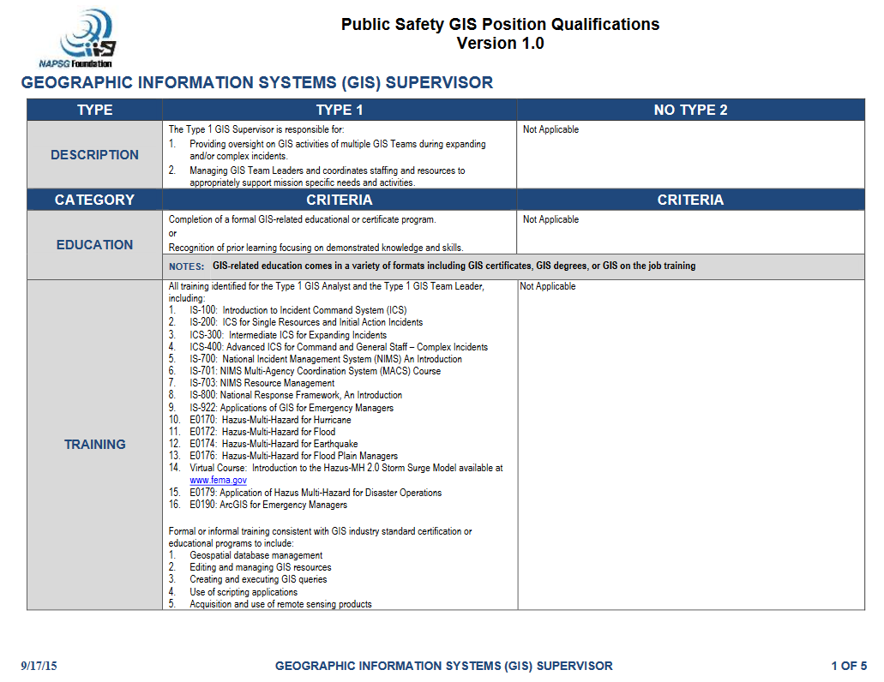
Position/Team Resource Types
Notes:
Here’s a review of the qualifications for supervisor

Slide 14
Position/Team Resource Types
Notes:
Here’s a review of the map support team types.

Slide 15
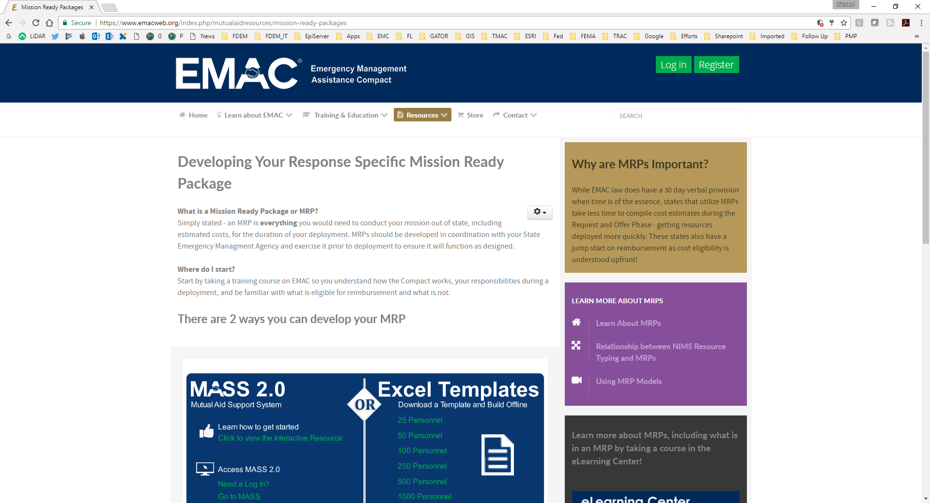
Mission Ready Packages
Notes:
Going back to EMAC….let’s look at Mission Ready Packages. A Mission Ready Package is everything you would need to conduct your mission out of state, including estimated costs, for the duration of your deployment.
There are 2 ways you can develop an MRP – using MASS, the Mutual Aid Support System, or using Excel templates.
You can take a training course on EMAC web to further assist as well.

Slide 16
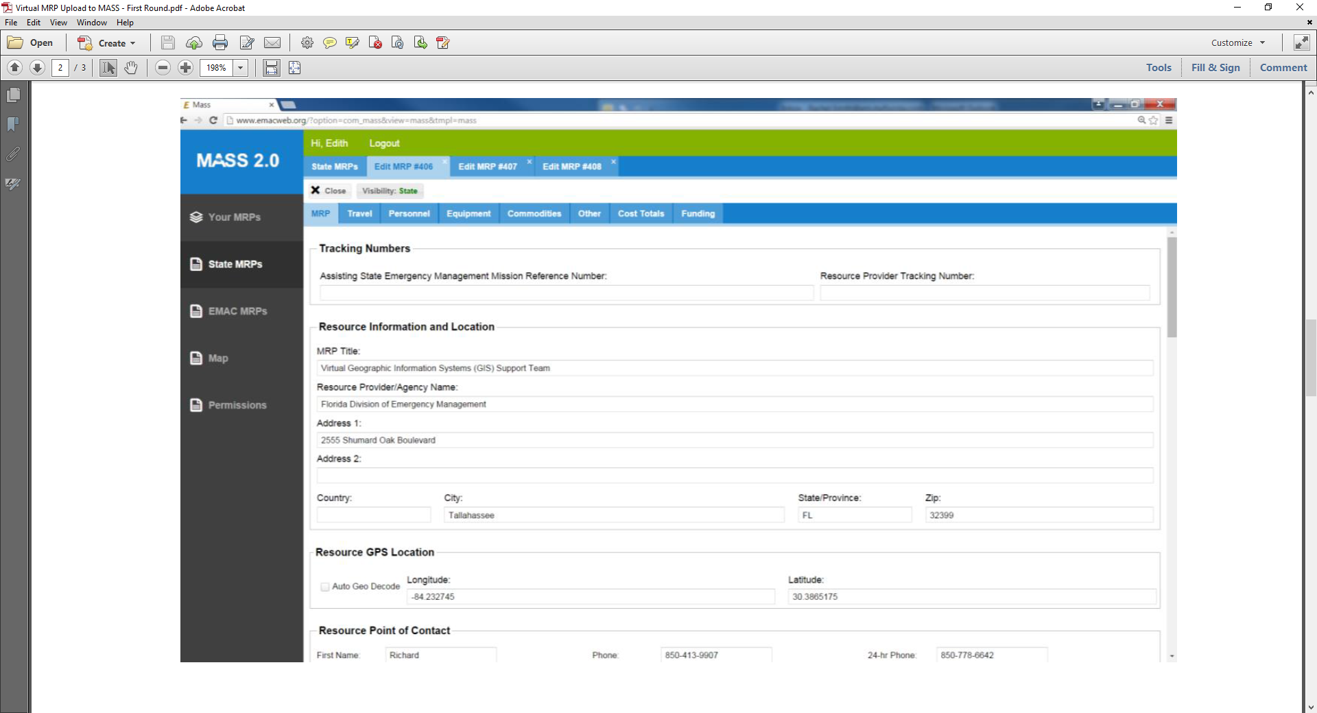
Mission Ready Packages
Notes:
Once developed, your mission ready packages may go into MASS and be available for other states.
Here’s an example of the Virtual Geographic Information Systems (GIS) Support Team that Florida has developed as a MRP and made available through EMAC.
Note that North Carolina emergency management developed a similar team, and has even been “deployed” in support of floods in West Virginia, becoming – as far as I know – only the second time the State-to-state EM assistance compact was used to accomplish GIS missions (the first being when Florida obtained GIS resources during Deepwater Horizon Response).

Slide 17
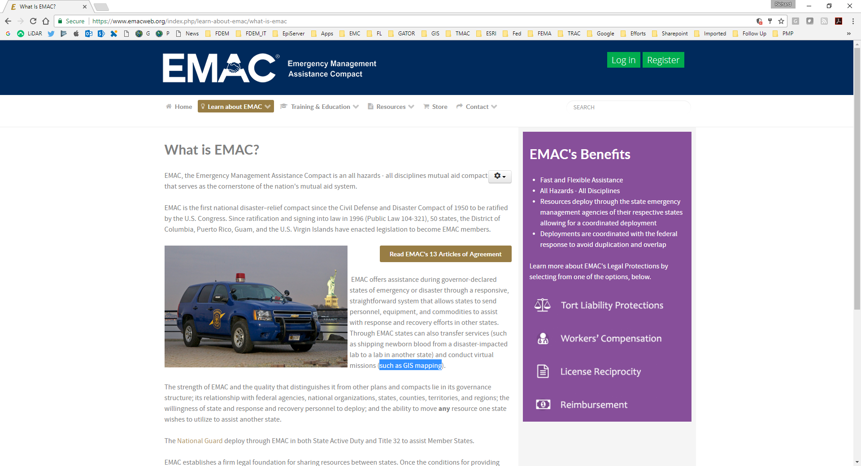
Questions?
Notes:
So – what does all of this mean to you? NAPSG position and team descriptions are available – use them. With your response plans, include the positions and teams descriptions from NAPSG. With our training plans, pursue the training requirements specified by the NAPSG position descriptions. Note there is room for further tailored use – for example, the Texas EGRT we just learned about requires a specific training course produced by their organization.
If you can support it, develop virtual and deployable Mission Ready Packages to share with EMAC.
Questions? Note shout out on EMAC website to GIS virtual missions!

