Slide 1
First Responders Group (FRG)
August 8, 2017

Slide 2
FRG Mission
Strengthen first responder safety and effectiveness
FRG is unique in supporting research for all first responder disciplines
3.3 Million First Responders, 70,000 Organizations,
$144B in Annual Operating Costs

Slide 3
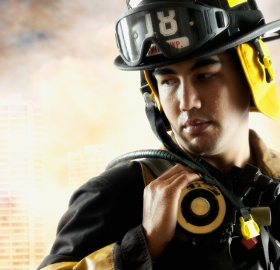
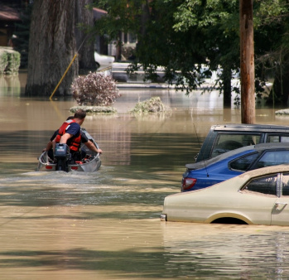
FRG Impact Themes
Protected, Connected and Fully Aware
Securing communities across America
Making first responders safer and more effective
Powering industry and spurring innovation

Slide 4
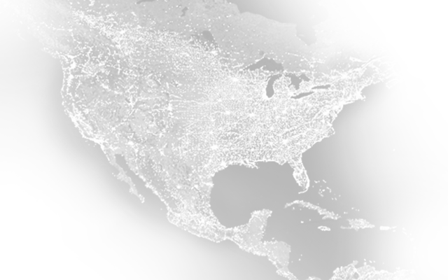
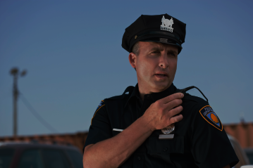
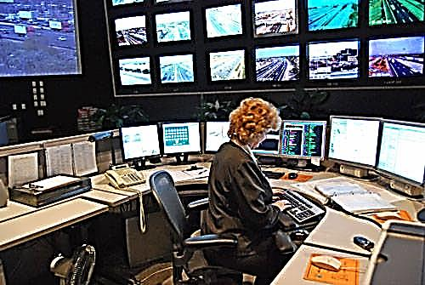
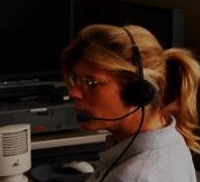
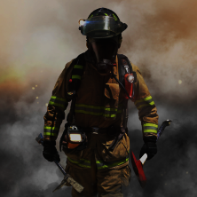
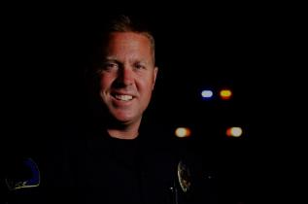
U.S. Public Safety Community
United States: 326+ Million people served daily by first responders
5.5 million responders, 70,000 organizations, 240 million 9-1-1 calls per year
1,100,000
6,000
250,000
State/ Local Law Enforcement Officers
Emergency Operations Centers
911 Operators
850,000
1,100,000
2,200,000
EMS Professionals
Firefighters
Security Officers
Notes:
5.5 million responders statistic includes private sector, which is not included in the 3.3 million first responder total on slide 2.

Slide 5
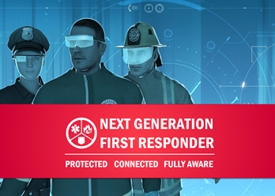
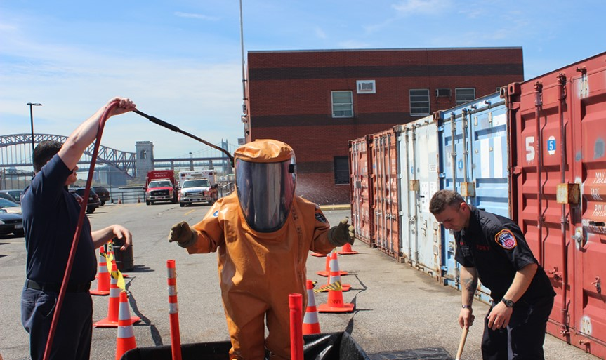
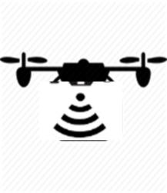
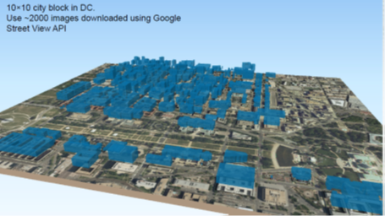
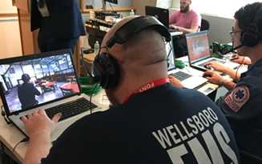
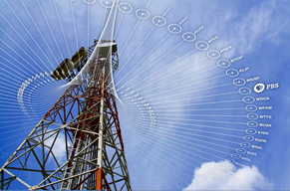
Major FRG Programs
First Responder Technologies
Personal Protective Equipment
Communications interoperability, compatibility and resiliency
IED Response and Defeat Operations (RedOps)
Public Safety Next Generation First Responder Apex
Situational Awareness and Decision Support
Behavioral, Economic and Social Sciences
Flood Apex
First Responder Unmanned Aerial Systems Applications
International Engagement
National Urban Security Technology Laboratory

Slide 6
Commercially Transitioned Technologies Examples
Project Name | Transition Partner / Manufacturer | Purchase Information / Support
Fire Ground Compass® | Halcyon Products, Inc. | http://www.halcyonproducts.com/fgc/
Board Armor™ | Board Armor® | http://www.board-armor.com/
Low Light TPZ Camera | Industrial Video and Control Co. | http://www.ivcco.com/
Flex-Tuff HS Glove (Improved Structure Firefighting Glove) | Shelby Specialty Gloves | http://www.shelbyglove.com/flextuff/flex-tuff-hs.html
First Responder Support Tools (FiRST) App | Applied Research Associates, Inc. | https://www.firstsupporttools.com/
Pipe Bomb Cutter | RE2, Inc. | http://www.resquared.com/products/eod-tools/
Virtual Training: Enhanced Dynamic Geo-Social Environment (EDGE) | California Fire & Rescue Training Authority | http://www.fireandrescuetraining.ca.gov/
Radio Internet-Protocol Communications Module (RIC-M) | Christine Wireless, Inc. Avtec, Inc. | http://christinewireless.com/purchase/ http://www.avtecinc.com/scout/integration/ric-m
Wildland Firefighter Advanced Personal Protective System (WLFF APPS) | Workrite Uniform Company Crew Boss PPE | http://www.workrite.com/ https://crewbossppe.com/
High Definition (HD) Video Encoder (HD-S600) | Digital Barriers | https://www.digitalbarriers.com/tvi-encoders
Finding Individuals for Disaster and Emergency Response (FINDER) | R4, Inc. SpecOps Group Inc. | http://www.r4-inc.com http://www.specops-group.com/
Prepaid Card Reader | ERAD Group | https://www.erad-group.com/erad-prepaid
ViSi Mobile® System (Wireless Patient Vital Signs Monitoring) | Sotera Wireless , Inc. | http://www.soterawireless.com/
Notes:
[Explosion]
When an incident does occur and that 9-1-1 call comes in, everything shifts from preparing to response and recovery. And here again, we are developing technologies to meet the needs of those who are on the front line.

Slide 7
Project Responder 4 Most Critical Capabilities in Rank Order
Capability 1: The ability to know the location of responders and their proximity to risks and hazards in real time.
Capability 5: The ability to communicate with responders in any environmental conditions (including through barriers, inside buildings, and underground).
Capability 2: The ability to detect, monitor, and analyze passive and active threats and hazards at incident scenes in real time.
Capability 3: The ability to rapidly identify hazardous agents and contaminants.
Capability 9: Protective clothing and equipment for all responders that protects against multiple hazards.
Capability 6: Communications systems that are hands-free, ergonomically-optimized, and can be integrated into personal protective equipment.
Capability 4: The ability to incorporate information from multiple and non-traditional sources (e.g., crowdsourcing and social media) into incident command and operations.
Capability 7: The ability to remotely monitor the tactical actions and progress of all responders involved in the incident in real time.
Capability 12: The ability to remotely scan an incident scene for signs of life and decomposition to identify and locate casualties and fatalities.
Capability 10: The ability to identify what resources are available to support a response (including resources not traditionally involved in response), what their capabilities are, and where they are, in real time.
Capability 11: Readily accessible, high-fidelity simulation tools to support training and exercises in incident management and response.
Capability 8: The ability to identify trends, patterns, and important content from large volumes of information from multiple sources (including non-traditional sources) to support incident decision-making.
Capability 13: The ability to monitor the status of resources and their functionality in current conditions, in real time.
Capability 14: The ability to identify, assess, and validate emergency-response related software applications.

