Slide 1
Emergency Response Mapping in Texas Who is involved and how we’re set up…
David W. Allen, GISP
State Director of Operations
Texas Emergency GIS Response Team
Director@TexasEGRT.org
www.TexasEGRT.org

Slide 2
Why do we need maps for emergency response
Stop me when you see a question that you HAVEN’T heard in the EOC …
Where did that happen?
How much area is affected?
What’s next to that?
The ?-Team has arrived … where can we stage them?
Somebody tell them how to get there.
How many houses / structures were damaged
What’s the population in that area?
The EOC command staff needs a LOT of information about the area – WE GOT THAT
… you don’t have to sell map people on the benefit of maps …

Slide 3
Why call a mapping team … Why not DIY?
Don’t tie up your trained responders by appointing them “The Map Guy”
We integrate well with specialty response teams that realize they need mapping
SWAT
HazMat
Public Works response
EOD
USAR
Wildland Fire
Emergency Management Support
UAS
- Texas A&M Forest Service
- Texas Commission on Environmental Quality
Texas A&M Emergency Veterinarian Response
Building Officials Association of Texas
Texas Task Force 1
- Tex-SAR

Slide 4
Emergency Mapping in Texas
Many larger cities and state agencies have formed GIS response teams
Members from multiple departments
Compiled local datasets
Texas Emergency GIS Response Team (Tx EGRT)
Training protocols set up
Available ArcGIS software and ArcGIS Online
Over 250 members state-wide
State-wide data and map templates set up and ready
Texas Division of Emergency Management (TDEM)
GIS analysts on staff for the State Operations Center w/ support
Plotters at the regional EOC’s
Available computers (coming soon)
The goal is to integrate other response teams, Texas EGRT, and TDEM into a state-wide GIS resource

Slide 5
What is Texas EGRT
Deployable GIS mapping team 1-844-Tex-EGRT
Started as a regional group in 2006 after the 2003 Space Shuttle disaster
Represented 14 cities
Expanded to a state-wide group in 2014
Started in TDEM Region 1 as a Pilot Study
42 Counties in North Texas
Trained GIS responders and participated in exercises
Built trust with EMC’s and regional agencies
Over 250 Members all over the State of Texas

Slide 6
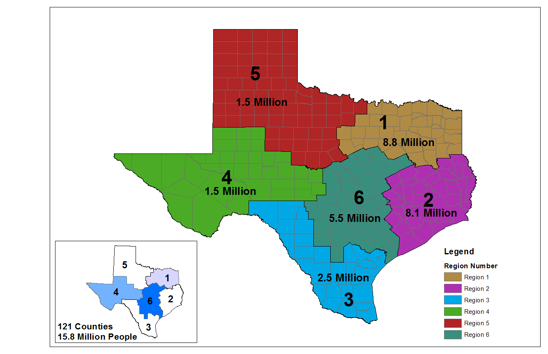
Currently Active in Regions 1, 4, and 6

Slide 7
Texas EGRT Training Level
FEMA IS Courses
IS 100 b
IS 700 a
IS 103
IS-200 b (optional)
IS-800 b (optional
Tx EGRT Online Course
Tx EGRT In-Person 1 day training class
Members receive training on standard mapping protocols in various scenarios as well as our response guide and data sets.

Slide 8
Texas EGRT Training Level

Slide 9
Texas EGRT Templates and Datasets
Templates for Common Operational Picture and Incident Action Plan
Each template can then be augmented with pre-symbolized layer files for various response scenarios
State-wide Datasets compiled from the Texas Natural Resources Information System
These datasets are then augmented with local datasets as needed
I just finished a project with ESRI to port these templates to ArcGIS Pro and make them available for free on their website.
http://esriurl.com/EMgtMaps

Slide 10
Texas EGRT Deployments
Equipment
Laptops / plotters / projectors
Trained Personnel
Typically one mapper for Planning and one mapper for Operations
Mapping software
Data
With our prepared datasets and mapping templates, we simply start up the laptop, pan the map to the disaster site, and we’re ready to go – even with no Internet connections.

Slide 11
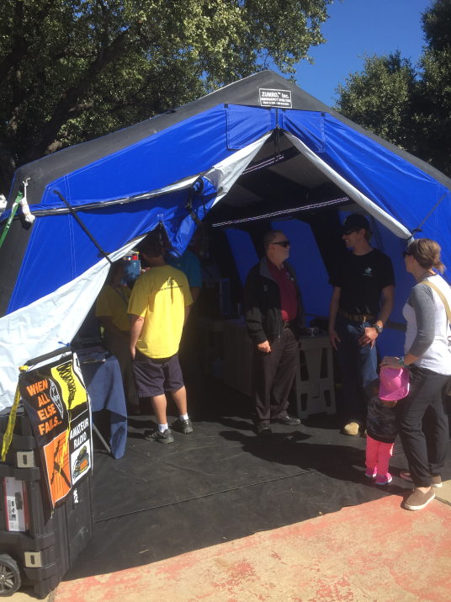
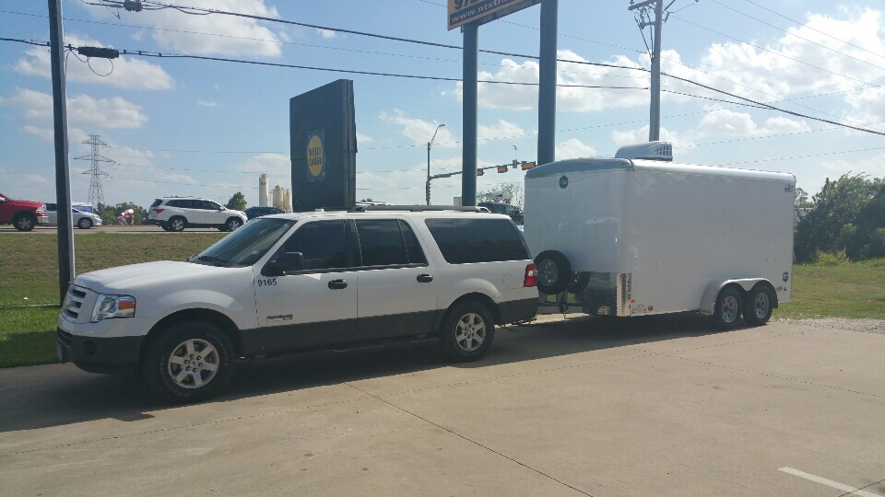
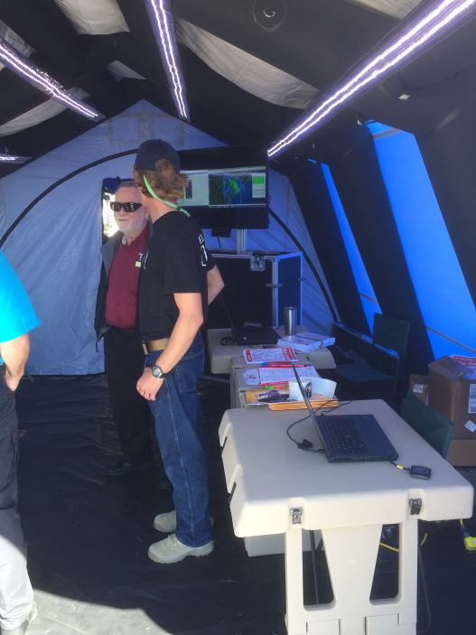
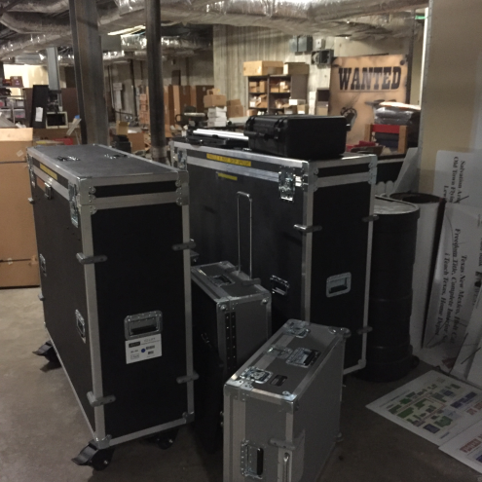
Mobile Capabilities
City of Lewisville EOC-In-A-Box

Slide 12
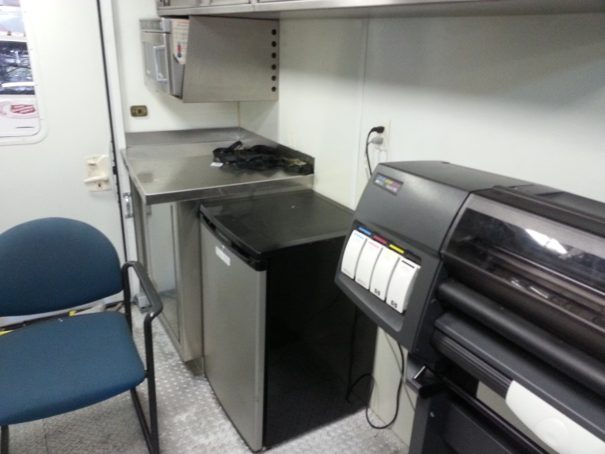
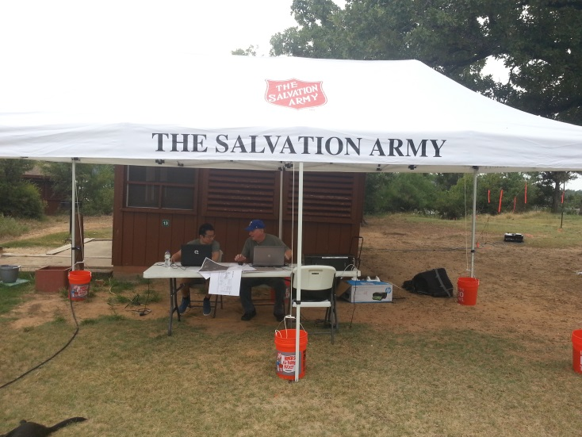
Mobile Capabilities
Salvation Army Communication Truck

Slide 13
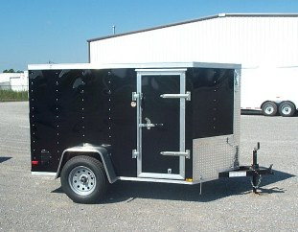
Mobile Capabilities
Texas EGRT Response Trailer (Fall 2017)

Slide 14
Texas EGRT Responses
Multiple flood events
Dam monitoring events
LP Tanker truck accident
Pope’s visit to Juarez, Mexico (supporting state operations in El Paso)
Multiple full-scale exercises
High profile responses:
Ebola cases in Dallas
2016 Flooding in Denton and Tarrant Counties
Christmas 2015 tornadoes in Rowlett / Garland
April 2017 tornadoes in Van Zandt County

Slide 15
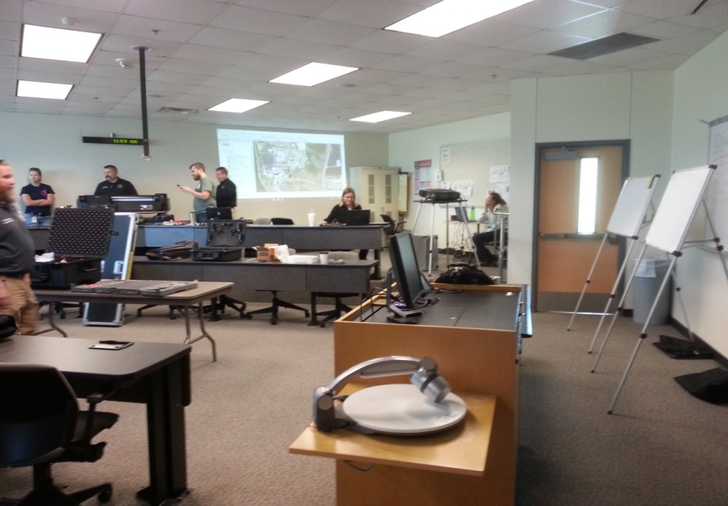
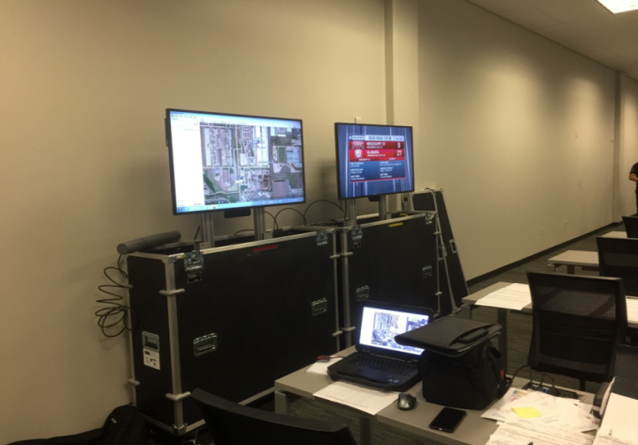
Texas EGRT Responses
Nick Turner, Gini Connolly, Kasey Cox
Tom Konzel, David Allen, Oleysa Powers

Slide 16
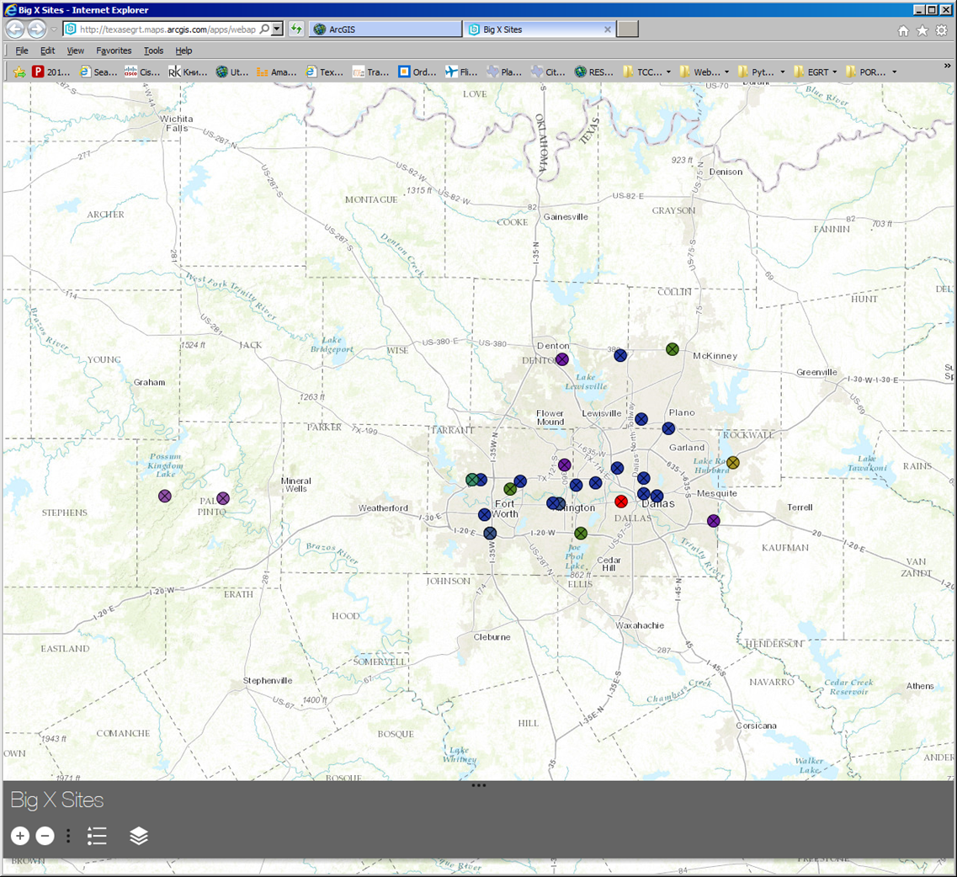
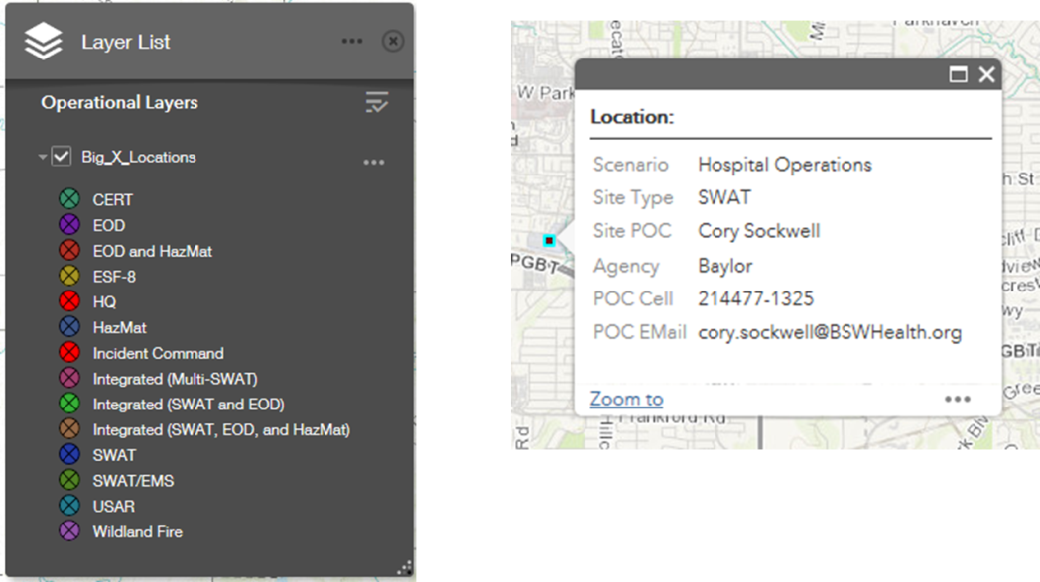
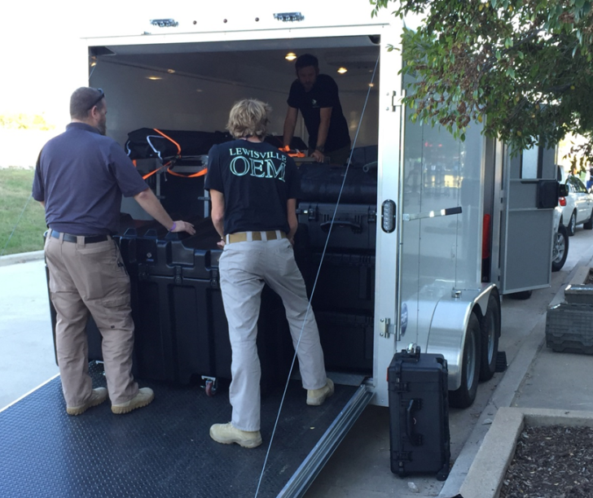
Texas EGRT Responses

Slide 17
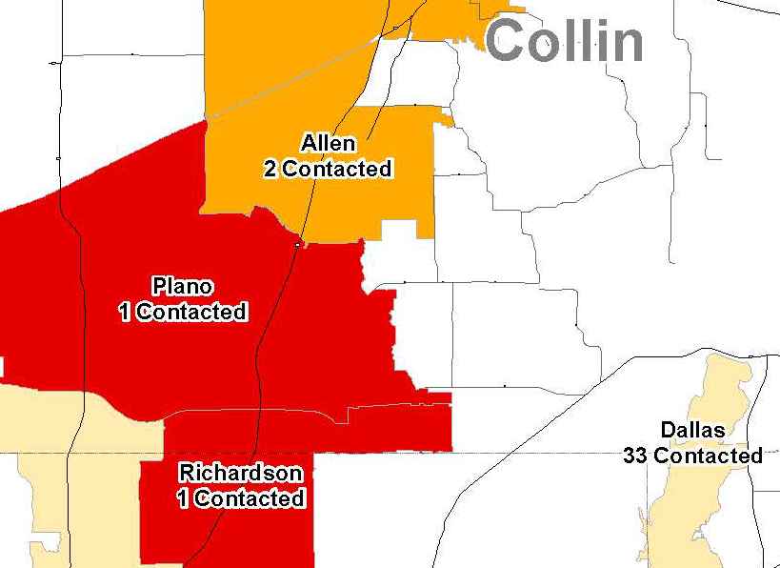
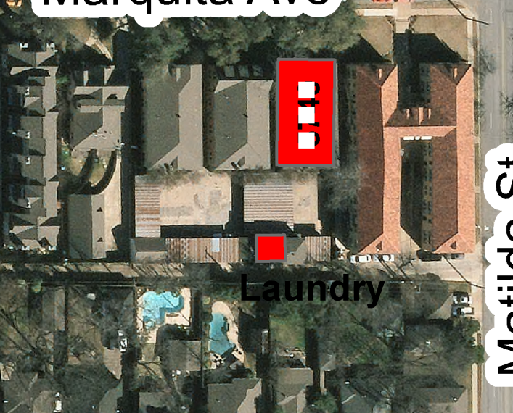
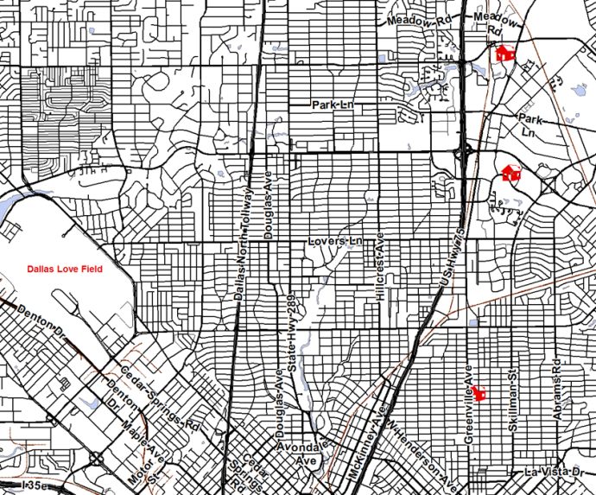
Texas EGRT Responses

Slide 18
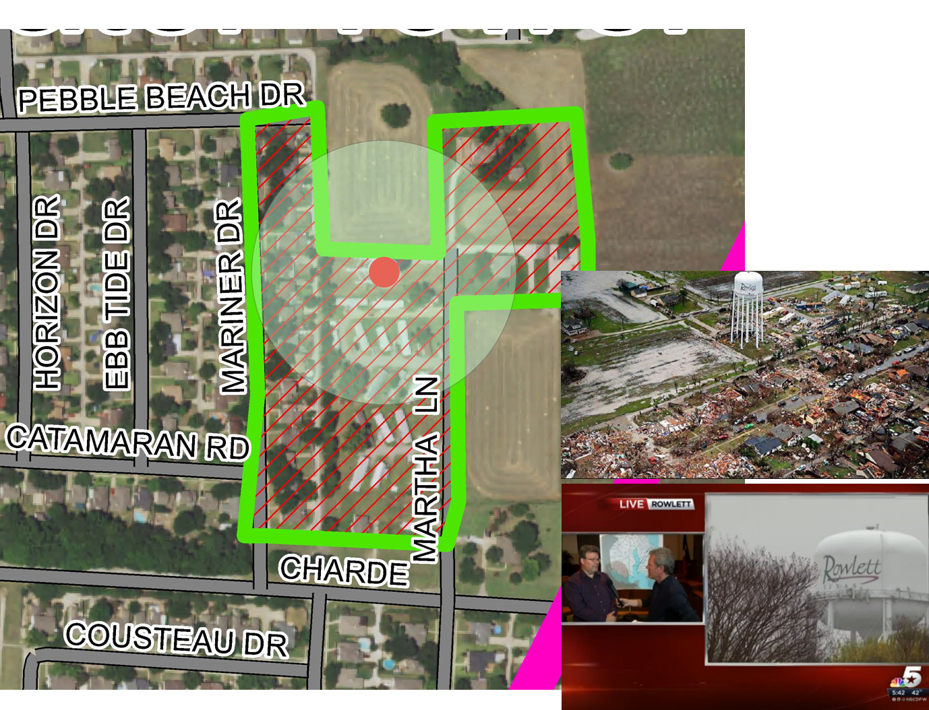
Texas EGRT Responses

Slide 19
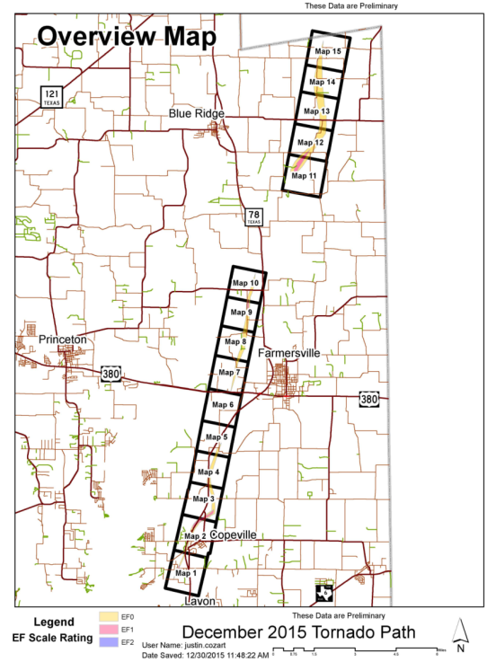
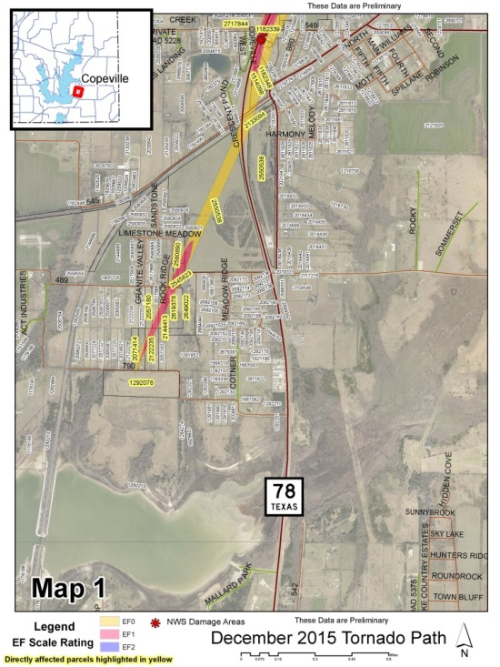
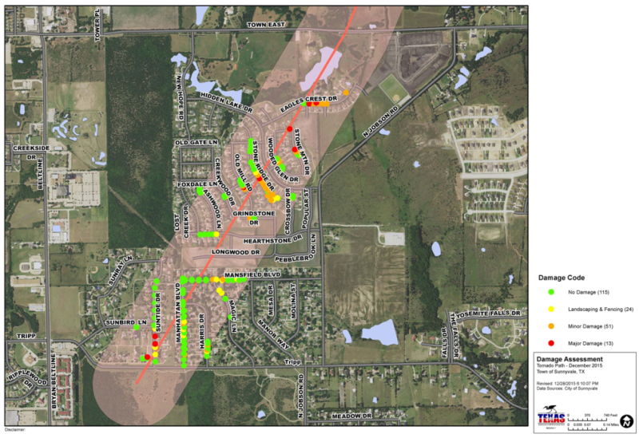

Slide 20
Future for Emergency Response Mapping
Drone Information can be imported into the mapping or put on a web map. (Geotagged images or Drone 2 Map)

Slide 21
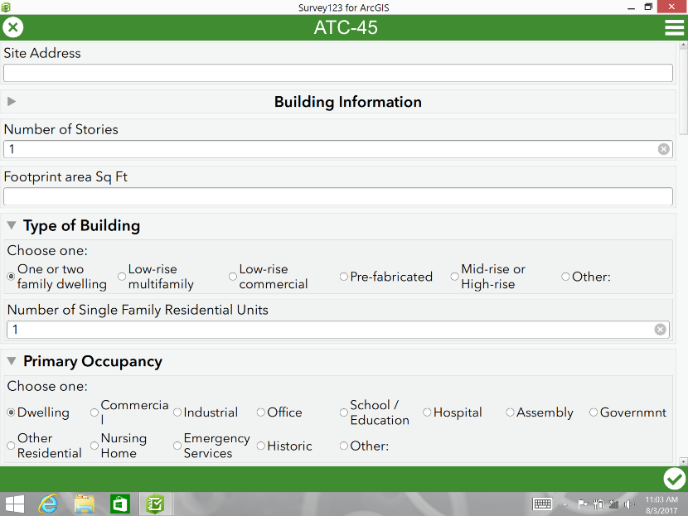
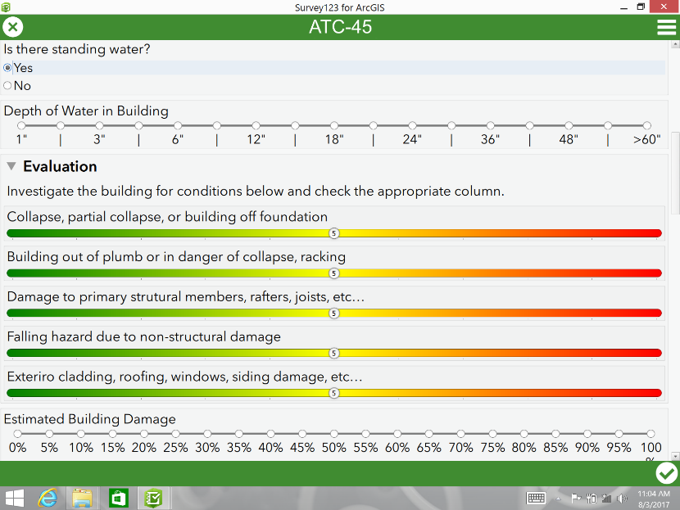
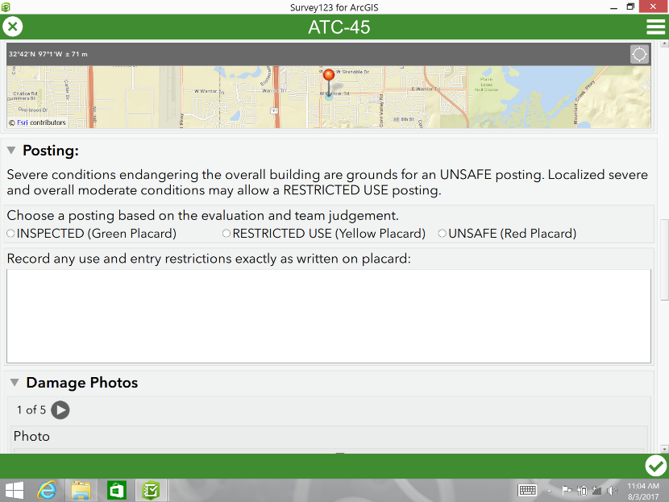
Future for Emergency Response Mapping
Phone / Tablet apps can be used to capture and relay field information into the EOC (example of ATC-45 using Survey 123)

Slide 22
Conclusions
Texas EGRT is experienced and prepared to provide mapping services in the EOC / Command Post in most of Texas
We coordinate with other agencies at the local, regional, or state level to supply on-site mapping services
Mapping is expanding from printed paper maps to include web services
Drones and or Mobile Device apps can be used for field collection
We are working to integrate mapping capabilities across different agencies to provide comprehensive mapping support throughout Texas

Slide 23
David W. Allen, GISP
817-685-1633
www.TexasEGRT.org
Director@TexasEGRT.org
http://esriurl.com/EMgtMaps

