Slide 1
DOMOPS Information and RFA Model
5 %
of domestic operations
DSCA response actions
Cloud Services
DHS / FEMA
ArcGIS Online
Amazon
Virtual USA
External
Information
Flow
NORTHCOM
10 %
of domestic operations
Federal Support through NRF
FEMA Region
DCE
NGB
FEMA GeoPortal
GeoPlatform.GOV
RFA
Civilian
Military
80 - 85 %
of domestic operations
State Emergency Operations Center
Supports response actions to incident
{
State & Local Response Actions
- Emergency Support Functions
- Supporting State Agencies
- Volunteer and Donations
- Contract Assistance
- National Guard
ate
Mutual-Aid
RFA
In some states National Guard
Monitor information
Mutual-Aid
State Police Dispatch
E911 Call Center
DOT Traffic
Public Health
National Weather Service
Critical Infrastructure
Nuclear Power Plants
Office of Energy
Banking Commission
News Media
Open Source Info
Social Media
Crowd Sourcing
NG Actions
Homeland Security and Emergency Operations
Monitor information
Town(s)
Mutual-Aid
DHS
to include
NCCIC, ISACs, FEMA
Major Incident
Public Health Info
National Weather Service
Critical Infrastructure
News Media
Open Source Info
CRISIS
State Information and Analysis Center
Monitor and analyze
Town
Mutual- Aid
Common Operational Data – Homeland Security Infrastructure Program; NG GeoPlatform
Local Incident
National Guard - Part of the Fabric of Our Nation

Slide 2
Knowledge Management
Based judgment & experience
what must I decide
when must I decide
what should the decision be
UNDER-
STANDING
Knowledge Management Focus
Apply
Decide
Create
Assess Risk
Organize
Judgment
Cognition
KNOWLEDGE
Do we operate above or below the RED line
Information
Management Focus
Store
Display
Protect
Disseminate
Process
Collect
Processing
INFORMATION
DATA

Slide 3
Geospatial Knowledge Management Path to Decision Making
Decision Making Process
Problem Solving and
Synchronization
Operations Plans
Development
Orders Creation
Directives
Response Action
UNDER-
STANDING
Knowledge Management Focus
Shared Understanding
Identified Threats / Opportunities
Integrated Perspectives
Actionable Knowledge
Tailored Decision Frameworks
Judgment
Cognition
“Sense Making”
KNOWLEDGE
Geospatial Analytical Tools
Shared Situational Awareness
Information
Management Focus
Store / Access
Display / Analyze
Consume / Share
Disseminate
Process
Collect
Processing
INFORMATION
Value Added Data
Rest Services
Map Layers
Situational Awareness
DATA

Slide 4
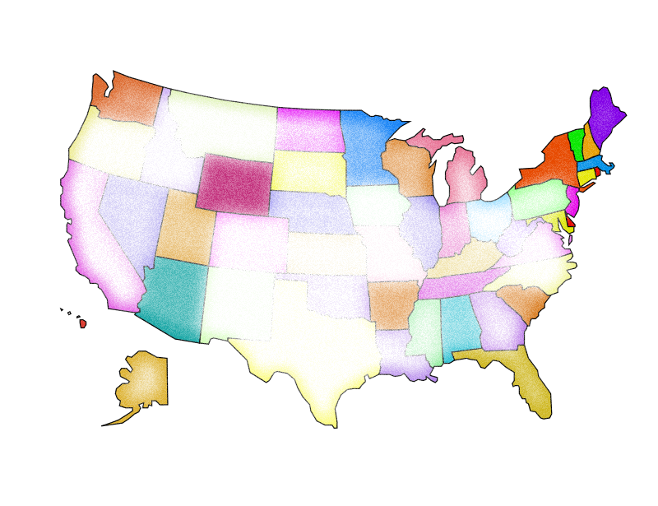
Cyber Events
FY 17 Existing Exercises
Cyber TN
Cyber Buckeye
(OH) 2017
Cyber Shield Legal/policy TTX
(NGB) Jan 2017:
Cyber Yankee
(Region 1) Jun 2017:
Cyber Guard
(USCC) June 2017:
Cyber Shield
(NG) May 2017
7 AT Days
5 AT Days
National
Regional
TTX
3 AT Days
State
Local
FY 18 Proposed Exercises
TTX x 4:
1 National Ex
1 per Regional Ex
3 Regional EX
Rotational basis
WG to determine Location
2 Joint National Exercises
Cyber Guard (USCC)
Joint Cyber EX (NGB)

